Slide 1
Principal Component Analysis: Additional Topics
Split Sample Validation
Detecting Outliers
Reliability of Summated Scales
Sample Problems

Slide 2
Split Sample Validation
To test the generalizability of findings from a principal component analysis, we could conduct a second research study to see if our findings are verified.
A less costly alternative is to split the sample randomly into two halves, do the principal component analysis on each half and compare the results.
If the communalities and the factor loadings are the same on the analysis on each half and the full data set, we have evidence that the findings are generalizable and valid because, in effect, the two analyses represent a study and a replication.

Slide 3
Misleading Results to Watch Out For
When we examine the communalities and factor loadings, we are matching up overall patterns, not exact results: the communalities should all be greater than 0.50 and the pattern of the factor loadings should be the same.
Sometimes the variables will switch their components (variables loading on the first component now load on the second and vice versa), but this does not invalidate our findings.
Sometimes, all of the signs of the factor loadings will reverse themselves (the plus's become minus's and the minus's become plus's), but this does not invalidate our findings because we interpret the size, not the sign of the loadings.

Slide 4
When validation fails
If the validation fails, we are warned that the solution found in the analysis of the full data set is not generalizable and should not be reported as valid findings.
We do have some options when validation fails:
  If the problem is limited to one or two variables, we can remove those variables and redo the analysis.
  Randomly selected samples are not always representative. We might try some different random number seeds and see if our negative finding was a fluke. If we choose this option, we should do a large number of validations to establish a clear pattern, at least 5 to 10. Getting one or two validations to negate the failed validation and support our findings is not sufficient.

Slide 5
Outliers
SPSS calculates factor scores as standard scores.
SPSS suggests that one way to identify outliers is to compute the factors scores and identify those have a value greater than ±3.0 as outliers.
If we find outliers in our analysis, we redo the analysis, omitting the cases that were outliers.
If there is no change in communality or factor structure in the solution, it implies that there outliers do not have an impact. If our factor solution changes, we will have to study the outlier cases to determine whether or not we should exclude them.
After testing outliers, restore full data set before any further calculations

Slide 6
Reliability of Summated Scales
One of the common uses of factor analysis is the formation of summated scales, where we add the scores on all the variables loading on a component to create the score for the component.
To verify that the variables for a component are measuring similar entities that are legitimate to add together, we compute Chronbach's alpha.
If Chronbach's alpha is 0.70 or greater (0.60 or greater for exploratory research), we have support on the interval consistency of the items justifying their use in a summated scale.

Slide 7
Problem 1
In the dataset GSS2000.sav, is the following statement true, false, or an incorrect application of a statistic? Assume that there is no problematic pattern of missing data. Use a level of significance of 0.05. Validate the results of your principal component analysis by splitting the sample in two, using 519447 as the random number seed.
Based on the results of a principal component analysis of the 8 variables "highest academic degree" [degree], "father's highest academic degree" [padeg], "mother's highest academic degree" [madeg], "spouse's highest academic degree" [spdeg], "general happiness" [happy], "happiness of marriage" [hapmar], "condition of health" [health], and "attitude toward life" [life], the information in these variables can be represented with 2 components and 3 individual variables. Cases that might be considered to be outliers do not have an impact on the factor solution. The internal consistency of the variables included in the components is sufficient to support the creation of a summated scale.
Component 1 includes the variables "highest academic degree" [degree], "father's highest academic degree" [padeg], and "mother's highest academic degree" [madeg]. Component 2 includes the variables "general happiness" [happy] and "happiness of marriage" [hapmar]. The variables "attitude toward life" [life], "condition of health" [health], and "spouse's highest academic degree" [spdeg] were not included on the components and are retained as individual variables.
1. True
2. True with caution
3. False
4. Inappropriate application of a statistic
The bold text indicates that parts to the problem that have been added this week.

Slide 8
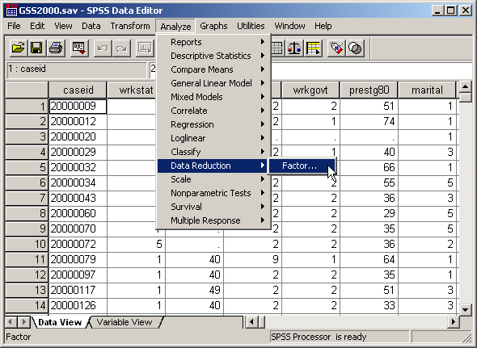
Computing a principal component analysis
To compute a principal component analysis in SPSS, select the Data Reduction | Factor… command from the Analyze menu.

Slide 9
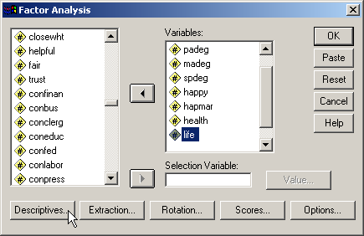
Add the variables to the analysis
First, move the variables listed in the problem to the Variables list box.
Second, click on the Descriptives… button to specify statistics to include in the output.

Slide 10
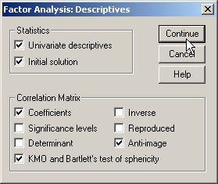
Compete the descriptives dialog box
First, mark the Univariate descriptives checkbox to get a tally of valid cases.
Sixth, click on the Continue button.
Second, keep the Initial solution checkbox to get the statistics needed to determine the number of factors to extract.
Fifth, mark the Anti-image checkbox to get more outputs used to assess the appropriateness of factor analysis for the variables.
Third, mark the Coefficients checkbox to get a correlation matrix, one of the outputs needed to assess the appropriateness of factor analysis for the variables.
Fourth, mark the KMO and Bartlett’s test of sphericity checkbox to get more outputs used to assess the appropriateness of factor analysis for the variables.

Slide 11
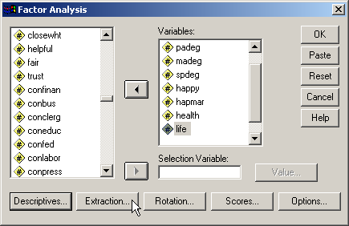
Select the extraction method
First, click on the Extraction… button to specify statistics to include in the output.
The extraction method refers to the mathematical method that SPSS uses to compute the factors or components.

Slide 12
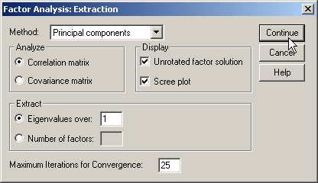
Compete the extraction dialog box
First, retain the default method Principal components.
Second, click on the Continue button.

Slide 13
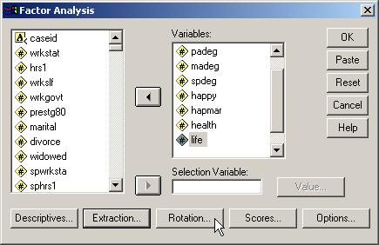
Select the rotation method
The rotation method refers to the mathematical method that SPSS rotate the axes in geometric space. This makes it easier to determine which variables are loaded on which components.
First, click on the Rotation… button to specify statistics to include in the output.

Slide 14
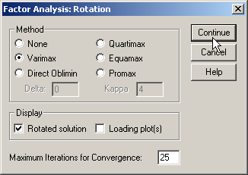
Compete the rotation dialog box
First, mark the Varimax method as the type of rotation to used in the analysis.
Second, click on the Continue button.

Slide 15
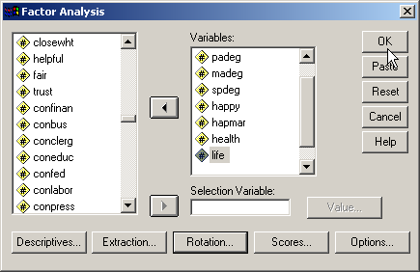
Complete the request for the analysis
First, click on the OK button to request the output.

Slide 16
Level of measurement requirement
"Highest academic degree" [degree], "father's highest academic degree" [padeg], "mother's highest academic degree" [madeg], "spouse's highest academic degree" [spdeg], "general happiness" [happy], "happiness of marriage" [hapmar], "condition of health" [health], and "attitude toward life" [life] are ordinal level variables. If we follow the convention of treating ordinal level variables as metric variables, the level of measurement requirement for principal component analysis is satisfied. Since some data analysts do not agree with this convention, a note of caution should be included in our interpretation.

Slide 17
Sample size requirement: minimum number of cases
The number of valid cases for this set of variables is 68.
While principal component analysis can be conducted on a sample that has fewer than 100 cases, but more than 50 cases, we should be cautious about its interpretation.

Slide 18
Sample size requirement: ratio of cases to variables
The ratio of cases to variables in a principal component analysis should be at least 5 to 1.
With 68 and 8 variables, the ratio of cases to variables is 8.5 to 1, which exceeds the requirement for the ratio of cases to variables.

Slide 19
Appropriateness of factor analysis:
Presence of substantial correlations
Principal components analysis requires that there be some correlations greater than 0.30 between the variables included in the analysis.
For this set of variables, there are 7 correlations in the matrix greater than 0.30, satisfying this requirement. The correlations greater than 0.30 are highlighted in yellow.

Slide 20
Appropriateness of factor analysis:
Sampling adequacy of individual variables
There are two anti-image matrices: the anti-image covariance matrix and the anti-image correlation matrix. We are interested in the anti-image correlation matrix.
Principal component analysis requires that the Kaiser-Meyer-Olkin Measure of Sampling Adequacy be greater than 0.50 for each individual variable as well as the set of variables.
On iteration 1, the MSA for all of the individual variables included in the analysis was greater than 0.5, supporting their retention in the analysis.

Slide 21
Appropriateness of factor analysis:
Sampling adequacy for set of variables
In addition, the overall MSA for the set of variables included in the analysis was 0.640, which exceeds the minimum requirement of 0.50 for overall MSA.

Slide 22
Appropriateness of factor analysis:
Bartlett test of sphericity
Principal component analysis requires that the probability associated with Bartlett's Test of Sphericity be less than the level of significance.
The probability associated with the Bartlett test is <0.001, which satisfies this requirement.

Slide 23
Number of factors to extract:
Latent root criterion
Using the output from iteration 1, there were 3 eigenvalues greater than 1.0.
The latent root criterion for number of factors to derive would indicate that there were 3 components to be extracted for these variables.

Slide 24
Number of factors to extract:
Percentage of variance criterion
In addition, the cumulative proportion of variance criteria can be met with 3 components to satisfy the criterion of explaining 60% or more of the total variance.
A 3 components solution would explain 68.137% of the total variance.
Since the SPSS default is to extract the number of components indicated by the latent root criterion, our initial factor solution was based on the extraction of 3 components.

Slide 25
Evaluating communalities
Communalities represent the proportion of the variance in the original variables that is accounted for by the factor solution.
The factor solution should explain at least half of each original variable's variance, so the communality value for each variable should be 0.50 or higher.

Slide 26
Communality requiring variable removal
On iteration 1, the communality for the variable "attitude toward life" [life] was 0.415. Since this is less than 0.50, the variable should be removed from the next iteration of the principal component analysis.
The variable was removed and the principal component analysis was computed again.

Slide 27
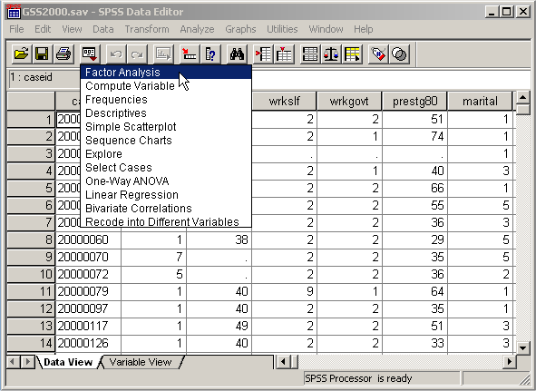
Repeating the factor analysis
In the drop down menu, select Factor Analysis to reopen the factor analysis dialog box.

Slide 28
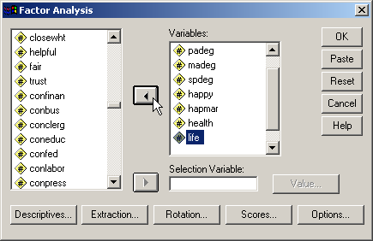
Removing the variable from the list of variables
First, highlight the life variable.
Second, click on the left arrow button to remove the variable from the Variables list box.

Slide 29
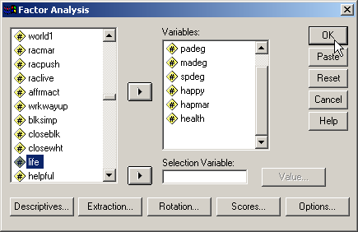
Replicating the factor analysis
The dialog recall command opens the dialog box with all of the settings that we had selected the last time we used factor analysis.
To replicate the analysis without the variable that we just removed, click on the OK button.

Slide 30
Communality requiring variable removal
On iteration 2, the communality for the variable "condition of health" [health] was 0.477. Since this is less than 0.50, the variable should be removed from the next iteration of the principal component analysis.
The variable was removed and the principal component analysis was computed again.

Slide 31
Repeating the factor analysis
In the drop down menu, select Factor Analysis to reopen the factor analysis dialog box.

Slide 32
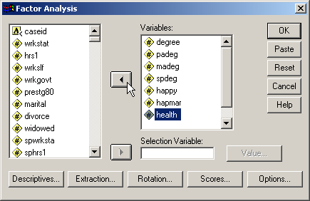
Removing the variable from the list of variables
First, highlight the health variable.
Second, click on the left arrow button to remove the variable from the Variables list box.

Slide 33
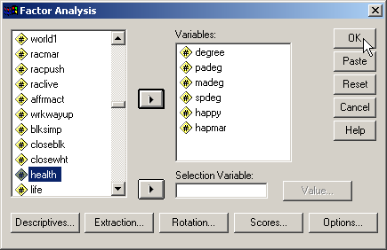
Replicating the factor analysis
The dialog recall command opens the dialog box with all of the settings that we had selected the last time we used factor analysis.
To replicate the analysis without the variable that we just removed, click on the OK button.

Slide 34
Communality requiring variable removal
On iteration 3, the communality for the variable "spouse's highest academic degree" [spdeg] was 0.491. Since this is less than 0.50, the variable should be removed from the next iteration of the principal component analysis.
The variable was removed and the principal component analysis was computed again.

Slide 35
Repeating the factor analysis
In the drop down menu, select Factor Analysis to reopen the factor analysis dialog box.

Slide 36
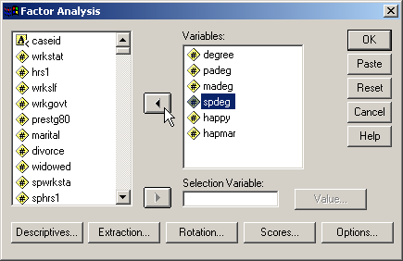
Removing the variable from the list of variables
First, highlight the spdeg variable.
Second, click on the left arrow button to remove the variable from the Variables list box.

Slide 37
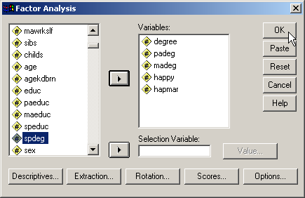
Replicating the factor analysis
The dialog recall command opens the dialog box with all of the settings that we had selected the last time we used factor analysis.
To replicate the analysis without the variable that we just removed, click on the OK button.

Slide 38
Communality satisfactory for all variables
Once any variables with communalities less than 0.50 have been removed from the analysis, the pattern of factor loadings should be examined to identify variables that have complex structure.
Complex structure occurs when one variable has high loadings or correlations (0.40 or greater) on more than one component. If a variable has complex structure, it should be removed from the analysis.
Variables are only checked for complex structure if there is more than one component in the solution. Variables that load on only one component are described as having simple structure.

Slide 39
Identifying complex structure
On iteration 4, none of the variables demonstrated complex structure. It is not necessary to remove any additional variables because of complex structure.

Slide 40
Variable loadings on components
On iteration 4, the 2 components in the analysis had more than one variable loading on each of them.
No variables need to be removed because they are the only variable loading on a component.

Slide 41
Final check of communalities
Once we have resolved any problems with complex structure, we check the communalities one last time to make certain that we are explaining a sufficient portion of the variance of all of the original variables.
The communalities for all of the variables included on the components were greater than 0.50 and all variables had simple structure.
The principal component analysis has been completed.

Slide 42
Interpreting the principal components
The information in 5 of the variables can be represented by 2 components.
Component 1 includes the variables
  "highest academic degree" [degree],
  "father's highest academic degree" [padeg], and
  "mother's highest academic degree" [madeg].
Component 2 includes the variables
  "general happiness" [happy] and
  "happiness of marriage" [hapmar].

Slide 43
Total variance explained
The 2 components explain 70.169% of the total variance in the variables which are included on the components.

Slide 44
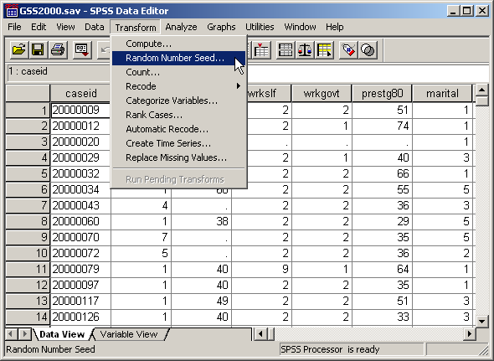
Split-sample validation
We validate our analysis by conducting an analysis on each half of the sample. We compare the results of these two split sample analyses with the analysis of the full data set.
To split the sample into two half, we generate a random variable that indicates which half of the sample each case should be placed in.
To compute a random selection of cases, we need to specify the starting value, or random number seed. Otherwise, the random sequence of numbers that you generate will not match mine, and we will get different results.
Before we do the do the random selection, you must make certain that your data set is sorted in the original sort order, or the cases in your two half samples will not match mine. To make certain your data set is in the same order as mine, sort your data set in ascending order by case id.

Slide 45
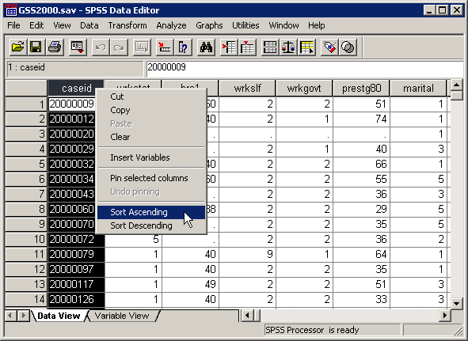
Sorting the data set in original order
To make certain the data set is sorted in the original order, highlight the case id column, right click on the column header, and select the Sort Ascending command from the popup menu.

Slide 46
Setting the random number seed
To set the random number seed, select the Random Number Seed… command from the Transform menu.

Slide 47
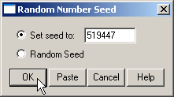
Set the random number seed
First, click on the Set seed to option button to activate the text box.
Second, type in the random seed stated in the problem.
Third, click on the OK button to complete the dialog box.
Note that SPSS does not provide you with any feedback about the change.

Slide 48
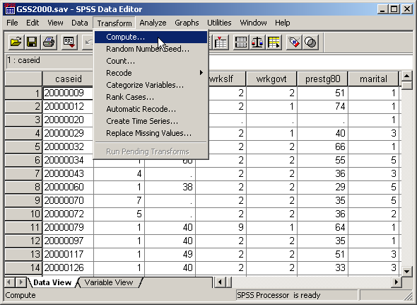
Select the compute command
To enter the formula for the variable that will split the sample in two parts, click on the Compute… command.

Slide 49
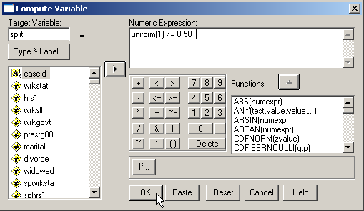
The formula for the split variable
First, type the name for the new variable, split, into the Target Variable text box.
Second, the formula for the value of split is shown in the text box.
The uniform(1) function generates a random decimal number between 0 and 1. The random number is compared to the value 0.50.
If the random number is less than or equal to 0.50, the value of the formula will be 1, the SPSS numeric equivalent to true. If the random number is larger than 0.50, the formula will return a 0, the SPSS numeric equivalent to false.
Third, click on the OK button to complete the dialog box.

Slide 50
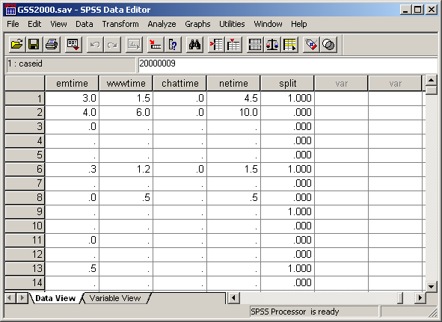
The split variable in the data editor
In the data editor, the split variable shows a random pattern of zero’s and one’s.
To select half of the sample for each validation analysis, we will first select the cases where split = 0, then select the cases where split = 1.

Slide 51
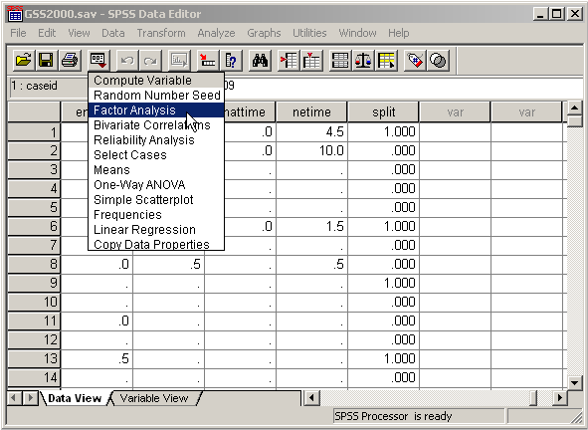
Repeating the analysis with the first validation sample
To repeat the principal component analysis for the first validation sample, select Factor Analysis from the Dialog Recall tool button.

Slide 52
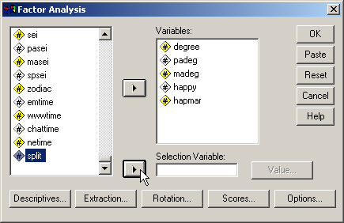
Using "split" as the selection variable
First, scroll down the list of variables and highlight the variable split.
Second, click on the right arrow button to move the split variable to the Selection Variable text box.

Slide 53
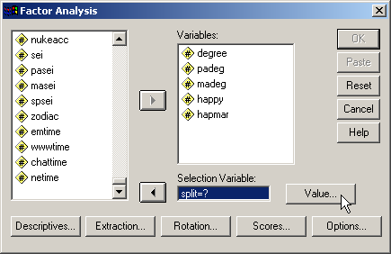
Setting the value of split to select cases
When the variable named split is moved to the Selection Variable text box, SPSS adds "=?" after the name to prompt up to enter a specific value for split.
Click on the Value… button to enter a value for split.

Slide 54
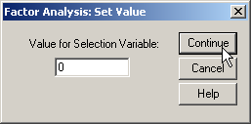
Completing the value selection
First, type the value for the first half of the sample, 0, into the Value for Selection Variable text box.
Second, click on the Continue button to complete the value entry.

Slide 55
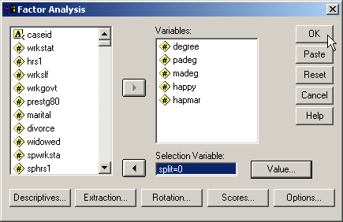
Requesting output for the first validation sample
Click on the OK button to request the output.
When the value entry dialog box is closed, SPSS adds the value we entered after the equal sign. This specification now tells SPSS to include in the analysis only those cases that have a value of 0 for the split variable.
Since the validation analysis requires us to compare the results of the analysis using the two split sample, we will request the output for the second sample before doing any comparison.

Slide 56
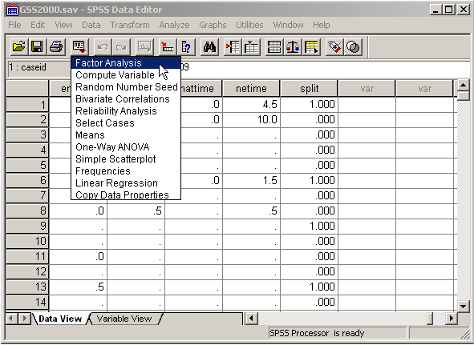
Repeating the analysis with the second validation sample
To repeat the principal component analysis for the second validation sample, select Factor Analysis from the Dialog Recall tool button.

Slide 57
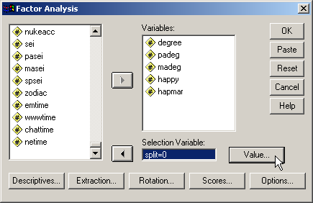
Setting the value of split to select cases
Since the split variable is already in the Selection Variable text box, we only need to change its value.
Click on the Value… button to enter a different value for split.

Slide 58

Completing the value selection
First, type the value for the second half of the sample, 1, into the Value for Selection Variable text box.
Second, click on the Continue button to complete the value entry.

Slide 59
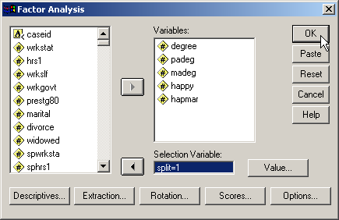
Requesting output for the second validation sample
Click on the OK button to request the output.
When the value entry dialog box is closed, SPSS adds the value we entered after the equal sign. This specification now tells SPSS to include in the analysis only those cases that have a value of 1 for the split variable.

Slide 60
Comparing communalities
All of the communalities for the first split sample satisfy the minimum requirement of being larger than 0.50.
All of the communalities for the second split sample satisfy the minimum requirement of being larger than 0.50.
Note how SPSS identifies for us which cases we selected for the analysis.

Slide 61
Comparing factor loadings
The pattern of factor loading for both split samples shows the variables RS HIGHEST DEGREE; FATHERS HIGHEST DEGREE; and MOTHERS HIGHEST DEGREE loading on the first component, and GENERAL HAPPINESS and HAPPINESS OF MARRIAGE loading on the second component.

Slide 62
Interpreting the validation results
All of the communalities in both validation samples met the criteria.
The pattern of loadings for both validation samples is the same, and the same as the pattern for the analysis using the full sample.
In effect, we have done the same analysis on two separate sub-samples of cases and obtained the same results.
This validation analysis supports a finding that the results of this principal component analysis are generalizable to the population represented by this data set.
When we are finished with this analysis, we should select all cases back into the data set and remove the variables we created.

Slide 63
Detecting outliers
To detect outliers, we compute the factor scores in SPSS.
Select the Factor Analysis command from the Dialog Recall tool button

Slide 64
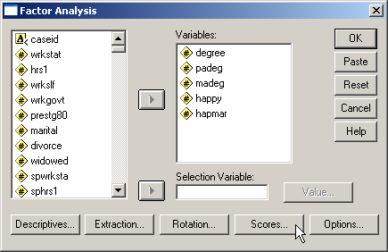
Access the Scores Dialog Box
Click on the Scores… button to access the factor scores dialog box.

Slide 65
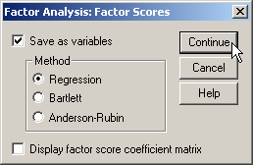
Specifications for factor scores
First, click on the Save as variables checkbox to create factor variables.
Second, accept the default method using a Regression equation to calculate the scores.
Third, click on the Continue button to complete the specifications.

Slide 66
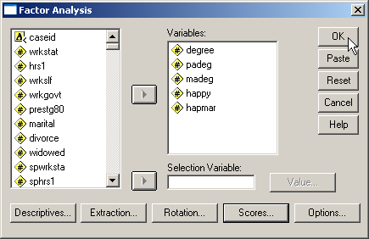
Compute the factor scores
Click on the Continue button to compute the factor scores.

Slide 67
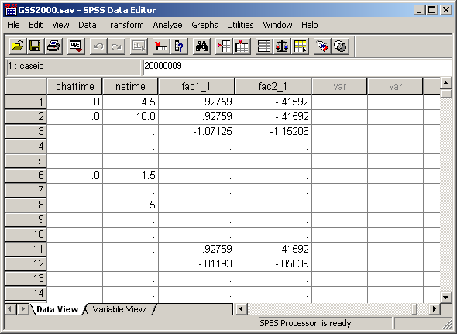
The factor scores in the data editor
SPSS creates the factor score variables in the data editor window. It names the first factor score “fac1_1,” and the second factor score “fac2_1.”
We need to check to see if we have any values for either factor score that are larger than ±3.0. One way to check for the presence of large values indicating outliers is to sort the factor variables and see if any fall outside the acceptable range.

Slide 68
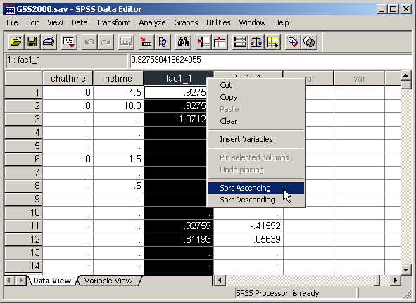
Sort the data to locate outliers for factor one
First, select the fac1_1 column by clicking on its header.
Second, right click on the column header and select the Sort Ascending command from the drop down menu.

Slide 69
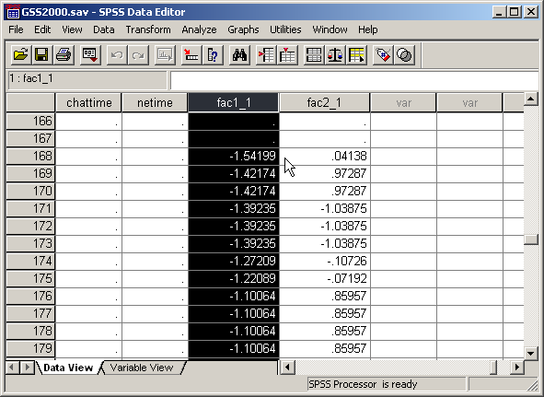
Negative outliers for factor one
Scroll down past the cases for whom factor scores could not be computed. We see that none of the scores for factor one are less than or equal to -3.0.

Slide 70
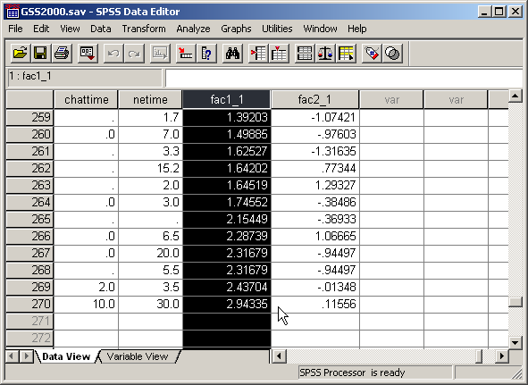
Positive outliers for factor one
Scrolling down to the bottom of the sorted data set, we see that none of the scores for factor one are greater than or equal to +3.0.
There are no outliers on factor one.

Slide 71
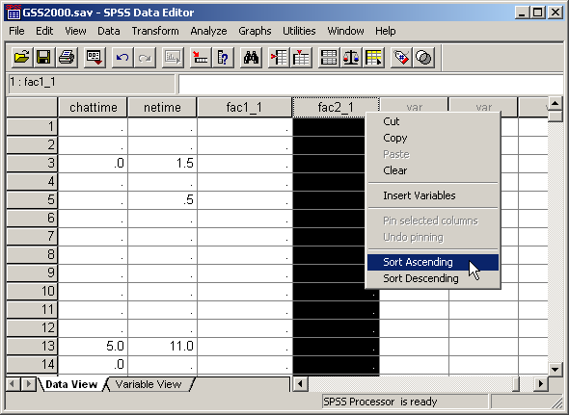
Sort the data to locate outliers on factor two
First, select the fac2_1 column by clicking on its header.
Second, right click on the column header and select the Sort Ascending command from the drop down menu.

Slide 72
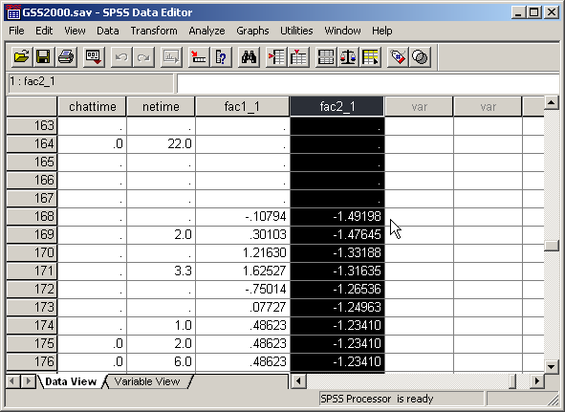
Negative outliers for factor two
Scrolling down past the cases for whom factor scores could not be computed, we see that none of the scores for factor two are less than or equal to -3.0.

Slide 73
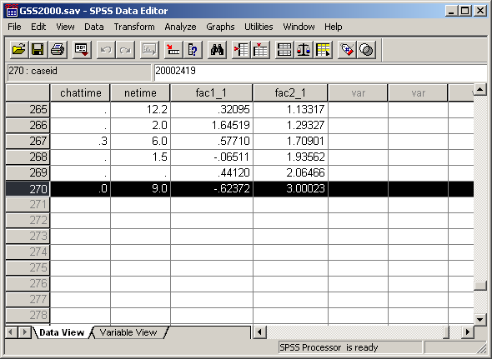
Positive outliers for factor two
Scrolling down to the bottom of the sorted data set, we see that one of the scores for factor two is greater than or equal to +3.0.
We will run the analysis excluding this outlier and see if it changes our interpretation of the analysis.

Slide 74
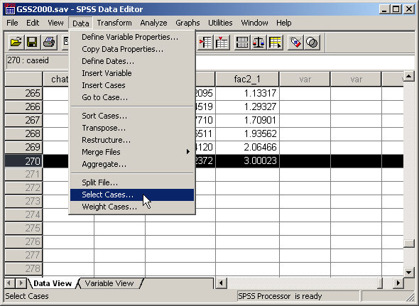
Removing the outliers
To see whether or not outliers are having an impact on the factor solution, we will compute the factor analysis without the outliers and compare the results.
To remove the outliers, we will include the cases that are not outliers.
Choose the Select Cases… command from the Data menu.

Slide 75
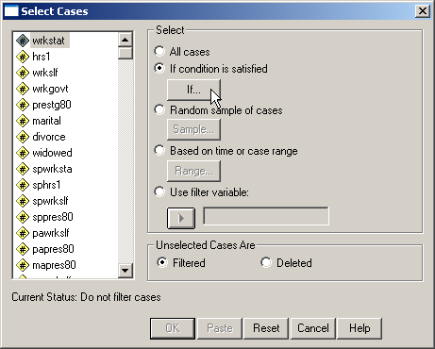
Setting the If condition
Click on the If… button to enter the formula for selecting cases in or out of the analysis.

Slide 76
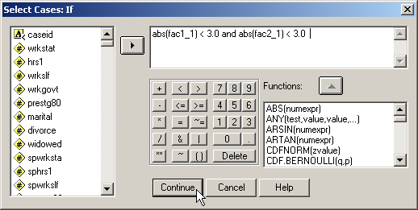
Formula to select cases that are not outliers
First, type the formula as shown. The formula says: include cases if the absolute value of the first and second factor scores are less than 3.0.
Second, click on the Continue button to complete the specification.

Slide 77
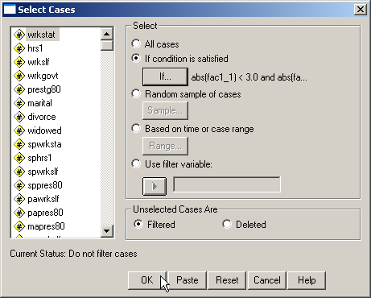
Complete the select cases command
Having entered the formula for including cases, click on the OK button to complete the selection.

Slide 78
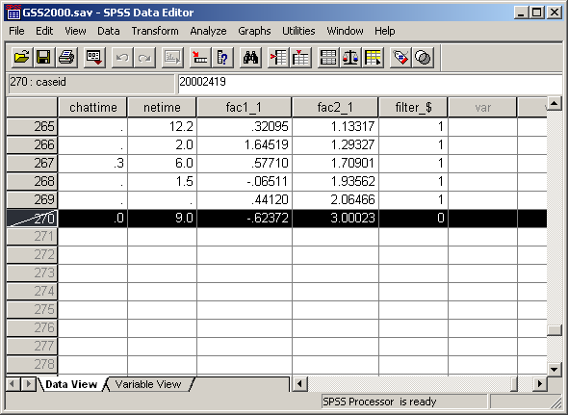
The outlier selected out of the analysis
When SPSS selects a case out of the data analysis, it draws a slash through the case number. The case that we identified as an outlier will be excluded.

Slide 79
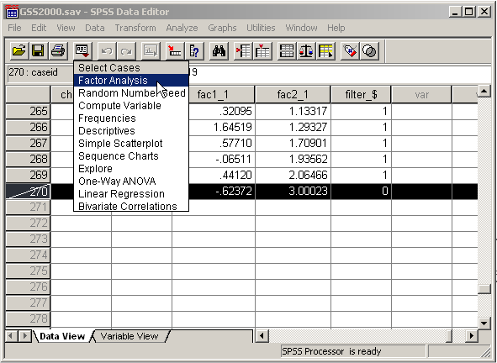
Repeating the factor analysis
To repeat the factor analysis without the outliers, select the Factor Analysis command from the Dialog Recall tool button

Slide 80
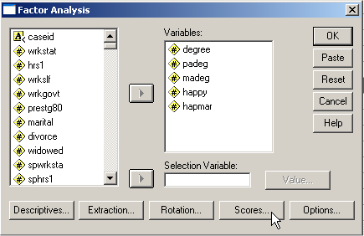
Stopping SPSS from computing factor scores again
On the last factor analysis, we included the specification to compute factor scores. Since we do not need to do this again, we will remove the specification.
Click on the Scores… button to access the factor scores dialog.

Slide 81
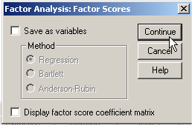
Clearing the command to save factor scores
First, clear the Save as variables checkbox. This will deactivate the Method options.
Second, click on the Continue button to complete the specification

Slide 82
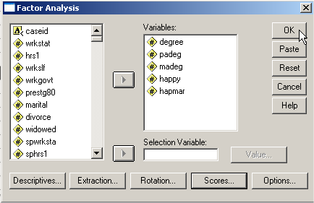
Computing the factor analysis
To produce the output for the factor analysis excluding outliers, click on the OK button.

Slide 83
Comparing communalities
All of the communalities for the factor analysis including all cases satisfy the minimum requirement of being larger than 0.50.
All of the communalities for the factor analysis excluding outliers satisfy the minimum requirement of being larger than 0.50.

Slide 84
Comparing factor loadings
The factor loadings for the factor analysis including all cases is shown on the left.
The factor loadings for the factor analysis excluding outliers is shown on the right.
The pattern of factor loading for both split analyses shows the variables RS HIGHEST DEGREE; FATHERS HIGHEST DEGREE; and MOTHERS HIGHEST DEGREE loading on the first component, and GENERAL HAPPINESS and HAPPINESS OF MARRIAGE loading on the second component.

Slide 85
Interpreting the outlier analysis
All of the communalities satisfy the criteria of being greater than 0.50.
The pattern of loadings for both analyses is the same.
Whether we include or exclude outliers, our interpretation is the same. The outliers do not have an effect which supports their exclusion from the analysis.
The part of the problem statement that outliers do not have an impact is true.
When we are finished with this analysis, we should select all cases back into the data set and remove the variables we created.

Slide 86
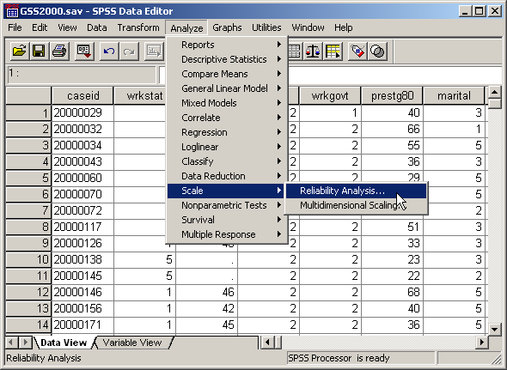
Computing Chronbach's Alpha
To compute Chronbach's alpha for each component in our analysis, we select Scale | Reliability Analysis… from the Analyze menu.

Slide 87
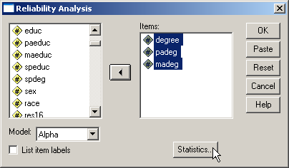
Selecting the variables for the first component
First, move the three variables that loaded on the first component to the Items list box.
Second, click on the Statistics… button to select the statistics we will need.

Slide 88

Selecting the statistics for the output
Second, click on the Continue button.
First, mark the checkboxes for Item, Scale, and Scale if item deleted.

Slide 89

Completing the specifications
Second, click on the OK button to produce the output.
First, If Alpha is not selected as the Model in the drop down menu, select it now.

Slide 90

Chronbach's Alpha
Chronbach's Alpha is located at the bottom of the output. An alpha of 0.60 or higher is the minimum acceptable level. Preferably, alpha will be 0.70 or higher, as it is in this case.

Slide 91
Chronbach's Alpha
If alpha is too small, this column may suggest which variable should be removed to improve the internal consistency of the scale variables. It tells us what alpha we would get if the variable listed were removed from the scale.

Slide 92
Computing Chronbach's Alpha
To compute Chronbach's alpha for each component in our analysis, we select Scale | Reliability Analysis… from the Analyze menu.

Slide 93

Selecting the variables for the second component
First, move the three variables that loaded on the second component to the Items list box.
Second, click on the Statistics… button to select the statistics we will need.

Slide 94
Selecting the statistics for the output
Second, click on the Continue button.
First, mark the checkboxes for Item, Scale, and Scale if item deleted.

Slide 95

Completing the specifications
Second, click on the OK button to produce the output.
First, If Alpha is not selected as the Model in the drop down menu, select it now.

Slide 96

Chronbach's Alpha
Chronbach's Alpha is located at the bottom of the output. An alpha of 0.60 or higher is the minimum acceptable level. Preferably, alpha will be 0.70 or higher, as it is in this case.
Second, click

Slide 97
Answering the problem question
The answer to the original question is true with caution.
Component 1 includes the variables "highest academic degree" [degree], "father's highest academic degree" [padeg], and "mother's highest academic degree" [madeg]. We can substitute one component variable for this combination of variables in further analyses.
Component 2 includes the variables "general happiness" [happy] and "happiness of marriage" [hapmar]. We can substitute one component variable for this combination of variables in further analyses.
The components explain at least 50% of the variance in each of the variables included in the final analysis.
The components explain 70.169% of the total variance in the variables which are included on the components.
A caution is added to our findings because of the inclusion of ordinal level variables in the analysis.

Slide 98
Validation with small samples
In the validation example completed above, 105 cases were used in the final principal component analysis model. When we have more than 100 cases available for the validation analysis, an even split should generally results in 50+ cases per validation sample.
However, if the number of cases available for the validation is less than 100, then splitting the sample in two may result in a validation samples that are less than the minimum of 50 cases to conduct a factor analysis.
When this happens, we draw two random samples of cases that are both larger than the minimum of 50. Since some of the same cases will be in both validation samples, the support for generalizability is not as strong, but it does offer some evidence, especially if we repeat the process a number of times.

Slide 99
Validation with small samples
We randomly create two split variables which we will call split1 and split 2, using a separate random number see for each.
In the formula for creating the split variables, we set the proportion of cases sufficient to randomly select fifty cases.
To calculate the proportion that we need, we divide 50 by the number of valid cases in the analysis and round up to the next highest 10% increment.
For example, if we have 80 valid cases, the proportion we need for validation is 50 / 80 = 0.625, which we would round up to 0.70 or 70%. The formulas for the split variables would be:
    split1 = uniform(1) <= 0.70
    split2 = uniform(1) <= 0.70

Slide 100
Validation with very small samples
When the number of valid cases in a factor analysis gets close to the lower limit of 50, the results of the validation may appear to support the analysis, but this can be misleading because the validation samples are not really different from the analysis of the full data set.
For example, if the number of valid cases were 60, a 90% sub-sample of 54 would result in 54 cases being the same in both the full analysis and the validation analysis. The validation may appear to support the full analysis simply because the validation had limited opportunity to be different.

Slide 101
Problem 2
In the dataset GSS2000.sav, is the following statement true, false, or an incorrect application of a statistic? Assume that there is no problematic pattern of missing data. Use a level of significance of 0.05. Validate the results of your principal component analysis by repeating the principal component analysis on two 70% random samples of the data set, using 743911 and 747454 as the random number seeds.
Based on the results of a principal component analysis of the 7 variables "claims about environmental threats are exaggerated" [grnexagg], "danger to the environment from modifying genes in crops" [genegen], "America doing enough to protect environment" [amprogrn], "should be international agreements for environment problems" [grnintl], "poorer countries should be expected to do less for the environment" [ldcgrn], "economic progress in America will slow down without more concern for environment" [econgrn], and "likelihood of nuclear power station damaging environment in next 5 years" [nukeacc], the information in these variables can be represented with 2 components and 3 individual variables. Cases that might be considered to be outliers do not have an impact on the factor solution. The internal consistency of the variables included in the components is sufficient to support the creation of a summated scale.
Component 1 includes the variables "danger to the environment from modifying genes in crops" [genegen] and "likelihood of nuclear power station damaging environment in next 5 years" [nukeacc]. Component 2 includes the variables "claims about environmental threats are exaggerated" [grnexagg] and "poorer countries should be expected to do less for the environment" [ldcgrn]. The variables "economic progress in America will slow down without more concern for environment" [econgrn], "should be international agreements for environment problems" [grnintl], and "America doing enough to protect environment" [amprogrn] were not included on the components and are retained as individual variables.
1. True
2. True with caution
3. False
4. Inappropriate application of a statistic

Slide 102
The principal component solution
A principal component analysis found a two-factor solution, with four of the original seven variables loading on the components. The communalities and factor loadings are shown below.

Slide 103
The size of the validation sample
There were 75 valid cases in the final analysis. The sample is to small to split in half and have enough cases to meet the minimum of 50 cases for factor analysis.
We will draw two random samples that each comprise 70% of the full sample. We arrive at 70% by dividing the minimum sample size by the number of valid cases (50 ÷ 75 = 0.667) and rounding up to the next 10% increment, 70%.

Slide 104
Split-sample validation
The first random number seed stated in the problem is 743911, so we enter this is the SPSS random number seed dialog.
To set the random number seed, select the Random Number Seed… command from the Transform menu.

Slide 105

Set the random number seed for first sample
First, click on the Set seed to option button to activate the text box.
Second, type in the random seed stated in the problem.
Third, click on the OK button to complete the dialog box.
Note that SPSS does not provide you with any feedback about the change.

Slide 106
Select the compute command
To enter the formula for the variable that will split the sample in two parts, click on the Compute… command.

Slide 107

The formula for the split1 variable
First, type the name for the new variable, split1, into the Target Variable text box.
Second, the formula for the value of split1 is shown in the text box.
The uniform(1) function generates a random decimal number between 0 and 1. The random number is compared to the value 0.70.
If the random number is less than or equal to 0.70, the value of the formula will be 1, the SPSS numeric equivalent to true. If the random number is larger than 0.70, the formula will return a 0, the SPSS numeric equivalent to false.
Third, click on the OK button to complete the dialog box.

Slide 108

Set the random number seed for second sample
First, click on the Set seed to option button to activate the text box.
Second, type in the random seed stated in the problem.
Third, click on the OK button to complete the dialog box.
Note that SPSS does not provide you with any feedback about the change.

Slide 109
Select the compute command
To enter the formula for the variable that will split the sample in two parts, click on the Compute… command.

Slide 110

The formula for the split2 variable
First, type the name for the new variable, split2, into the Target Variable text box.
Second, the formula for the value of split2 is shown in the text box.
The uniform(1) function generates a random decimal number between 0 and 1. The random number is compared to the value 0.70.
If the random number is less than or equal to 0.70, the value of the formula will be 1, the SPSS numeric equivalent to true. If the random number is larger than 0.70, the formula will return a 0, the SPSS numeric equivalent to false.
Third, click on the OK button to complete the dialog box.

Slide 111
Repeating the analysis with the first validation sample
To repeat the principal component analysis for the first validation sample, select Factor Analysis from the Dialog Recall tool button.

Slide 112

Using split1 as the selection variable
First, scroll down the list of variables and highlight the variable split1.
Second, click on the right arrow button to move the split1 variable to the Selection Variable text box.

Slide 113

Setting the value of split1 to select cases
When the variable named split1 is moved to the Selection Variable text box, SPSS adds "=?" after the name to prompt up to enter a specific value for split1.
Click on the Value… button to enter a value for split1.

Slide 114

Completing the value selection
First, type the value for the first sample, 1, into the Value for Selection Variable text box.
Second, click on the Continue button to complete the value entry.

Slide 115

Requesting output for the first validation sample
Click on the OK button to request the output.
When the value entry dialog box is closed, SPSS adds the value we entered after the equal sign. This specification now tells SPSS to include in the analysis only those cases that have a value of 1 for the split1 variable.
Since the validation analysis requires us to compare the results of the analysis using the first validation sample, we will request the output for the second validation sample before doing any comparison.

Slide 116
Repeating the analysis with the second validation sample
To repeat the principal component analysis for the second validation sample, select Factor Analysis from the Dialog Recall tool button.

Slide 117

Removing split1 as the selection variable
First, highlight the Selection Variable text box.
Second, click on the left arrow button to move the split1 back to the list of variables.

Slide 118

Using split2 as the selection variable
First, scroll down the list of variables and highlight the variable split2.
Second, click on the right arrow button to move the split2 variable to the Selection Variable text box.

Slide 119

Setting the value of split2 to select cases
When the variable named split2 is moved to the Selection Variable text box, SPSS adds "=?" after the name to prompt up to enter a specific value for split2.
Click on the Value… button to enter a value for split2.

Slide 120
Completing the value selection
First, type the value for the second sample, 1, into the Value for Selection Variable text box.
Second, click on the Continue button to complete the value entry.

Slide 121

Requesting output for the second validation sample
Click on the OK button to request the output.
When the value entry dialog box is closed, SPSS adds the value we entered after the equal sign. This specification now tells SPSS to include in the analysis only those cases that have a value of 1 for the split2 variable.

Slide 122
Comparing the communalities for the validation samples
All of the communalities for the first validation sample satisfy the minimum requirement of being larger than 0.50.
All of the communalities for the second validation sample satisfy the minimum requirement of being larger than 0.50.

Slide 123
Comparing the factor loadings for the validation samples
The factor loadings for the first validation analysis including all cases is shown on the left.
The factor loadings for the second validation analysis excluding outliers is shown on the right.
The pattern of factor loading for both validation analyses shows the same pattern of variables, though the first and second component have switched places.
The communalities and factor loadings of the validation analysis supports the generalizability of the factor model.

Slide 124
Steps in validation analysis - 1
The following is a guide to the decision process for answering problems about validation analysis:
Is the number of valid cases greater than or equal to 100?
No
Yes
Set the first random seed and compute the split1 variable
Re-run factor with split1 = 1
Set the second random seed and compute the split2 variable
Re-run factor with split2 = 1
Set the random seed and compute the split variable
Re-run factor with split = 0
Re-run factor with split = 1
Yes
Are all of the communalities in the validations greater than 0.50?
No
False
Yes

Slide 125
Steps in validation analysis - 2
Yes
Does pattern of factor loadings match pattern for full data set?
No
False
Yes
True

Slide 126
Steps in outlier analysis - 1
The following is a guide to the decision process for answering problems about outlier analysis:
Are any of the factor scores outliers (larger than ±3.0)?
No
True
Yes
Re-run factor analysis, excluding outliers
Yes
Are all of the communalities excluding outliers greater than 0.50?
No
False
Yes
Yes

Slide 127
Steps in outlier analysis - 2
Yes
Pattern of factor loadings excluding outliers match pattern for full data set?
No
False
Yes
True

Slide 128
Steps in reliability analysis
The following is a guide to the decision process for answering problems about reliability analysis:
Are Chronbach’s Alpha greater than 0.60 for all factors?
No
False
Yes
Are Chronbach’s Alpha greater than 0.70 for all factors?
No
True with caution
Yes
True

