Slide 1
Multinomial Logistic Regression:
Complete Problems
Outliers and Influential Cases
Split-sample Validation
Sample Problems

Slide 2
Outliers and Influential Cases
Multinomial logistic regression in SPSS does not compute any diagnostic statistics.
In the absence of diagnostic statistics, SPSS recommends using the Logistic Regression procedure to calculate and examine diagnostic measures.
A multinomial logistic regression for three groups compares group 1 to group 3 and group 2 to group 3. To test for outliers and influential cases, we will run two binary logistic regressions, using case selection to compare group 1 to group 3 and group 2 to group 3.
From both of these analyses we will identify a list of cases with standardized residuals greater than 3 and Cook's distance greater than 1.0, and test the multinomial solution without these cases. If the accuracy rate of this model is less than 2% more accurate, we will interpret the model that includes all cases.

Slide 3
80-20 Cross-validation Strategy
In this validation strategy, the cases are randomly divided into two subsets: a training sample containing 80% of the cases and a holdout sample containing the remaining 20% of the cases.
The training sample is used to derive the multinomial logistic regression model. The holdout sample is classified using the coefficients for the training model. The classification accuracy for the holdout sample is used to estimate how well the model based on the training sample will perform for the population represented by the data set.
If the classification accuracy rate of the holdout sample that is no less than 10% lower than the accuracy rate for the training sample (greater than 0.90 * training accuracy rate), it is deemed sufficient evidence of the utility of the logistic regression model.
In addition to satisfying the classification accuracy, we will require that the significance of the overall relationship and the relationships with individual predictors for the training sample match the significance results for the model using the full data set.

Slide 4
80-20 Cross-validation Strategy
SPSS does not classify cases that are not included in the training sample, so we will have to manually compute the classifications for the holdout sample if we want to use this strategy.
We will run the analysis for the training sample, use the coefficients from the training sample analysis to compute classification scores (log of the odds) for each group, compute the probabilities that correspond to each group defined by the dependent variable, and classify the case in the group with the highest probability.

Slide 5
Problem 1
10. In the dataset GSS2000, is the following statement true, false, or an incorrect application of a statistic? Assume that there is no problem with missing data. Use a level of significance of 0.05 for evaluating the statistical relationship. Test the generalizability of the logistic regression model with a cross-validation analysis using a 80% random sample of the data set as a training sample. Use 892776 as the random number seed.
The variables "number of hours worked in the past week" [hrs1], "self-employment" [wrkslf], "highest year of school completed" [educ] and "income" [rincom98] were useful predictors for distinguishing between groups based on responses to "opinion about spending on welfare" [natfare]. These predictors differentiate survey respondents who thought we spend too little money on welfare from survey respondents who thought we spend too much money on welfare and survey respondents who thought we spend about the right amount of money on welfare from survey respondents who thought we spend too much money on welfare.
Among this set of predictors, self-employment was helpful in distinguishing among the groups defined by responses to opinion about spending on welfare. Survey respondents who were self-employed were 84.3% less likely to be in the group of survey respondents who thought we spend too little money on welfare, rather than the group of survey respondents who thought we spend too much money on welfare.
1. True
2. True with caution
3. False
4. Inappropriate application of a statistic

Slide 6
Dissecting problem 1 - 1
10. In the dataset GSS2000, is the following statement true, false, or an incorrect application of a statistic? Assume that there is no problem with missing data. Use a level of significance of 0.05 for evaluating the statistical relationship. Test the generalizability of the logistic regression model with a cross-validation analysis using a 80% random sample of the data set as a training sample. Use 892776 as the random number seed.
The variables "number of hours worked in the past week" [hrs1], "self-employment" [wrkslf], "highest year of school completed" [educ] and "income" [rincom98] were useful predictors for distinguishing between groups based on responses to "opinion about spending on welfare" [natfare]. These predictors differentiate survey respondents who thought we spend too little money on welfare from survey respondents who thought we spend too much money on welfare and survey respondents who thought we spend about the right amount of money on welfare from survey respondents who thought we spend too much money on welfare.
Among this set of predictors, self-employment was helpful in distinguishing among the groups defined by responses to opinion about spending on welfare. Survey respondents who were self-employed were 84.3% less likely to be in the group of survey respondents who thought we spend too little money on welfare, rather than the group of survey respondents who thought we spend too much money on welfare.
1. True
2. True with caution
3. False
4. Inappropriate application of a statistic
For these problems, we will assume that there is no problem with missing data.
In this problem, we are told to use 0.05 as alpha for the logistic regression.
We are also told to do an 80-20 cross-validation, using 892776 as the random number seed.

Slide 7
Dissecting problem 1 - 2
The variables listed first in the problem statement are the independent variables (IVs): "number of hours worked in the past week" [hrs1], "self-employment" [wrkslf], "highest year of school completed" [educ] and "income" [rincom98].
10. In the dataset GSS2000, is the following statement true, false, or an incorrect application of a statistic? Assume that there is no problem with missing data. Use a level of significance of 0.05 for evaluating the statistical relationship. Test the generalizability of the logistic regression model with a cross-validation analysis using a 80% random sample of the data set as a training sample. Use 892776 as the random number seed.
The variables "number of hours worked in the past week" [hrs1], "self-employment" [wrkslf], "highest year of school completed" [educ] and "income" [rincom98] were useful predictors for distinguishing between groups based on responses to "opinion about spending on welfare" [natfare]. These predictors differentiate survey respondents who thought we spend too little money on welfare from survey respondents who thought we spend too much money on welfare and survey respondents who thought we spend about the right amount of money on welfare from survey respondents who thought we spend too much money on welfare.
Among this set of predictors, self-employment was helpful in distinguishing among the groups defined by responses to opinion about spending on welfare. Survey respondents who were self-employed were 84.3% less likely to be in the group of survey respondents who thought we spend too little money on welfare, rather than the group of survey respondents who thought we spend too much money on welfare.
1. True
2. True with caution
3. False
4. Inappropriate application of a statistic
The variable used to define groups is the dependent variable (DV): "opinion about spending on welfare" [natfare].
SPSS only supports direct or simultaneous entry of independent variables in multinomial logistic regression, so we have no choice of method for entering variables.

Slide 8
Dissecting problem 1 - 3
SPSS multinomial logistic regression models the relationship by comparing each of the groups defined by the dependent variable to the group with the highest code value.
The responses to opinion about spending on welfare were:
1= Too little, 2 = About right, and 3 = Too much.
Assume that there is no problem with missing data. Use a level of significance of 0.05 for evaluating the statistical relationship. Test the generalizability of the logistic regression model with a cross-validation analysis using a 80% random sample of the data set as a training sample. Use 892776 as the random number seed.
The variables "number of hours worked in the past week" [hrs1], "self-employment" [wrkslf], "highest year of school completed" [educ] and "income" [rincom98] were useful predictors for distinguishing between groups based on responses to "opinion about spending on welfare" [natfare]. These predictors differentiate survey respondents who thought we spend too little money on welfare from survey respondents who thought we spend too much money on welfare and survey respondents who thought we spend about the right amount of money on welfare from survey respondents who thought we spend too much money on welfare.
Among this set of predictors, self-employment was helpful in distinguishing among the groups defined by responses to opinion about spending on welfare. Survey respondents who were self-employed were 84.3% less likely to be in the group of survey respondents who thought we spend too little money on welfare, rather than the group of survey respondents who thought we spend too much money on welfare.
1. True
2. True with caution
3. False
4. Inappropriate application of a statistic
The analysis will result in two comparisons:
survey respondents who thought we spend too little money versus survey respondents who thought we spend too much money on welfare
survey respondents who thought we spend about the right amount of money versus survey respondents who thought we spend too much money on welfare.

Slide 9
Dissecting problem 1 - 4
Each problem includes a statement about the relationship between one independent variable and the dependent variable. The answer to the problem is based on the stated relationship, ignoring the relationships between the other independent variables and the dependent variable.
This problem identifies a difference for between the group who thought we spend too little versus the group that thought we spend too much .
10. In the dataset GSS2000, is the following statement true, false, or an incorrect application of a statistic? Assume that there is no problem with missing data. Use a level of significance of 0.05 for evaluating the statistical relationship. Test the generalizability of the logistic regression model with a cross-validation analysis using a 80% random sample of the data set as a training sample. Use 892776 as the random number seed.
The variables "number of hours worked in the past week" [hrs1], "self-employment" [wrkslf], "highest year of school completed" [educ] and "income" [rincom98] were useful predictors for distinguishing between groups based on responses to "opinion about spending on welfare" [natfare]. These predictors differentiate survey respondents who thought we spend too little money on welfare from survey respondents who thought we spend too much money on welfare and survey respondents who thought we spend about the right amount of money on welfare from survey respondents who thought we spend too much money on welfare.
Among this set of predictors, self-employment was helpful in distinguishing among the groups defined by responses to opinion about spending on welfare. Survey respondents who were self-employed were 84.3% less likely to be in the group of survey respondents who thought we spend too little money on welfare, rather than the group of survey respondents who thought we spend too much money on welfare.
1. True
2. True with caution
3. False
4. Inappropriate application of a statistic

Slide 10
Dissecting problem 1 - 5
10. In the dataset GSS2000, is the following statement true, false, or an incorrect application of a statistic? Assume that there is no problem with missing data. Use a level of significance of 0.05 for evaluating the statistical relationship. Test the generalizability of the logistic regression model with a cross-validation analysis using a 80% random sample of the data set as a training sample. Use 892776 as the random number seed.
The variables "number of hours worked in the past week" [hrs1], "self-employment" [wrkslf], "highest year of school completed" [educ] and "income" [rincom98] were useful predictors for distinguishing between groups based on responses to "opinion about spending on welfare" [natfare]. These predictors differentiate survey respondents who thought we spend too little money on welfare from survey respondents who thought we spend too much money on welfare and survey respondents who thought we spend about the right amount of money on welfare from survey respondents who thought we spend too much money on welfare.
Among this set of predictors, self-employment was helpful in distinguishing among the groups defined by responses to opinion about spending on welfare. Survey respondents who were self-employed were 84.3% less likely to be in the group of survey respondents who thought we spend too little money on welfare, rather than the group of survey respondents who thought we spend too much money on welfare.
1. True
2. True with caution
3. False
4. Inappropriate application of a statistic
In order for the multinomial logistic regression question to be true, the overall relationship must be statistically significant, there must be no evidence of numerical problems, the classification accuracy rate must be substantially better than could be obtained by chance alone, and the stated individual relationship must be statistically significant and interpreted correctly.

Slide 11
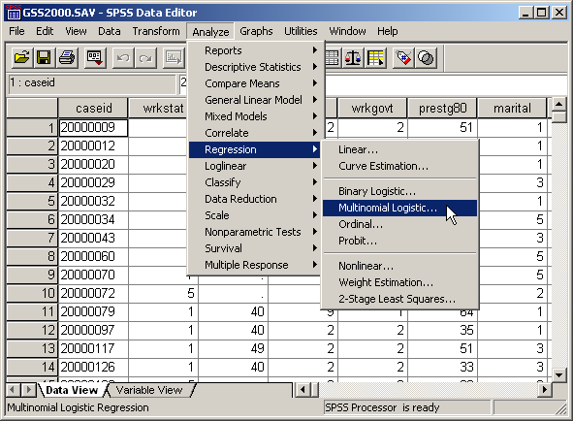
Request multinomial logistic regression for baseline model
Select the Regression | Multinomial Logistic… command from the Analyze menu.

Slide 12
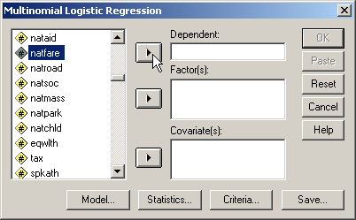
Selecting the dependent variable
First, highlight the dependent variable natfare in the list of variables.
Second, click on the right arrow button to move the dependent variable to the Dependent text box.

Slide 13
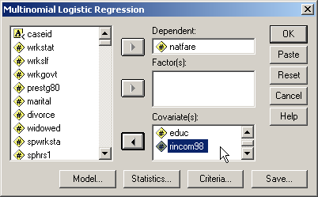
Selecting metric independent variables
Metric independent variables are specified as covariates in multinomial logistic regression. Metric variables can be either interval or, by convention, ordinal.
Move the metric independent variables, hrs1, educ and rincom98 to the Covariate(s) list box.

Slide 14
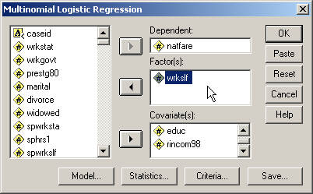
Selecting non-metric independent variables
Non-metric independent variables are specified as factors in multinomial logistic regression. Non-metric variables will automatically be dummy-coded.
Move the metric independent variables, wrkslf to the Factors(s) list box.

Slide 15
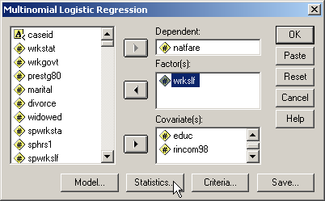
Specifying statistics to include in the output
While we will accept most of the SPSS defaults for the analysis, we need to specifically request the classification table.
Click on the Statistics… button to make a request.

Slide 16
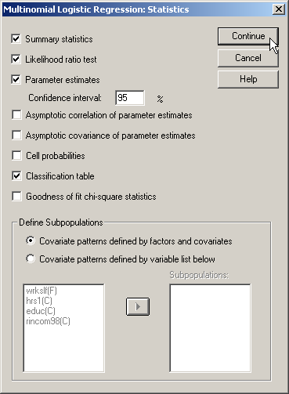
Requesting the classification table
First, keep the SPSS defaults for Summary statistics, Likelihood ratio test, and Parameter estimates.
Third, click on the Continue button to complete the request.
Second, mark the checkbox for the Classification table.

Slide 17
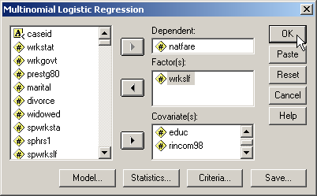
Completing the multinomial logistic regression request
Click on the OK button to request the output for the multinomial logistic regression.
The multinomial logistic procedure supports additional commands to specify the model computed for the relationships (we will use the default main effects model), additional specifications for computing the regression, and saving classification results. We will not make use of these options.

Slide 18
LEVEL OF MEASUREMENT - 1
10. In the dataset GSS2000, is the following statement true, false, or an incorrect application of a statistic? Assume that there is no problem with missing data. Use a level of significance of 0.05 for evaluating the statistical relationship. Test the generalizability of the logistic regression model with a cross-validation analysis using a 80% random sample of the data set as a training sample. Use 892776 as the random number seed.
The variables "number of hours worked in the past week" [hrs1], "self-employment" [wrkslf], "highest year of school completed" [educ] and "income" [rincom98] were useful predictors for distinguishing between groups based on responses to "opinion about spending on welfare" [natfare]. These predictors differentiate survey respondents who thought we spend too little money on welfare from survey respondents who thought we spend too much money on welfare and survey respondents who thought we spend about the right amount of money on welfare from survey respondents who thought we spend too much money on welfare.
Among this set of predictors, self-employment was helpful in distinguishing among the groups defined by responses to opinion about spending on welfare. Survey respondents who were self-employed were 84.3% less likely to be in the group of survey respondents who thought we spend too little money on welfare, rather than the group of survey respondents who thought we spend too much money on welfare.
1. True
2. True with caution
3. False
4. Inappropriate application of a statistic
Multinomial logistic regression requires that the dependent variable be non-metric and the independent variables be metric or dichotomous.
"Opinion about spending on welfare" [natfare] is ordinal, satisfying the non-metric level of measurement requirement for the dependent variable.
It contains three categories: survey respondents who thought we spend too little money, about the right amount of money, and too much money on welfare.

Slide 19
LEVEL OF MEASUREMENT - 2
"Number of hours worked in the past week" [hrs1] and "highest year of school completed" [educ] are interval, satisfying the metric or dichotomous level of measurement requirement for independent variables.
"Self-employment" [wrkslf] is dichotomous, satisfying the metric or dichotomous level of measurement requirement for independent variables.
10. In the dataset GSS2000, is the following statement true, false, or an incorrect application of a statistic? Assume that there is no problem with missing data. Use a level of significance of 0.05 for evaluating the statistical relationship. Test the generalizability of the logistic regression model with a cross-validation analysis using a 80% random sample of the data set as a training sample. Use 892776 as the random number seed.
The variables "number of hours worked in the past week" [hrs1], "self-employment" [wrkslf], "highest year of school completed" [educ] and "income" [rincom98] were useful predictors for distinguishing between groups based on responses to "opinion about spending on welfare" [natfare]. These predictors differentiate survey respondents who thought we spend too little money on welfare from survey respondents who thought we spend too much money on welfare and survey respondents who thought we spend about the right amount of money on welfare from survey respondents who thought we spend too much money on welfare.
Among this set of predictors, self-employment was helpful in distinguishing among the groups defined by responses to opinion about spending on welfare. Survey respondents who were self-employed were 84.3% less likely to be in the group of survey respondents who thought we spend too little money on welfare, rather than the group of survey respondents who thought we spend too much money on welfare.
1. True
2. True with caution
3. False
4. Inappropriate application of a statistic
"Income" [rincom98] is ordinal, satisfying the metric or dichotomous level of measurement requirement for independent variables. If we follow the convention of treating ordinal level variables as metric variables, the level of measurement requirement for the analysis is satisfied. Since some data analysts do not agree with this convention, a note of caution should be included in our interpretation.

Slide 20
Sample size – ratio of cases to variables
Multinomial logistic regression requires that the minimum ratio of valid cases to independent variables be at least 10 to 1. The ratio of valid cases (138) to number of independent variables( 4) was 34.5 to 1, which was equal to or greater than the minimum ratio. The requirement for a minimum ratio of cases to independent variables was satisfied.
The preferred ratio of valid cases to independent variables is 20 to 1. The ratio of 34.5 to 1 was equal to or greater than the preferred ratio. The preferred ratio of cases to independent variables was satisfied.

Slide 21
Classification accuracy for all cases
With all cases, including those that might be identified as outliers or influential cases, the accuracy rate was 52.2%.
We note this to compare with the classification accuracy after removing outliers and influential cases.

Slide 22
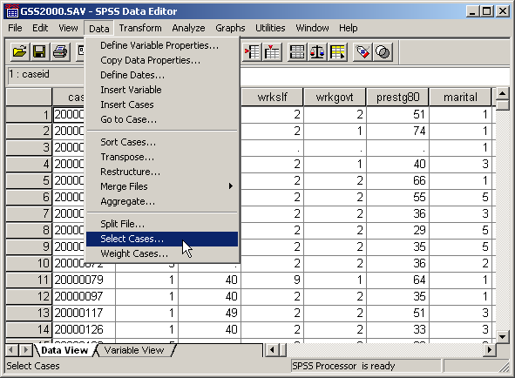
Outliers and influential cases for the comparison of groups 1 and 3
Since multinomial logistic regression does not identify outliers or influential cases, we will use binary logistic regressions to identify them.
Choose the Select Cases… command from the Data menu to include only groups 1 and 3 in the analysis.

Slide 23
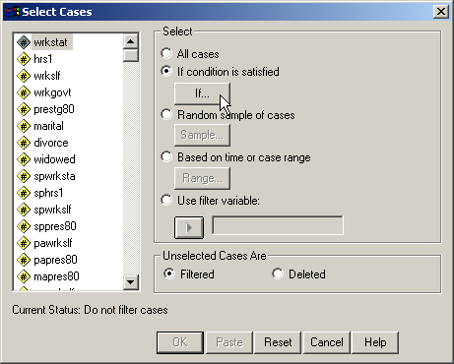
Selecting groups 1 and 3
First, mark the If condition is satisfied option button.
Second, click on the IF… button to specify the condition.

Slide 24
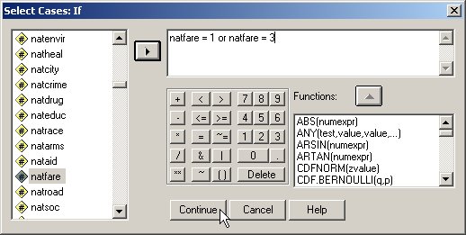
Formula for selecting groups 1 and 3
To include only groups 1 and 3 in the analysis, we enter the formula to include cases that had a value of 1 for natfare or a value of 3 for natfare.
After completing the formula, click on the Continue button to close the dialog box.

Slide 25
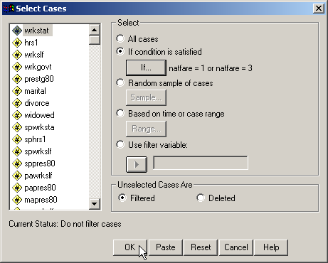
Completing the selection of groups 1 and 3
To activate the selection, click on the OK button.

Slide 26
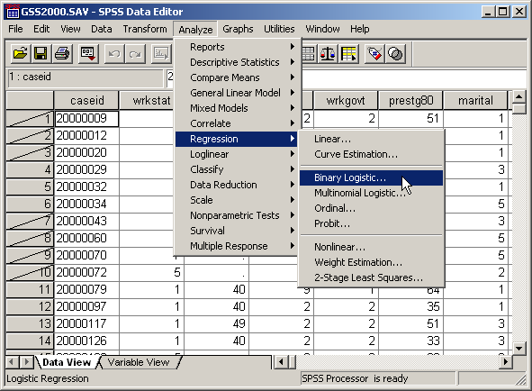
Binary logistic regression comparing groups 1 and 3
Select the Regression | Binary Logistic… command from the Analyze menu.

Slide 27
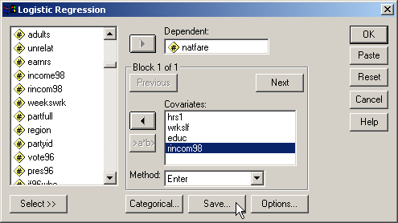
Dependent and independent variables for the comparison of groups 1 and 3
First, move the dependent variable natfare to the Dependent variable text box.
Second, move the independent variables, hrs1, wrkslf, educ, and incom98 to the Covariates list box.
Third, click on the Save… button to request the inclusion of standardized residuals and Cook's distance scores in the data set.

Slide 28
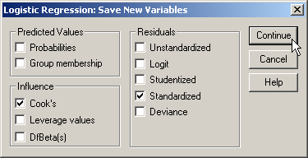
Including Cook's distance and standardized residuals in the comparison of groups 1 and 3
First, mark the checkbox for Standardized residuals in the Residuals panel.
Third, click on the Continue button to complete the specifications.
Second, mark the checkbox for Cook’s in the Influence panel. This will compute Cook’s distances to identify influential cases.

Slide 29
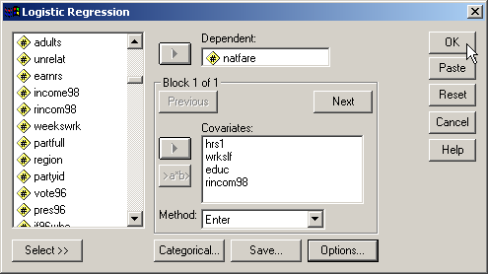
Outliers and influential cases for the comparison of groups 1 and 3
Click on the OK button to request the output for the logistic regression.

Slide 30

Locating the case ids for outliers and influential cases for groups 1 and 3
In order to exclude outliers and influential cases from the multinomial logistic regression, we must identify their case ids.
Choose the Select Cases… command from the Data menu to identify cases that are outliers or influential cases.

Slide 31
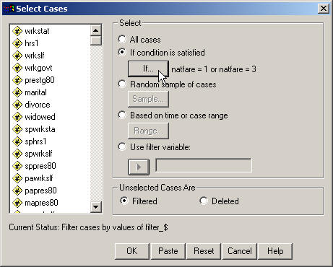
Replace the selection criteria
To replace the formula that selected cases in group 1 and 3 for the dependent variable, click on the IF… button.

Slide 32
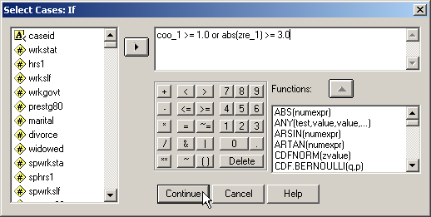
Formula for identifying outliers and influential cases
Type in the formula for including outliers and influential cases.
Note that we are including outliers and influential cases because we want to identify them. This is different that previous procedures where we included cases that were not outliers and not influential cases in the analysis.
Click on the Continue button to close the dialog box.

Slide 33
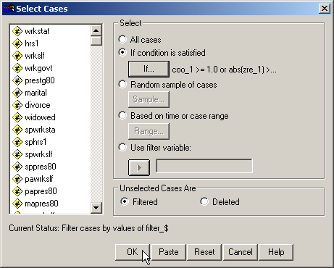
Completing the selection of outliers and influential cases
To activate the selection, click on the OK button.

Slide 34
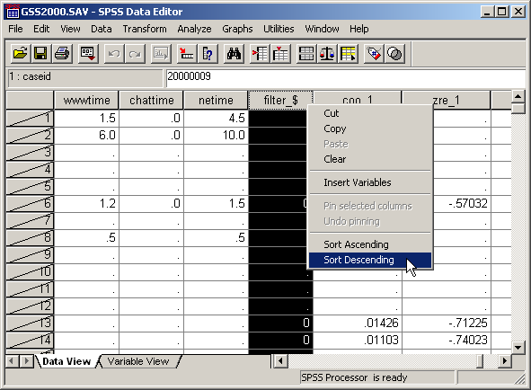
Locating the outliers and influential cases in the data editor
We used Select cases to specify a criteria for including cases that were outliers or influential cases. Select cases will assign a 1 (true) to the filter_$ variable if a cases satisfies the criteria. To locate the cases that have a filter_$ value of 1, we can sort the data set in descending order of the values for the filter variable.
Click on the column header for filter_$ and select Sort Descending from the drop down menu.

Slide 35
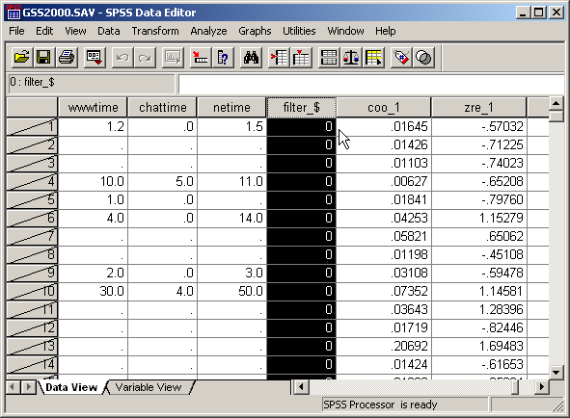
The outliers and influential cases in the data editor
At the top of the sorted column for filter_$, we see only 0's indicating that no cases met the criteria for being considered an outlier or influential case.

Slide 36
Outliers and influential cases for the comparison of groups 2 and 3
The process for identifying outliers and influential cases is repeated for the other comparison done by the multinomial logistic regression, group 2 versus group 3.
Since multinomial logistic regression does not identify outliers or influential cases, we will use binary logistic regressions to identify them.
Choose the Select Cases… command from the Data menu to include only groups 2 and 3 in the analysis.

Slide 37
Selecting groups 2 and 3
First, mark the If condition is satisfied option button.
Second, click on the IF… button to specify the condition.

Slide 38
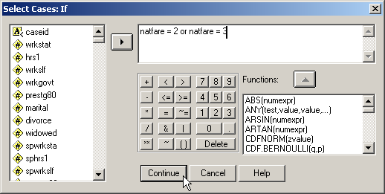
Formula for selecting groups 2 and 3
To include only groups 2 and 3 in the analysis, we enter the formula to include cases that had a value of 2 for natfare or a value of 3 for natfare.
After completing the formula, click on the Continue button to close the dialog box.

Slide 39

Completing the selection of groups 2 and 3
To activate the selection, click on the OK button.

Slide 40
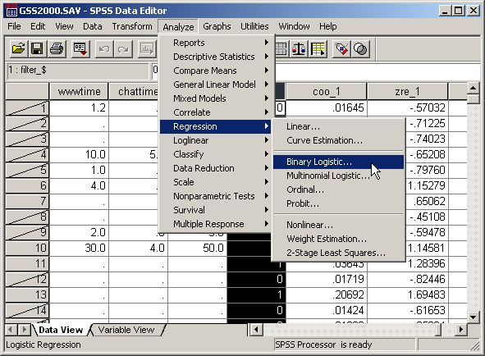
Binary logistic regression comparing groups 2 and 3
Select the Regression | Binary Logistic… command from the Analyze menu.

Slide 41
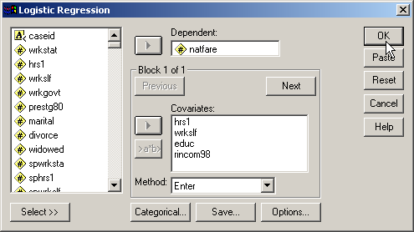
Outliers and influential cases for the comparison of groups 2 and 3
The specifications for the analysis are the same as the ones we used for detecting outliers and influential cases for groups 1 and 3.
Click on the OK button to request the output for the logistic regression.

Slide 42
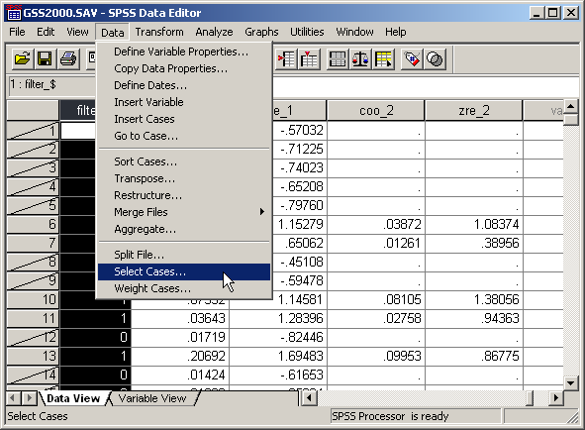
Locating the case ids for outliers and influential cases for groups 2 and 3
In order to exclude outliers and influential cases from the multinomial logistic regression, we must identify their case ids.
Choose the Select Cases… command from the Data menu to identify cases that are outliers or influential cases.

Slide 43

Replace the selection criteria
To replace the formula that selected cases in group 2 and 3 for the dependent variable, click on the IF… button.

Slide 44

Formula for identifying outliers and influential cases
Type in the formula for including outliers and influential cases.
Note that we use the second version of cook's distance, coo_2, and the second version of the standardized residual, zre_2.
Click on the Continue button to close the dialog box.

Slide 45

Completing the selection of outliers and influential cases
To activate the selection, click on the OK button.

Slide 46
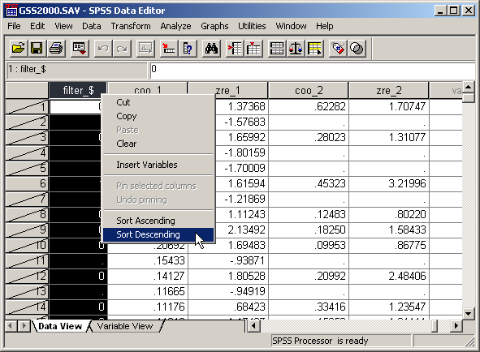
Locating the outliers and influential cases in the data editor
We used Select cases to specify a criteria for including cases that were outliers or influential cases. Select cases will assign a 1 (true) to the filter_$ variable if a cases satisfies the criteria. To locate the cases that have a filter_$ value of 1, we can sort the data set in descending order of the values for the filter variable.
Click on the column header for filter_$ and select Sort Descending from the drop down menu.

Slide 47
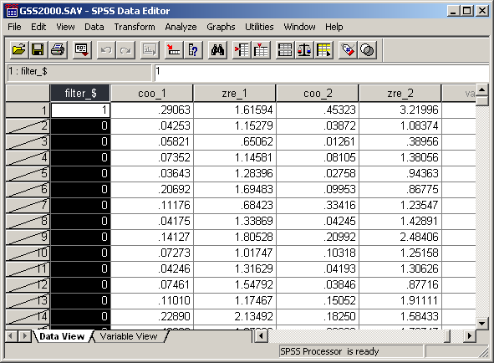
The outliers and influential cases in the data editor
At the top of the sorted column for filter_$, we see that we have one outlier or influential case.
In the column zre_2, we see that this case was an outlier on the standardized residual.

Slide 48
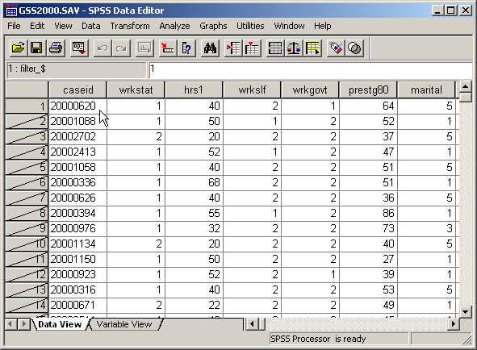
The case id of the outlier
The case id for the outlier is "20000620." This is the case that we will omit from the multinomial logistic regression.

Slide 49
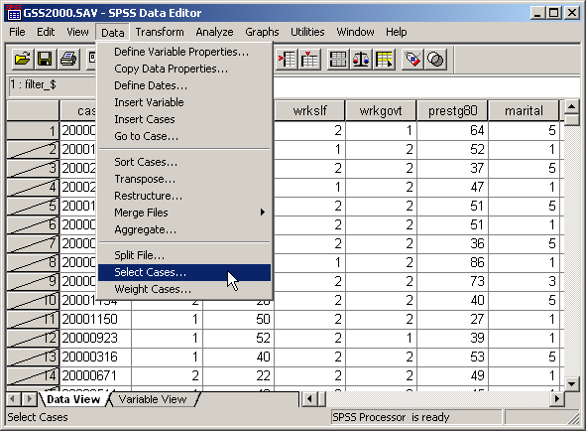
Excluding the outlier from the analysis
To exclude the outlier from the analysis, we will use the Select Cases… command again.

Slide 50
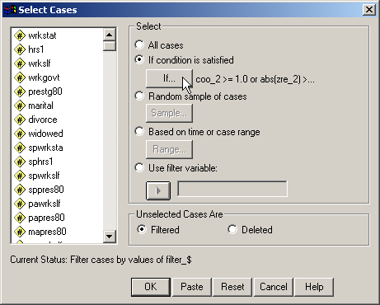
Changing the condition for the selection
Click on the IF… button to change the condition.

Slide 51
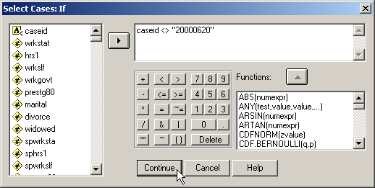
Excluding case 20000620
To include all of the cases except the outlier, we set caseid not equal to the subject's id. Note that the subject's id is put in quotation marks because it is string data in this data set.
After completing the formula, click on the Continue button to close the dialog box.

Slide 52
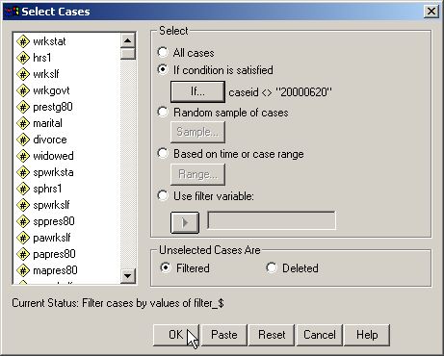
Completing the exclusion of the outlier
To activate the exclusion, click on the OK button.

Slide 53
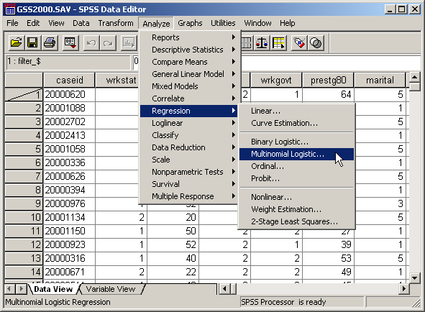
Multinomial logistic regression excluding the outlier
Select the Regression | Multinomial Logistic… command from the Analyze menu.

Slide 54
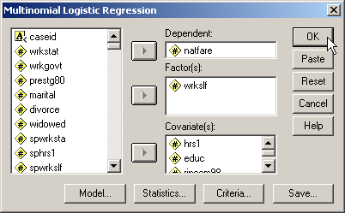
Running the multinomial logistic regression without the outlier
The specifications for the analysis are the same as the ones we used the multinomial logistic regression with all cases.
Click on the OK button to request the output for the logistic regression.

Slide 55
Classification accuracy after omitting outliers
With all cases the classification accuracy rate was 52.2%.After omitting the outlier, the accuracy rate improved to 52.6%. However, since the amount of the increase was not greater than 2%, the model with all cases will be interpreted.

Slide 56
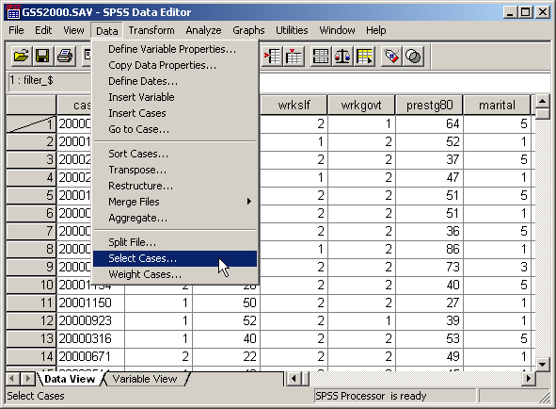
Restoring the outlier to the data set
To include the outlier back into the analysis, we will use the Select Cases… command again.

Slide 57
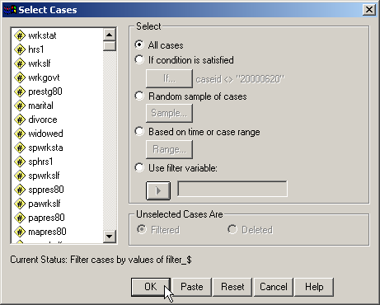
Restoring the outlier to the data set
Mark the All cases option button to include the outlier back into the data set.
To activate the exclusion, click on the OK button.

Slide 58
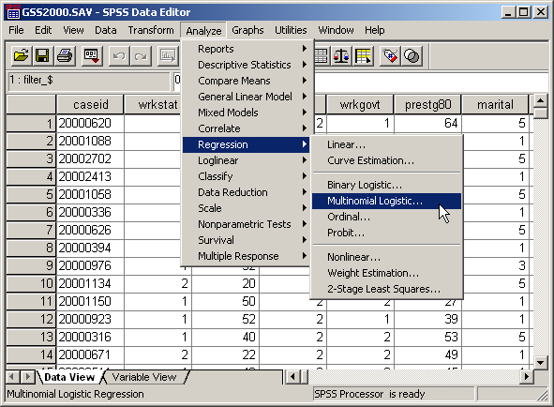
Re-running the multinomial logistic regression with all cases
Select the Regression | Multinomial Logistic… command from the Analyze menu.

Slide 59
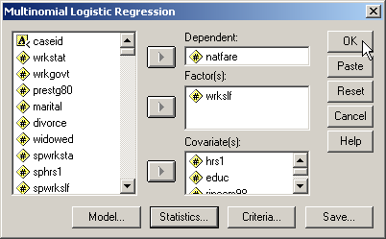
Requesting the multinomial logistic regression again
The specifications for the analysis are the same as the ones we have been using all along.
Click on the OK button to request the output for the multinomial logistic regression.

Slide 60
OVERALL RELATIONSHIP BETWEEN INDEPENDENT AND DEPENDENT VARIABLES
The presence of a relationship between the dependent variable and combination of independent variables is based on the statistical significance of the final model chi-square in the SPSS table titled "Model Fitting Information".
In this analysis, the probability of the model chi-square (25.882) was 0.001, less than or equal to the level of significance of 0.05. The null hypothesis that there was no difference between the model without independent variables and the model with independent variables was rejected. The existence of a relationship between the independent variables and the dependent variable was supported.

Slide 61
NUMERICAL PROBLEMS
Multicollinearity in the multinomial logistic regression solution is detected by examining the standard errors for the b coefficients. A standard error larger than 2.0 indicates numerical problems, such as multicollinearity among the independent variables, zero cells for a dummy-coded independent variable because all of the subjects have the same value for the variable, and 'complete separation' whereby the two groups in the dependent event variable can be perfectly separated by scores on one of the independent variables. Analyses that indicate numerical problems should not be interpreted.
None of the independent variables in this analysis had a standard error larger than 2.0.

Slide 62
RELATIONSHIP OF INDIVIDUAL INDEPENDENT VARIABLES TO DEPENDENT VARIABLE - 1
The statistical significance of the relationship between self-employment and opinion about spending on welfare is based on the statistical significance of the chi-square statistic in the SPSS table titled "Likelihood Ratio Tests".
For this relationship, the probability of the chi-square statistic (7.525) was 0.023, less than or equal to the level of significance of 0.05. The null hypothesis that all of the b coefficients associated with self-employment were equal to zero was rejected. The existence of a relationship between self-employment and opinion about spending on welfare was supported.

Slide 63
RELATIONSHIP OF INDIVIDUAL INDEPENDENT VARIABLES TO DEPENDENT VARIABLE - 2
In the comparison of survey respondents who thought we spend too little money on welfare to survey respondents who thought we spend too much money on welfare, the probability of the Wald statistic (6.612) for the variable category survey respondents who were self-employed [wrkslf=1] was 0.010. Since the probability was less than or equal to the level of significance of 0.05, the null hypothesis that the b coefficient for self-employment was equal to zero for this comparison was rejected.

Slide 64
RELATIONSHIP OF INDIVIDUAL INDEPENDENT VARIABLES TO DEPENDENT VARIABLE - 3
The value of Exp(B) was 0.157 which implies that the odds decreased by 84.3% (0.157 - 1.0 = -0.843).
The relationship stated in the problem is supported. Survey respondents who were self-employed were 84.3% less likely to be in the group of survey respondents who thought we spend too little money on welfare, rather than the group of survey respondents who thought we spend too much money on welfare.

Slide 65
CLASSIFICATION USING THE MULTINOMIAL LOGISTIC REGRESSION MODEL: BY CHANCE ACCURACY RATE
The independent variables could be characterized as useful predictors distinguishing survey respondents who thought we spend too little money on welfare, survey respondents who thought we spend about the right amount of money on welfare and survey respondents who thought we spend too much money on welfare if the classification accuracy rate was substantially higher than the accuracy attainable by chance alone. Operationally, the classification accuracy rate should be 25% or more higher than the proportional by chance accuracy rate.
The proportional by chance accuracy rate was computed by calculating the proportion of cases for each group based on the number of cases in each group in the 'Case Processing Summary', and then squaring and summing the proportion of cases in each group (0.406² + 0.362² + 0.232² = 0.350).

Slide 66
CLASSIFICATION USING THE MULTINOMIAL LOGISTIC REGRESSION MODEL: CLASSIFICATION ACCURACY
The classification accuracy rate was 52.2% which was greater than or equal to the proportional by chance accuracy criteria of 43.7% (1.25 x 35.0% = 43.7%).
The criteria for classification accuracy is satisfied.

Slide 67
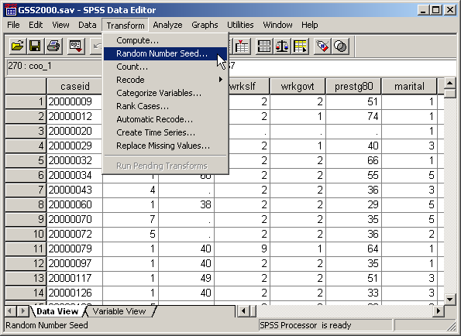
Validation analysis: set the random number seed
To set the random number seed, select the Random Number Seed… command from the Transform menu.

Slide 68
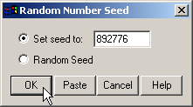
Set the random number seed
First, click on the Set seed to option button to activate the text box.
Second, type in the random seed stated in the problem.
Third, click on the OK button to complete the dialog box.
Note that SPSS does not provide you with any feedback about the change.

Slide 69
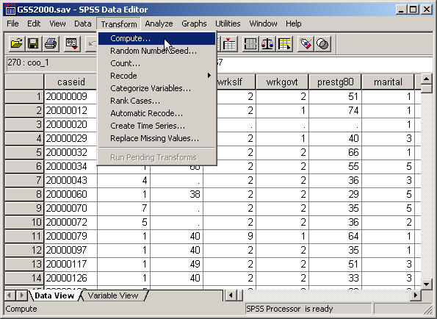
Validation analysis: compute the split variable
To enter the formula for the variable that will split the sample in two parts, click on the Compute… command.

Slide 70
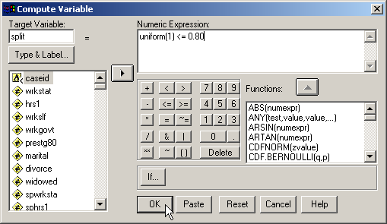
The formula for the split variable
First, type the name for the new variable, split, into the Target Variable text box.
Second, the formula for the value of split is shown in the text box.
The uniform(1) function generates a random decimal number between 0 and 1. The random number is compared to the value 0.80.
If the random number is less than or equal to 0.80, the value of the formula will be 1, the SPSS numeric equivalent to true. If the random number is larger than 0.80, the formula will return a 0, the SPSS numeric equivalent to false.
Third, click on the OK button to complete the dialog box.

Slide 71

Selecting the teaching sample
To select the cases that we will use to , we will use the Select Cases… command again.

Slide 72
Selecting the teaching sample
First, mark the If condition is satisfied option button.
Second, click on the IF… button to specify the condition.

Slide 73
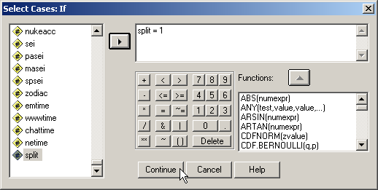
Selecting the teaching sample
To include the cases for the teaching sample, we enter the selection criteria: "split = 1".
After completing the formula, click on the Continue button to close the dialog box.

Slide 74
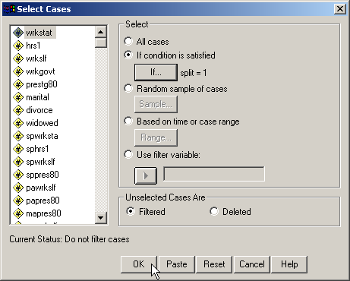
Selecting the teaching sample
To activate the selection, click on the OK button.

Slide 75
Re-running the multinomial logistic regression with the teaching sample
Select the Regression | Multinomial Logistic… command from the Analyze menu.

Slide 76
Requesting the multinomial logistic regression again
The specifications for the analysis are the same as the ones we have been using all along.
Click on the OK button to request the output for the multinomial logistic regression.

Slide 77
Comparing the teaching model to full model - 1
In the cross-validation analysis, the relationship between the independent variables and the dependent variable was statistically significant.
The probability for the model chi-square (25.513) testing overall relationship was = 0.003.
The significance of the overall relationship between the individual independent variables and the dependent variable supports the interpretation of the model using the full data set.

Slide 78
Comparing the teaching model to full model - 2
The pattern of significance of individual predictors for the teaching model matches the pattern for the full data set: hrs1, educ, and wrkslf have statistically significant relationships to the dependent variable.

Slide 79
Comparing the teaching model to full model - 3
The statistical significance and direction of the relationship between WKRSLF=1 and group 1 versus group 3 of the dependent variable for the teaching model agrees with the findings for the model using the full data set.

Slide 80
Classification accuracy of the holdout sample
To compute the accuracy rate of the holdout sample, our first task is to explicitly dummy code any independent variables which SPSS dummy coded in the multinomial logistic regression.
In this example, we must explicitly dummy code WRKSLF=1.

Slide 81
Dummy-coding WRKSLF
WRKSFL=2 is the excluded category for WRKSLF in the table of parameter estimates. Using this category as our reference category, the syntax for dummy-coding WRKSLF is:
RECODE WRKSLF(1=1)(2=0) INTO WRKSLF1.

Slide 82
The log of the odds for the first group
To calculate the log of the odds for the first group (G1), we multiple the coefficients for the first group from the table of parameter estimates times the variables:
COMPUTE G1 = -1.30238345543984
+ 0.0261986923704887 * HRS1
+ 0.174611208588235 * EDUC
- 0.0867944152322106 * RINCOM98
- 2.51888052878127 * WRKSLF1.
To get all of the decimal places for a number, double click on a cell to highlight it and the full number will appear.

Slide 83
The log of the odds for the second group
To calculate the log of the odds for the second group (G2), we multiple the coefficients for the second group from the table of parameter estimates times the variables:
COMPUTE G2 = -1.79765485734901
- 0.0252840253968005 * HRS1
+ 0.327632806335678 * EDUC
- 0.0744568011819021 * RINCOM98
- 1.34937062997864 * WRKSLF1.

Slide 84
The log of the odds for the third group
The third group (G3) is the reference group and does not appear in the table of parameter estimates.
By definition, the log of the odds for the reference group is equal to zero (0). We create the variable for G3 with the command:
COMPUTE G3 = 0.

Slide 85
The probabilities for each group
Having computed the log of the odds for each group, we convert the log of the odds back to a probability number with the following formulas:
  COMPUTE P1 = EXP(G1) / (EXP(G1) + EXP(G2) + EXP(G3)).
  COMPUTE P2 = EXP(G2) / (EXP(G1) + EXP(G2) + EXP(G3)).
  COMPUTE P3 = EXP(G3) / (EXP(G1) + EXP(G2) + EXP(G3)).
  EXECUTE.

Slide 86
Group classification
Each case is predicted to be a member of the group to which it has the highest probability of belonging. We can accomplish this using "IF" statements in SPSS:
  IF (P1 > P2 AND P1 > P3) PREDGRP = 1.
  IF (P2 > P1 AND P2 > P3) PREDGRP = 2.
  IF (P3 > P1 AND P3 > P2) PREDGRP = 3.
  EXECUTE.

Slide 87
Selecting the holdout sample
To select the cases that we will use to , we will use the Select Cases… command again.

Slide 88
Selecting the holdout sample
First, mark the If condition is satisfied option button.
Second, click on the IF… button to specify the condition.

Slide 89
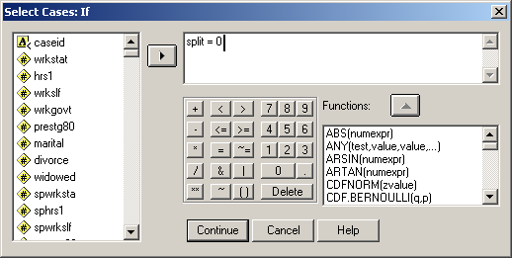
Selecting the holdout sample
To include the cases in the 20% holdout sample, we enter the criterion: "split = 0".
After completing the formula, click on the Continue button to close the dialog box.

Slide 90

Selecting the holdout sample
To activate the selection, click on the OK button.

Slide 91
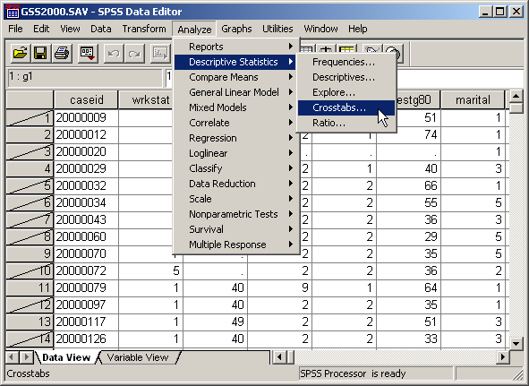
The classification accuracy table
The classification accuracy table is a table of predicted group membership versus actual group membership. SPSS can create it as a cross-tabulated table.
Select the Crosstabs… | Descriptive Statistics command from the Analyze menu.

Slide 92
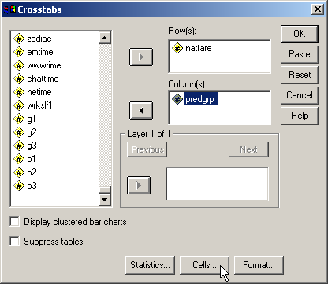
The classification accuracy table
To mimic the appearance of classification tables in SPSS, we will put the original variable, natfare, in the rows of the table and the predicted group variable, predgrp, in the columns.
After specifying the row and column variables, we click on the Cells… button to request percentages.

Slide 93
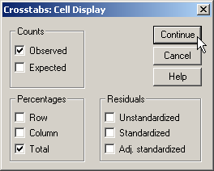
The classification accuracy table
The classification accuracy rate will be the sum of the total percentages on the main diagonal.
Second, click on the Continue button to close the dialog box.
First, to obtain these percentage, mark the check box for Total on the Percentages panel.

Slide 94
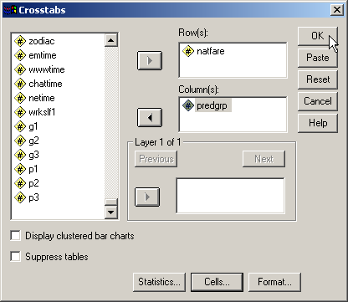
The classification accuracy table
To complete the request for the cross-tabulated table, click on the OK button.

Slide 95
The classification accuracy table
The classification accuracy rate will be the sum of the total percentages on the main diagonal:
13.0% + 34.8% + 4.3% = 52.1%.
The criteria to support the classification accuracy of the model is an accuracy rate for the holdout sample that is no less than 10% lower than the accuracy rate for the training sample. The accuracy rate for the training sample was 51.3%, making the minimum requirement for the holdout sample equal to 46.2% (0.90 x 51.3%). The accuracy rate for the holdout sample was 52.1%, which satisfied the minimum requirement. The classification accuracy for the analysis of the full data set was supported.

Slide 96
Answering the question in problem 1 - 1
10. In the dataset GSS2000, is the following statement true, false, or an incorrect application of a statistic? Assume that there is no problem with missing data. Use a level of significance of 0.05 for evaluating the statistical relationship. Test the generalizability of the logistic regression model with a cross-validation analysis using a 80% random sample of the data set as a training sample. Use 892776 as the random number seed.
The variables "number of hours worked in the past week" [hrs1], "self-employment" [wrkslf], "highest year of school completed" [educ] and "income" [rincom98] were useful predictors for distinguishing between groups based on responses to "opinion about spending on welfare" [natfare]. These predictors differentiate survey respondents who thought we spend too little money on welfare from survey respondents who thought we spend too much money on welfare and survey respondents who thought we spend about the right amount of money on welfare from survey respondents who thought we spend too much money on welfare.
Among this set of predictors, self-employment was helpful in distinguishing among the groups defined by responses to opinion about spending on welfare. Survey respondents who were self-employed were 84.3% less likely to be in the group of survey respondents who thought we spend too little money on welfare, rather than the group of survey respondents who thought we spend too much money on welfare.
1. True
2. True with caution
3. False
4. Inappropriate application of a statistic
We found a statistically significant overall relationship between the combination of independent variables and the dependent variable.
Removal of outliers did not improve the model substantially, so they were included in the solution.
There was no evidence of numerical problems in the solution.
Moreover, the classification accuracy surpassed the proportional by chance accuracy criteria, supporting the utility of the model.

Slide 97
Answering the question in problem 1 - 2
We verified that each statement about the relationship between an independent variable and the dependent variable was correct in both direction of the relationship and the change in likelihood associated with a one-unit change of the independent variable, for the comparison between groups stated in the problem.
10. In the dataset GSS2000, is the following statement true, false, or an incorrect application of a statistic? Assume that there is no problem with missing data. Use a level of significance of 0.05 for evaluating the statistical relationship. Test the generalizability of the logistic regression model with a cross-validation analysis using a 80% random sample of the data set as a training sample. Use 892776 as the random number seed.
The variables "number of hours worked in the past week" [hrs1], "self-employment" [wrkslf], "highest year of school completed" [educ] and "income" [rincom98] were useful predictors for distinguishing between groups based on responses to "opinion about spending on welfare" [natfare]. These predictors differentiate survey respondents who thought we spend too little money on welfare from survey respondents who thought we spend too much money on welfare and survey respondents who thought we spend about the right amount of money on welfare from survey respondents who thought we spend too much money on welfare.
Among this set of predictors, self-employment was helpful in distinguishing among the groups defined by responses to opinion about spending on welfare. Survey respondents who were self-employed were 84.3% less likely to be in the group of survey respondents who thought we spend too little money on welfare, rather than the group of survey respondents who thought we spend too much money on welfare.
1. True
2. True with caution
3. False
4. Inappropriate application of a statistic

Slide 98
Answering the question in problem 1 - 3
10. In the dataset GSS2000, is the following statement true, false, or an incorrect application of a statistic? Assume that there is no problem with missing data. Use a level of significance of 0.05 for evaluating the statistical relationship. Test the generalizability of the logistic regression model with a cross-validation analysis using a 80% random sample of the data set as a training sample. Use 892776 as the random number seed.
The variables "number of hours worked in the past week" [hrs1], "self-employment" [wrkslf], "highest year of school completed" [educ] and "income" [rincom98] were useful predictors for distinguishing between groups based on responses to "opinion about spending on welfare" [natfare]. These predictors differentiate survey respondents who thought we spend too little money on welfare from survey respondents who thought we spend too much money on welfare and survey respondents who thought we spend about the right amount of money on welfare from survey respondents who thought we spend too much money on welfare.
Among this set of predictors, self-employment was helpful in distinguishing among the groups defined by responses to opinion about spending on welfare. Survey respondents who were self-employed were 84.3% less likely to be in the group of survey respondents who thought we spend too little money on welfare, rather than the group of survey respondents who thought we spend too much money on welfare.
1. True
2. True with caution
3. False
4. Inappropriate application of a statistic
The 80-20 split validation supported the interpretation of the model using the full data set. The overall relationship for the teaching sample was statistically significant, as were the pattern of relationships for individual predictors. Finally, the accuracy rate for the holdout sample was sufficient to support the accuracy of the full model.
The answer to the question is true with caution.
A caution is added because of the inclusion of ordinal level variables.

Slide 99
Steps in multinomial logistic regression: level of measurement and initial sample size
The following is a guide to the decision process for answering
problems about the basic relationships in multinomial logistic regression:
Dependent non-metric?
Independent variables metric or dichotomous?
No
Inappropriate application of a statistic
Yes
Ratio of cases to independent variables at least 10 to 1?
No
Inappropriate application of a statistic
Yes
Yes
Run multinomial logistic regression
Record classification accuracy for evaluation of the effect of removing outliers and influential cases.

Slide 100
Steps in multinomial logistic regression: detecting outliers and influential cases
Run binary logistic regression for pairs of groups compared in multinomial logistic regression to identify outliers and influential cases.
Outliers/influential cases by standardized residuals or Cook's distance?
Yes
Remove outliers and influential cases from data set
No
Ratio of cases to independent variables at least 10 to 1?
No
Restore outliers and influential cases to data set, add caution to findings
Yes

Slide 101
Steps in multinomial logistic regression: picking model for interpretation
Were outliers and influential cases omitted from the analysis?
No
Yes
Classification accuracy omitting outliers better than baseline by 2% or more?
Yes
No
Pick multinomial logistic regression that omits outliers for interpretation
Pick baseline multinomial logistic regression
for interpretation

Slide 102
Steps in multinomial logistic regression: overall relationship and numerical problems
Overall relationship statistically significant?
(model chi-square test)
No
False
Yes
Standard errors of coefficients indicate no numerical problems (s.e. <= 2.0)?
No
False
Yes

Slide 103
Steps in multinomial logistic regression: relationships between IV's and DV
Overall relationship between specific IV and DV is statistically significant?
(likelihood ratio test)
No
False
Yes
Role of specific IV and DV groups statistically significant and interpreted correctly?
(Wald test and Exp(B))
No
False
Yes
Overall accuracy rate is 25% > than proportional by chance accuracy rate?
No
False
Yes
Yes

Slide 104
Steps in logistic regression: split-sample validation
Compute 80-20 split variable.
Re-run logistic regression.
Overall relationship in teaching sample supports full model?
No
False
Yes

Slide 105
Steps in logistic regression: validation supports generalizability
Significance of predictors in teaching sample matches pattern for model using full data set?
No
False
Yes
Classification accuracy for holdout sample close enough to training sample?
No
False
Yes

Slide 106
Steps in multinomial logistic regression: adding cautions
Yes
Satisfies preferred ratio of cases to IV's of 20 to 1
No
True with caution
Yes
Yes
One or more IV's are ordinal level treated as metric?
Yes
True with caution
No
True

