Slide 1

Market Structure

Slide 2
Perfect Competition
Firms are price-takers
  Each produces only a very small portion of total market or industry output
All firms produce a homogeneous product
Entry into & exit from the market is unrestricted

Slide 3
Demand for a Competitive Price-Taker
Demand curve is horizontal at price determined by intersection of market demand & supply
  Perfectly elastic
Marginal revenue equals price
  Demand curve is also marginal revenue curve (D = MR)
Can sell all they want at the market price
  Each additional unit of sales adds to total revenue an amount equal to price

Slide 4


Demand for a Competitive Price-Taking Firm (Figure 11.2)
Price (dollars)
S
Price (dollars)
P₀
P₀
D = MR
D
0
Q₀
0
Quantity
Quantity
Panel A – Market
Panel B – Demand curve facing a price-taker

Slide 5
Profit-Maximization in the Short Run
In the short run, managers must make two decisions:
  Produce or shut down?
    If shut down, produce no output and hires no variable inputs
    If shut down, firm loses amount equal to TFC
  If produce, what is the optimal output level?
    If firm does produce, then how much?
    Produce amount that maximizes economic profit
Max

Slide 6
Short-Run Output Decision
Firm’s manager will produce output where P = MC as long as P ≥ AVC
If price is less than average variable cost (P < AVC), manager will shut down
  Produce zero output
  Lose only total fixed costs
  Shutdown price is minimum AVC

Slide 7
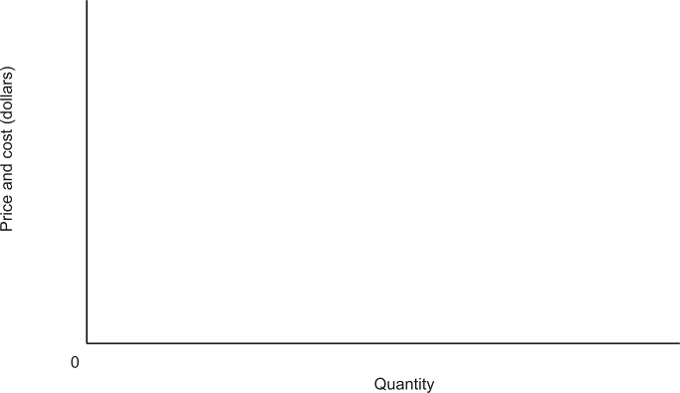
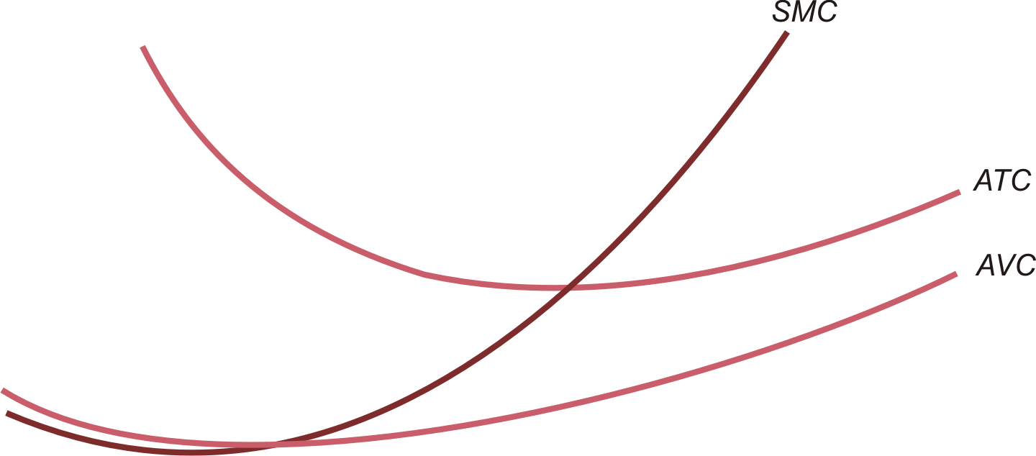
Short-Run Decisions:
Do
D1
D2
D3

Slide 8
Short-Run Decisions:
Q | P | MR | MC | AFC | AVC | ATC | Profit
0 | $10 |  |  | $10.00 | $0.00 | $10.00 | -$10
1 | $10 | $10 | $4 | $10.00 | $4.00 | $14.00 | -$4
2 | $10 | $10 | $3 | $5.00 | $3.50 | $8.50 | $3
3 | $10 | $10 | $4 | $3.33 | $3.67 | $7.00 | $9
4 | $10 | $10 | $7 | $2.50 | $4.50 | $7.00 | $12
5 | $10 | $10 | $10 | $2.00 | $5.60 | $7.60 | $12
6 | $10 | $10 | $19 | $1.67 | $7.83 | $9.50 | $3
7 | $10 | $10 | $27 | $1.43 | $10.57 | $12.00 | -$14
8 | $10 | $10 | $38 | $1.25 | $14.00 | $15.25 | -$42
9 | $10 | $10 | $50 | $1.11 | $18.00 | $19.11 | -$82
Companion Spreadsheet: ProductionCost.xls

Slide 9
Irrelevance of Fixed Costs
Fixed costs are irrelevant in the production decision
  Level of fixed cost has no effect on marginal cost or minimum average variable cost
  Thus no effect on optimal level of output

Slide 10
Summary of Short-Run Output Decision
AVC tells whether to produce
  Shut down if price falls below minimum AVC
SMC tells how much to produce
  If P ≥ minimum AVC, produce output at which P = SMC
ATC tells how much profit/loss if produce
•

Slide 11
Short-Run Supply Curves
For an individual price-taking firm
  Portion of firms’ marginal cost curve above minimum AVC
  For prices below minimum AVC, quantity supplied is zero
For a competitive industry
  Horizontal sum of supply curves of all individual firms; always upward sloping
  Supply prices give marginal costs of production for every firm

Slide 12
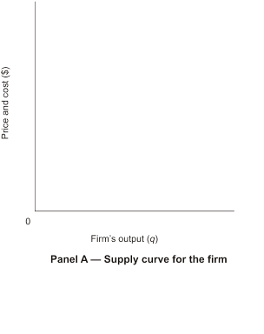
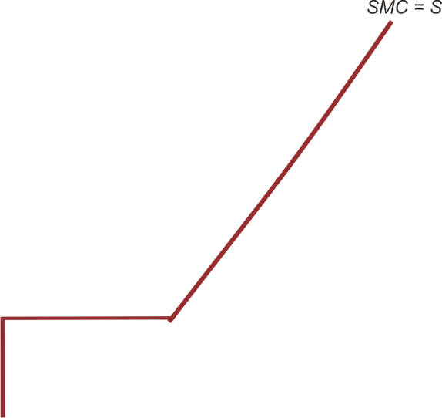
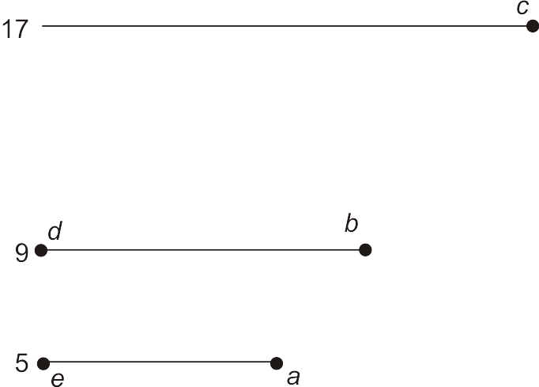
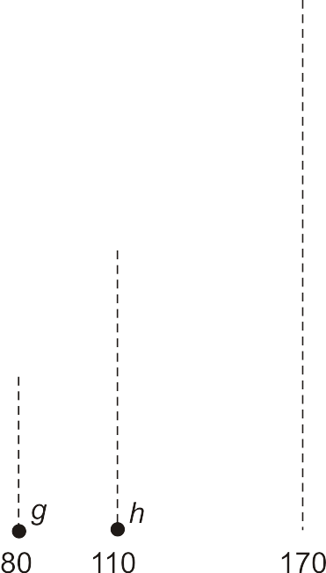
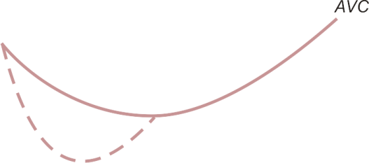
Short-Run Firm & Industry Supply (Figure 11.6)

Slide 13
Long-Run Competitive Equilibrium
Salary
Suppose explicit cost for each producer are the some (example local producer of corn)
Teacher
$40,000
Principal
$60,000
Superintendent
$100,000
The Market
Superintendent
Teacher
Principal
Suppose all are teachers and the only cost difference is enterprise productivity
Copyright © michael.roberson@estudy.us

Slide 14
Long-Run Competitive Equilibrium
All firms are in profit-maximizing equilibrium (P = LMC)
Occurs because of entry/exit of firms in/out of industry
  Market adjusts so P = LMC = LAC

Slide 15
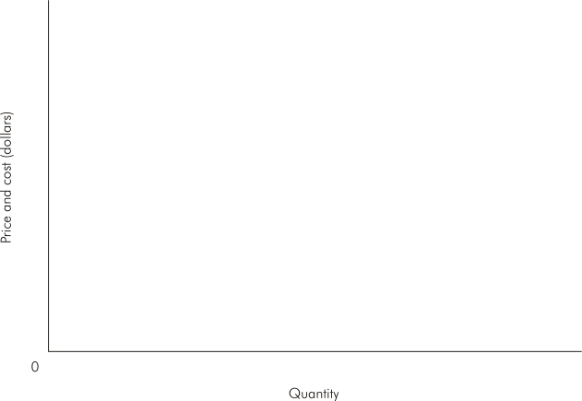
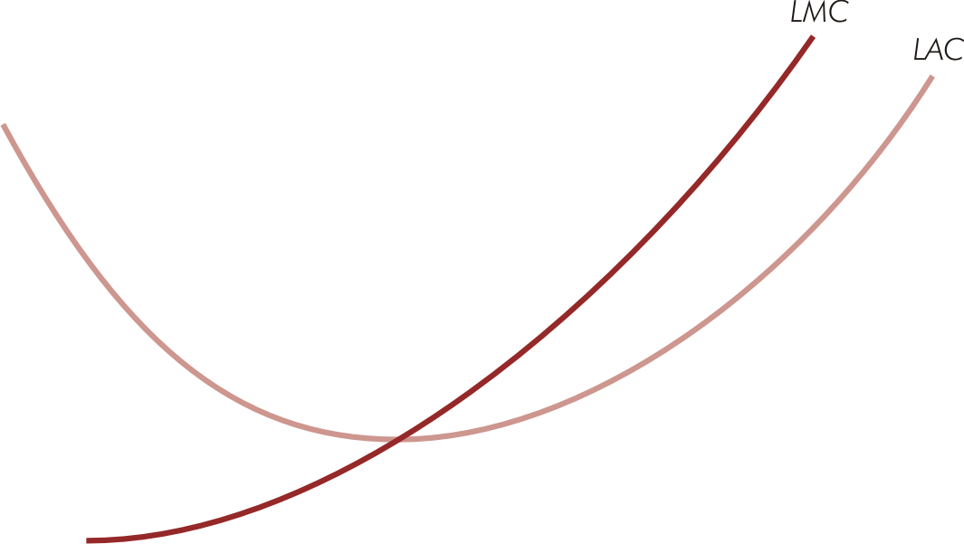
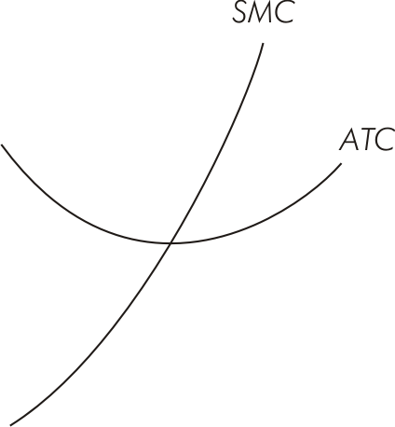

Long-Run Competitive Equilibrium (Figure 11.8)

Slide 16
Market Power
Ability of a firm to raise price without losing all its sales
  Any firm that faces downward sloping demand has market power
Gives firm ability to raise price above average cost & earn economic profit (if demand & cost conditions permit)

Slide 17
Monopoly
Single firm
Produces & sells a good or service for which there are no good substitutes
New firms are prevented from entering market because of a barrier to entry

Slide 18
Measurement of Market Power
Degree of market power inversely related to price elasticity of demand
  The less elastic the firm’s demand, the greater its degree of market power
  The fewer close substitutes for a firm’s product, the smaller the elasticity of demand (in absolute value) & the greater the firm’s market power
  When demand is perfectly elastic (demand is horizontal), the firm has no market power

Slide 19
Measurement of Market Power
If consumers view two goods as substitutes, cross-price elasticity of demand (E_{XY}) is positive
  The higher the positive cross-price elasticity, the greater the substitutability between two goods, & the smaller the degree of market power for the two firms

Slide 20
Determinants of Market Power
Entry of new firms into a market erodes market power of existing firms by increasing the number of substitutes
A firm can possess a high degree of market power only when strong barriers to entry exist
  Conditions that make it difficult for new firms to enter a market in which economic profits are being earned

Slide 21
Common Entry Barriers
Economies of scale
  When long-run average cost declines over a wide range of output relative to demand for the product, there may not be room for another large producer to enter market
Barriers created by government
  Licenses, exclusive franchises

Slide 22
Common Entry Barriers
Input barriers
  One firm controls a crucial input in the production process
Brand loyalties
  Strong customer allegiance to existing firms may keep new firms from finding enough buyers to make entry worthwhile

Slide 23
Common Entry Barriers
Consumer lock-in
  Potential entrants can be deterred if they believe high switching costs will keep them from inducing many consumers to change brands
Network externalities
  Occur when value of a product increases as more consumers buy & use it
  Make it difficult for new firms to enter markets where firms have established a large network of buyers

Slide 24
Demand & Marginal Revenue for a Monopolist
Market demand curve is the firm’s demand curve
Monopolist must lower price to sell additional units of output
  Marginal revenue is less than price for all but the first unit sold
When MR is positive (negative), demand is elastic (inelastic)
For linear demand, MR is also linear, has the same vertical intercept as demand, & is twice as steep

Slide 25
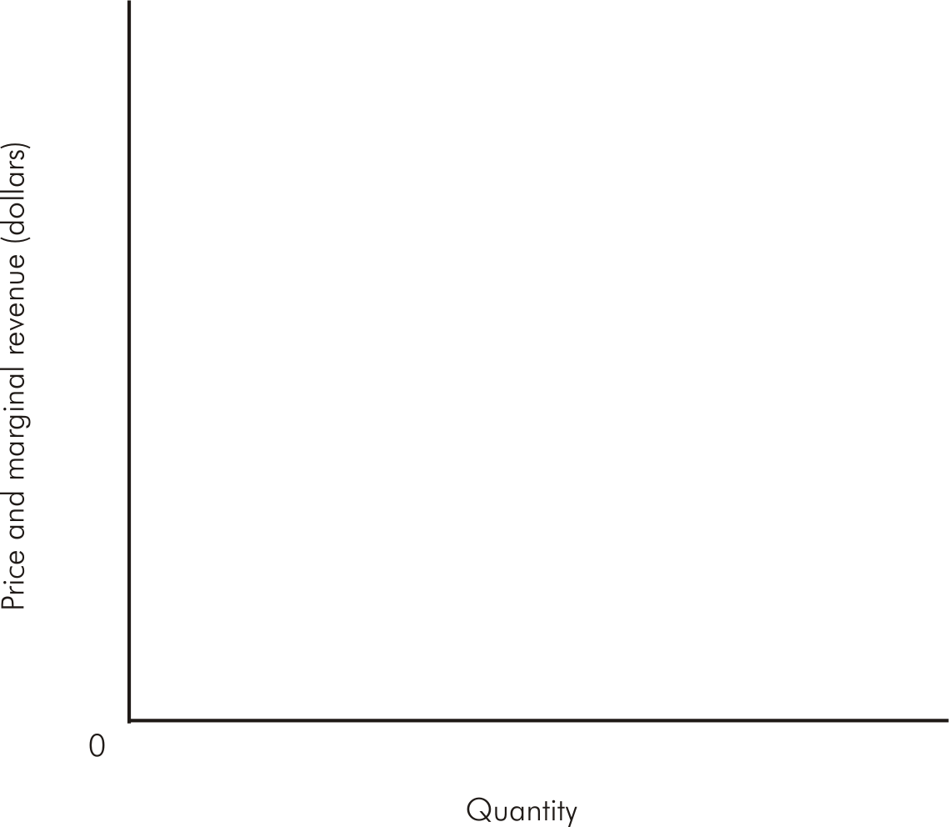
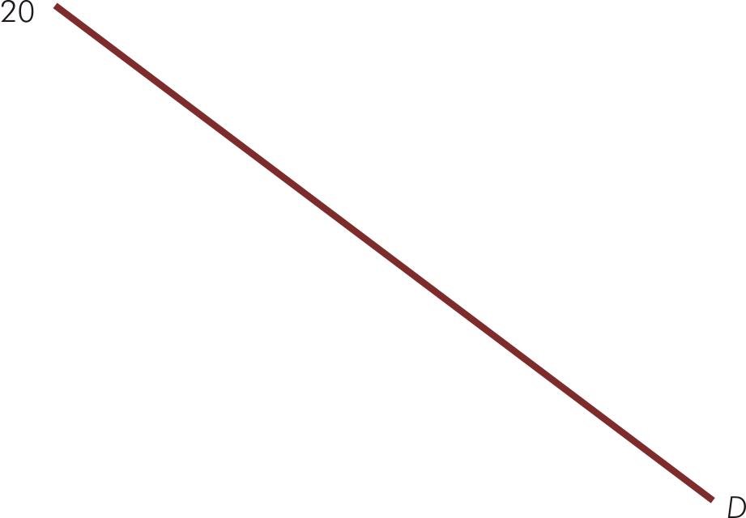
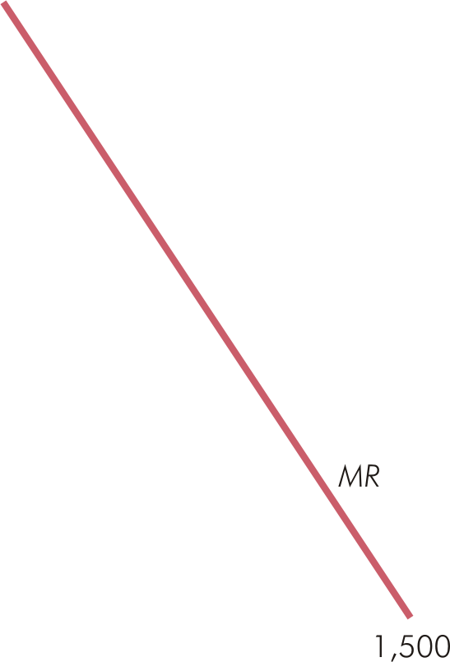
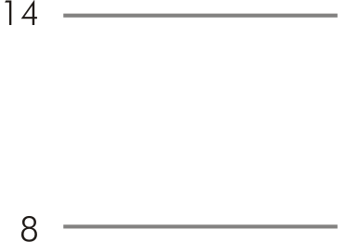


Demand & Marginal Revenue for a Monopolist (Figure 12.1)

Slide 26
Short-Run Profit Maximization for Monopoly
Monopolist will produce a positive output if some price on the demand curve exceeds average variable cost
Profit maximization or loss minimization occurs by producing quantity for which MR = MC

Slide 27
Short-Run Profit Maximization for Monopoly
If P > ATC, firm makes economic profit
If ATC > P > AVC, firm incurs loss, but continues to produce in short run
If demand falls below AVC at every level of output, firm shuts down & loses only fixed costs

Slide 28
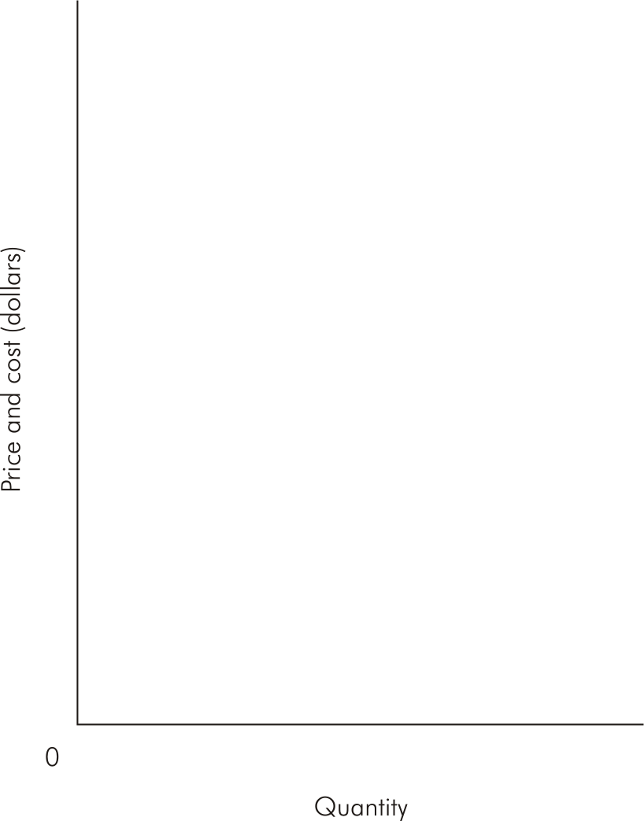
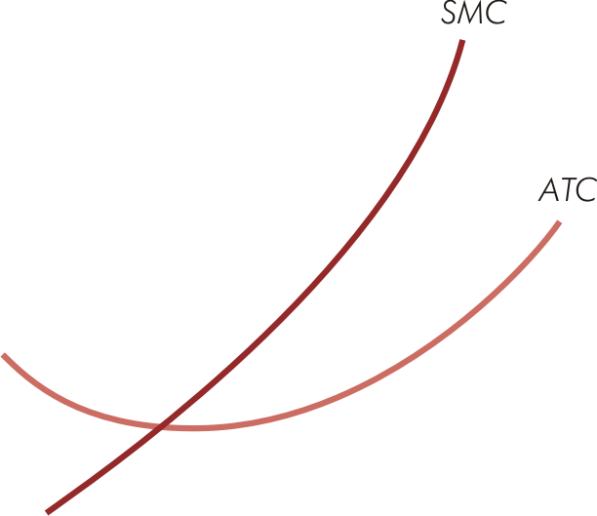
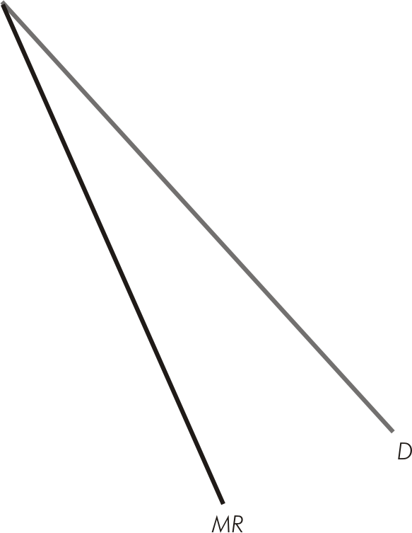
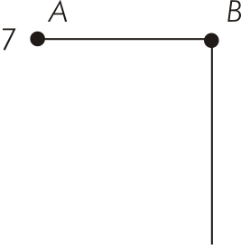


Short-Run Profit Maximization for Monopoly (Figure 12.3)

Slide 29
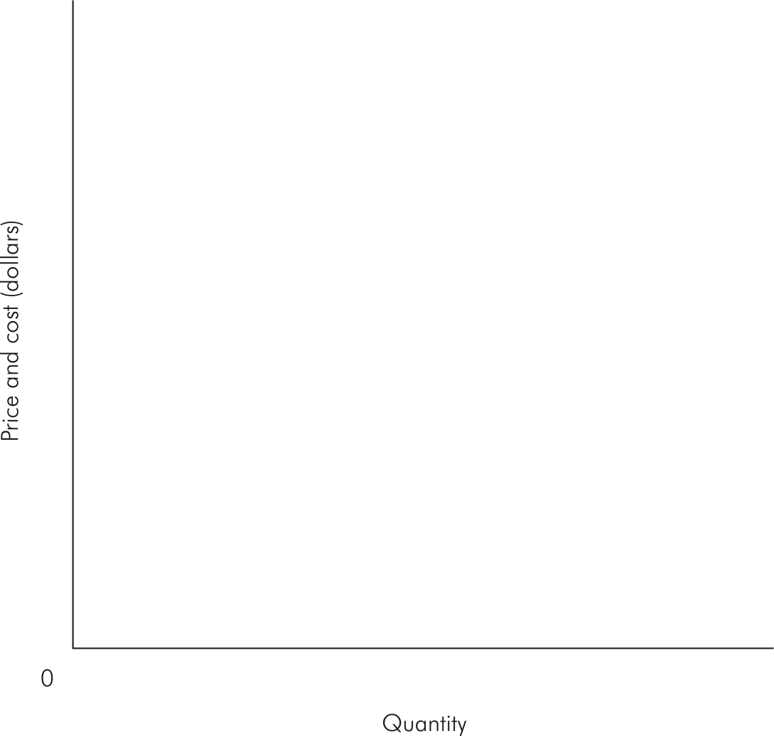
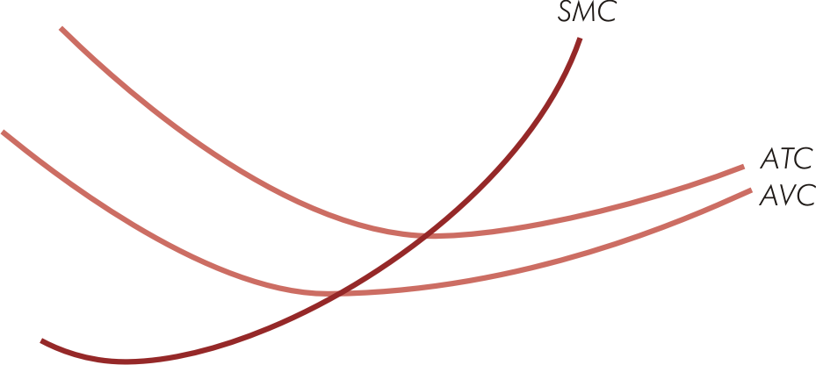
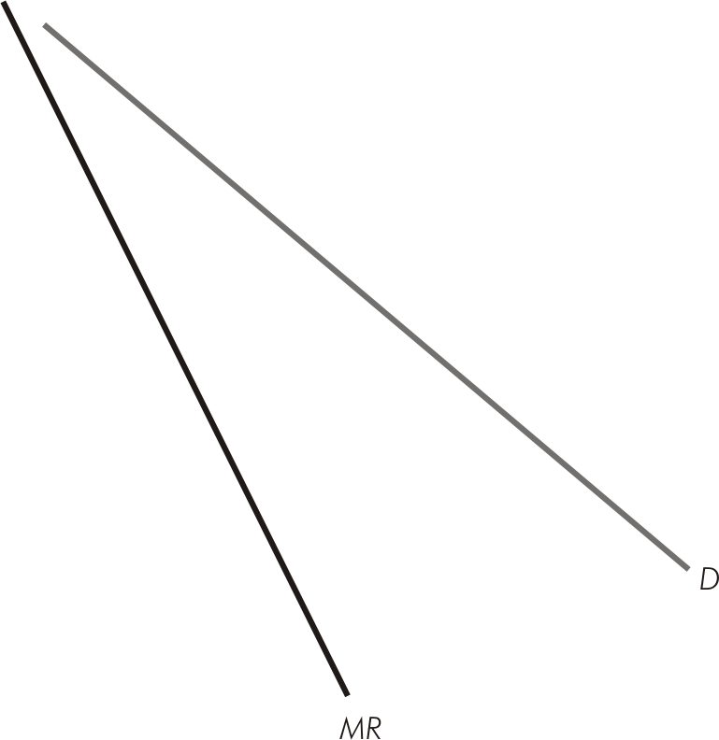
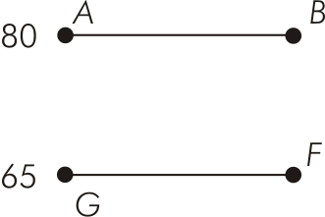

Short-Run Loss Minimization for Monopoly (Figure 12.4)

Slide 30
Long-Run Profit Maximization for Monopoly
Monopolist maximizes profit by choosing to produce output where MR = LMC, as long as P ≥ LAC
Will exit industry if P < LAC
Monopolist will adjust plant size to the optimal level
  Optimal plant is where the short-run average cost curve is tangent to the long-run average cost at the profit-maximizing output level

Slide 31

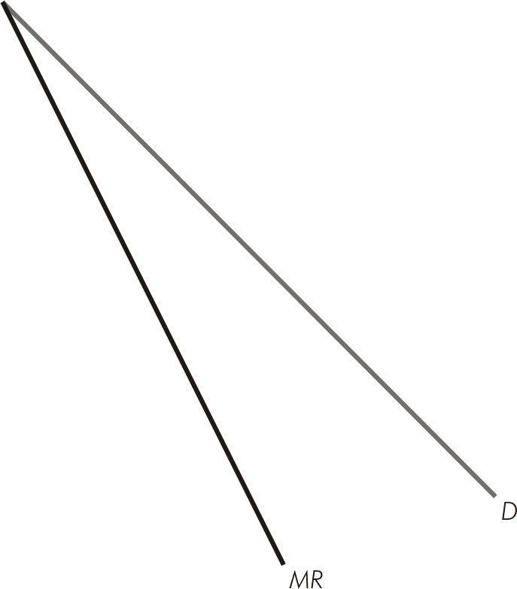
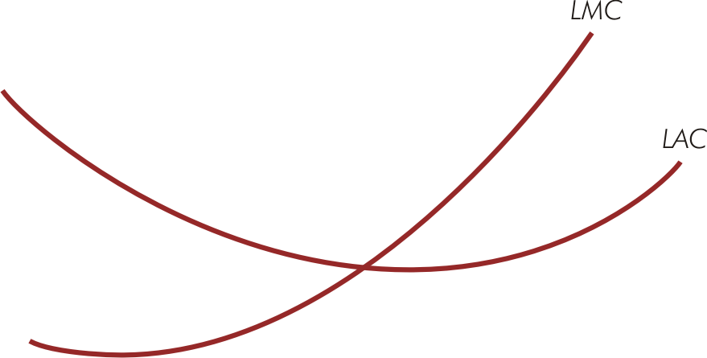

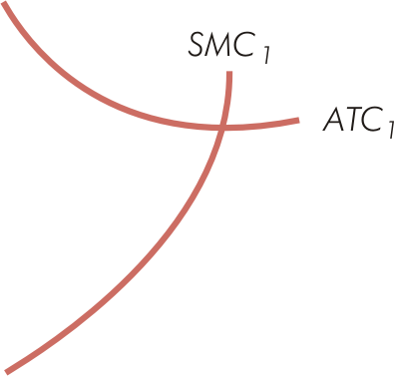


Long-Run Profit Maximization for Monopoly (Figure 12.5)

Slide 32
Monopolistic Competition
Large number of firms sell a differentiated product
  Products are close (not perfect) substitutes
Market is monopolistic
  Product differentiation creates a degree of market power
Market is competitive
  Large number of firms, easy entry

Slide 33
Monopolistic Competition
Short-run equilibrium is identical to monopoly
Unrestricted entry/exit leads to long-run equilibrium
  Attained when demand curve for each producer is tangent to LAC
  At equilibrium output, P = LAC and MR = LMC

Slide 34

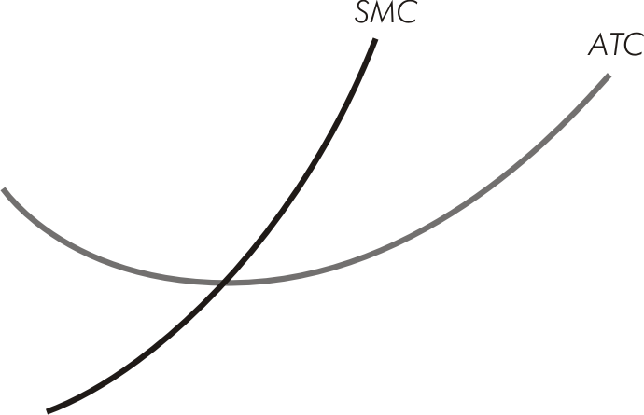
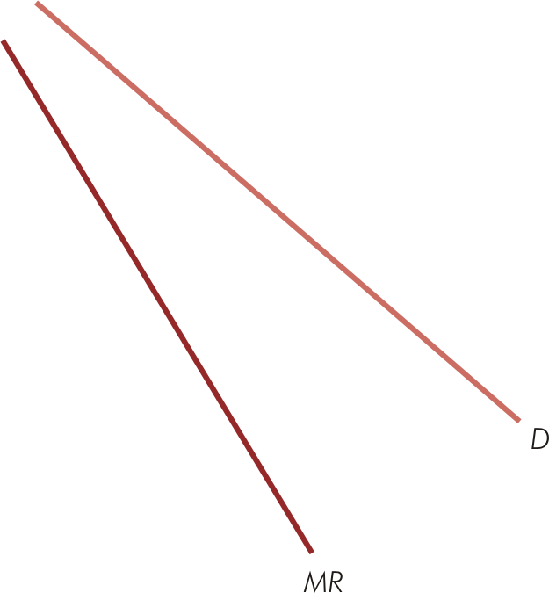


Short-Run Profit Maximization for Monopolistic Competition (Figure 12.7)

Slide 35
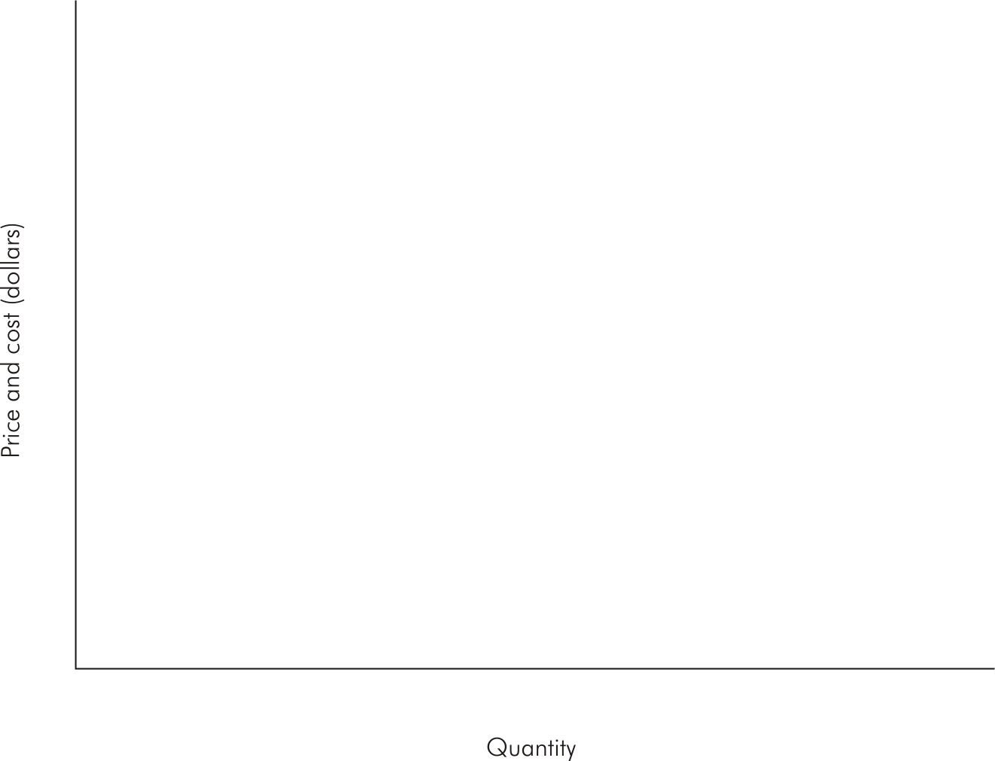
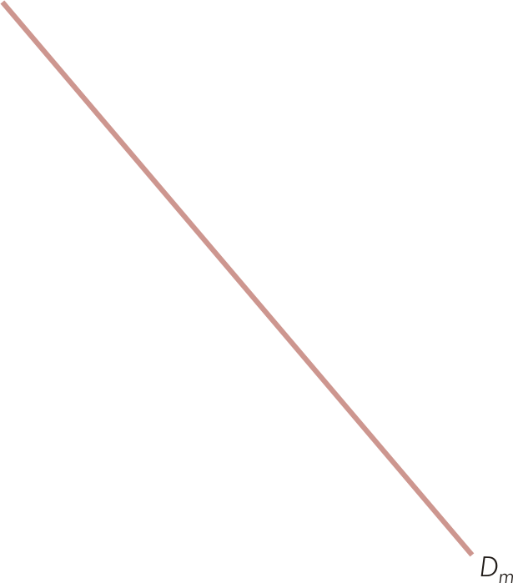
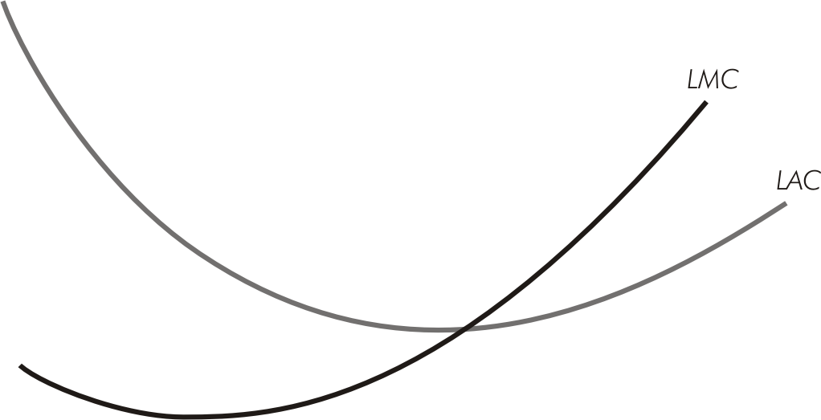
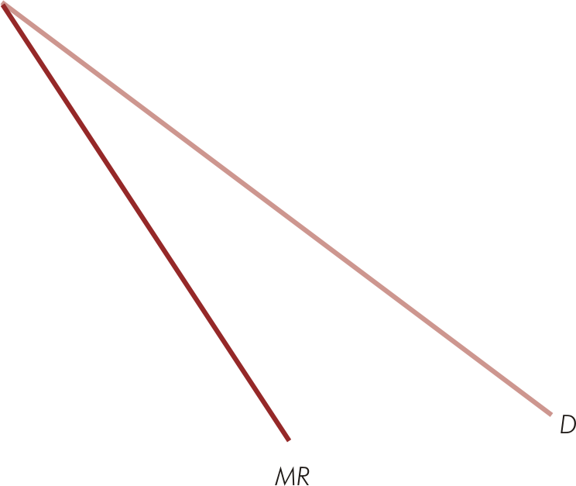
Long-Run Profit Maximization for Monopolistic Competition (Figure 12.8)

Slide 36
Multiple Plants
If a firm produces in 2 plants, A & B
  Allocate production so MC_{A} = MC_{B}
  Optimal total output is that for which MR = MC_{T}
For profit-maximization, allocate total output so that
  MR = MC_{T} = MC_{A} = MC_{B}

Slide 37

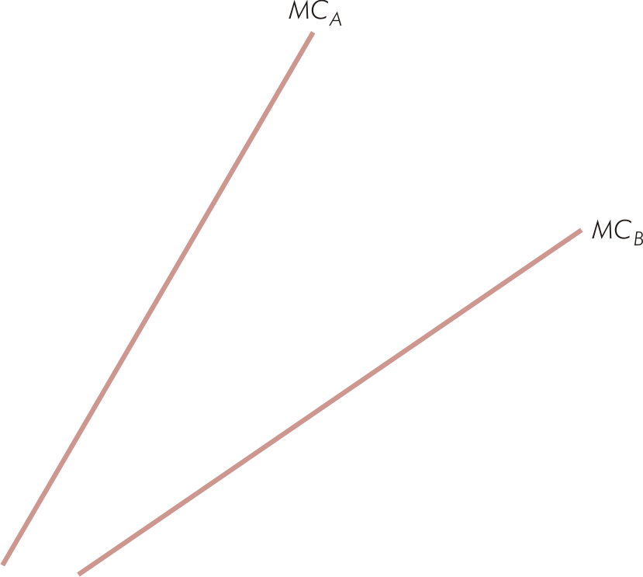
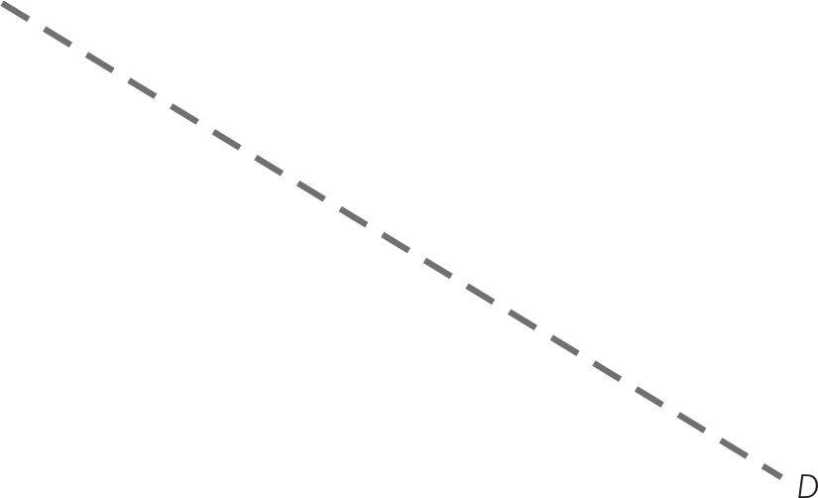
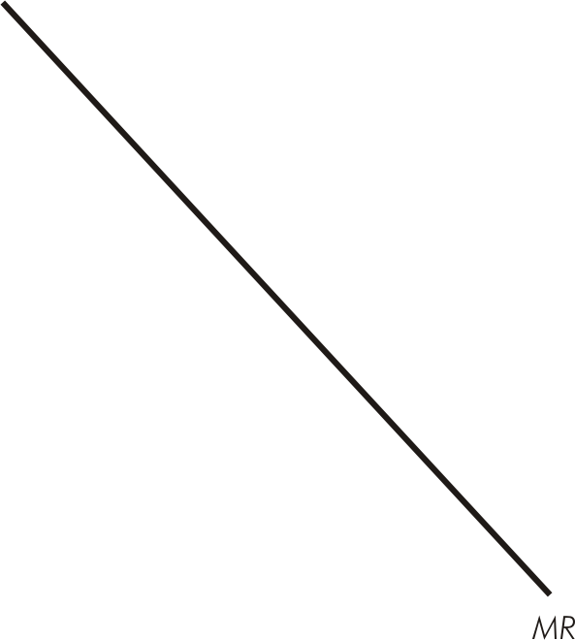
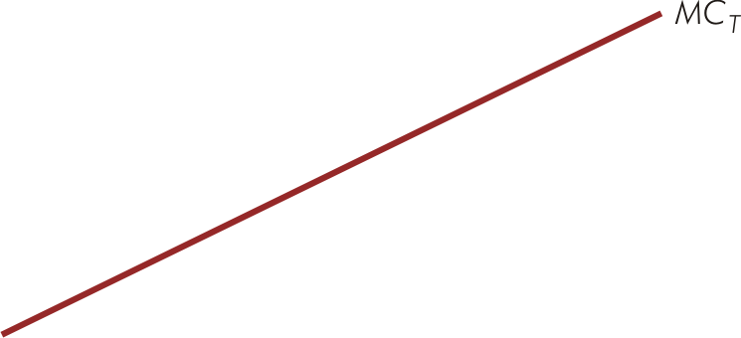
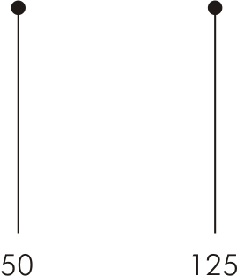
A Multiplant Firm (Figure 12.11)

Slide 38
Oligopoly Markets
Interdependence of firms’ profits
  Distinguishing feature of oligopoly
  Arises when number of firms in market is small enough that every firms’ price & output decisions affect demand & marginal revenue conditions of every other firm in market

Slide 39
Strategic Decisions
Strategic behavior
  Actions taken by firms to plan for & react to competition from rival firms
Game theory
  Useful guidelines on behavior for strategic situations involving interdependence

Slide 40
Simultaneous Decisions
Occur when managers must make individual decisions without knowing their rivals’ decisions

Slide 41
Dominant Strategies
Always provide best outcome no matter what decisions rivals make
When one exists, the rational decision maker always follows its dominant strategy
Predict rivals will follow their dominant strategies, if they exist
Dominant strategy equilibrium
  Exists when when all decision makers have dominant strategies

Slide 42
Prisoners’ Dilemma
All rivals have dominant strategies
In dominant strategy equilibrium, all are worse off than if they had cooperated in making their decisions

Slide 43
Prisoners’ Dilemma (Table 13.1)
 | Bill
 |  | Don’t confess | Confess
Jane | Don’t confess | A 2 years, 2 years | B 12 years, 1 year
 | Confess | C 1 year, 12 years | D 6 years, 6 years
B
J
J
B

Slide 44
Dominated Strategies
Never the best strategy, so never would be chosen & should be eliminated
Successive elimination of dominated strategies should continue until none remain
Search for dominant strategies first, then dominated strategies
  When neither form of strategic dominance exists, employ a different concept for making simultaneous decisions

Slide 45
Successive Elimination of Dominated Strategies (Table 13.3)
For Palace, high price never payoff (always yields lower profit no matter Castle’s choice)
 |  |  | Palace’s price
 |  |  | High ($10) | Medium ($8) | Low ($6)
Castle’s price |  | High ($10) | $1,000, $1,000 | $900, $1,100 | $500, $1,200
 |  | Medium ($8) | $1,100, $400 | $800, $800 | $450, $500
 |  | Low ($6) | $1,200, $300 | $500, $350 | $400, $400
Castle will not choose medium price (never yields highest profit no matter Palace’s choice)
Payoffs in dollars of profit per week.

Slide 46
Successive Elimination of Dominated Strategies (Table 13.3)
Reduced Payoff Table
Unique Solution
 | Palace’s price
 |  |  | Medium ($8) | Low ($6)
Castle’s price |  | High ($10) | $900, $1,100 | $500, $1,200
 |  | Low ($6) | $500, $350 | $400, $400
C
P
C
P
Payoffs in dollars of profit per week.

Slide 47
Making Mutually Best Decisions
For all firms in an oligopoly to be predicting correctly each others’ decisions:
  All firms must be choosing individually best actions given the predicted actions of their rivals, which they can then believe are correctly predicted
  Strategically astute managers look for mutually best decisions

Slide 48
Nash Equilibrium
Set of actions or decisions for which all managers are choosing their best actions given the actions they expect their rivals to choose
Strategic stability
  No single firm can unilaterally make a different decision & do better

Slide 49
Super Bowl Advertising: A Unique Nash Equilibrium (Table 13.4)
 |  |  | Pepsi’s budget
 |  |  | Low | Medium | High
Coke’s budget |  | Low | A $60, $45 | B $57.5, $50 | C $45, $35
 |  | Medium | D $50, $35 | E $65, $30 | F $30, $25
 |  | High | G $45, $10 | H $60, $20 | I $50, $40
C
P
P
C
C
P
Payoffs in millions of dollars of semiannual profit.

Slide 50
Nash Equilibrium
When a unique Nash equilibrium set of decisions exists
  Rivals can be expected to make the decisions leading to the Nash equilibrium
  With multiple Nash equilibria, no way to predict the likely outcome
All dominant strategy equilibria are also Nash equilibria
  Nash equilibria can occur without dominant or dominated strategies

Slide 51
Sequential Decisions
One firm makes its decision first, then a rival firm, knowing the action of the first firm, makes its decision
  The best decision a manager makes today depends on how rivals respond tomorrow

Slide 52
Game Tree
Shows firms decisions as nodes with branches extending from the nodes
  One branch for each action that can be taken at the node
  Sequence of decisions proceeds from left to right until final payoffs are reached
Roll-back method (or backward induction)
  Method of finding Nash solution by looking ahead to future decisions to reason back to the current best decision

Slide 53
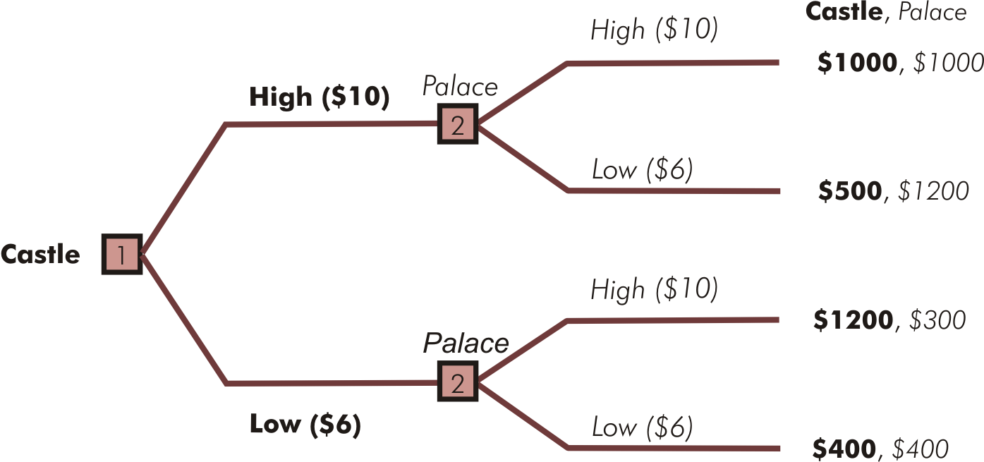
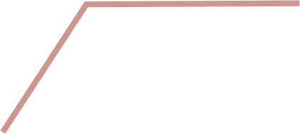



Sequential Pizza Pricing (Figure 13.3)
Panel B – Roll-back solution

Slide 54
First-Mover & Second-Mover Advantages
First-mover advantage
  If letting rivals know what you are doing by going first in a sequential decision increases your payoff
Second-mover advantage
  If reacting to a decision already made by a rival increases your payoff

Slide 55
First-Mover & Second-Mover Advantages
Determine whether the order of decision making can be confer an advantage
  Apply roll-back method to game trees for each possible sequence of decisions

Slide 56
First-Mover Advantage in Technology Choice (Figure 13.4)
 | Motorola’s technology
 |  |  | Analog | Digital
Sony’s technology |  | Analog | A $10, $13.75 | B $8, $9
 |  | Digital | C $9.50, $11 | D $11.875, $11.25
S
M
S
M
Panel A – Simultaneous technology decision

Slide 57
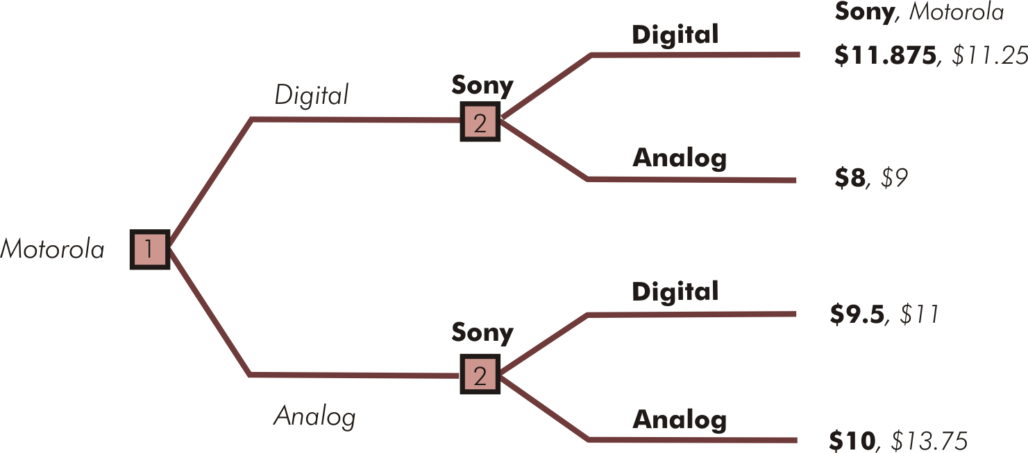




First-Mover Advantage in Technology Choice (Figure 13.4)
Panel B – Motorola secures a first-mover advantage

Slide 58
Strategic Moves
Actions used to put rivals at a disadvantage
Three types
  Commitments
  Threats
  Promises
Only credible strategic moves matter

Slide 59
Commitments
Managers announce or demonstrate to rivals that they will bind themselves to take a particular action or make a specific decision
  No matter what action or decision is taken by rivals

Slide 60
Threats & Promises
Conditional statements
Threats
  Explicit or tacit
  “If you take action A, I will take action B, which is undesirable or costly to you.”
Promises
  “If you take action A, I will take action B, which is desirable or rewarding to you.”

Slide 61
Cooperation in Repeated Strategic Decisions
Cooperation occurs when oligopoly firms make individual decisions that make every firm better off than they would be in a (noncooperative) Nash equilibrium

Slide 62
Cheating
Making noncooperative decisions
  Does not imply that firms have made any agreement to cooperate
One-time prisoners’ dilemmas
  Cooperation is not strategically stable
  No future consequences from cheating, so both firms expect the other to cheat
  Cheating is best response for each

Slide 63
Pricing Dilemma for AMD & Intel (Table 13.5)
 | AMD’s price
 |  |  | High | Low
Intel’s price |  | High | A: $5, $2.5 | B: $2, $3
 |  | Low | C: $6, $0.5 | D: $3, $1
Cooperation
AMD cheats
A
Intel cheats
Noncooperation
I
I
A
Payoffs in millions of dollars of profit per week.

Slide 64
Punishment for Cheating
With repeated decisions, cheaters can be punished
When credible threats of punishment in later rounds of decision making exist
  Strategically astute managers can sometimes achieve cooperation in prisoners’ dilemmas

Slide 65
Deciding to Cooperate
Cooperate
  When present value of costs of cheating exceeds present value of benefits of cheating
  Achieved in an oligopoly market when all firms decide not to cheat
Cheat
  When present value of benefits of cheating exceeds present value of costs of cheating

Slide 66
Deciding to Cooperate

Slide 67
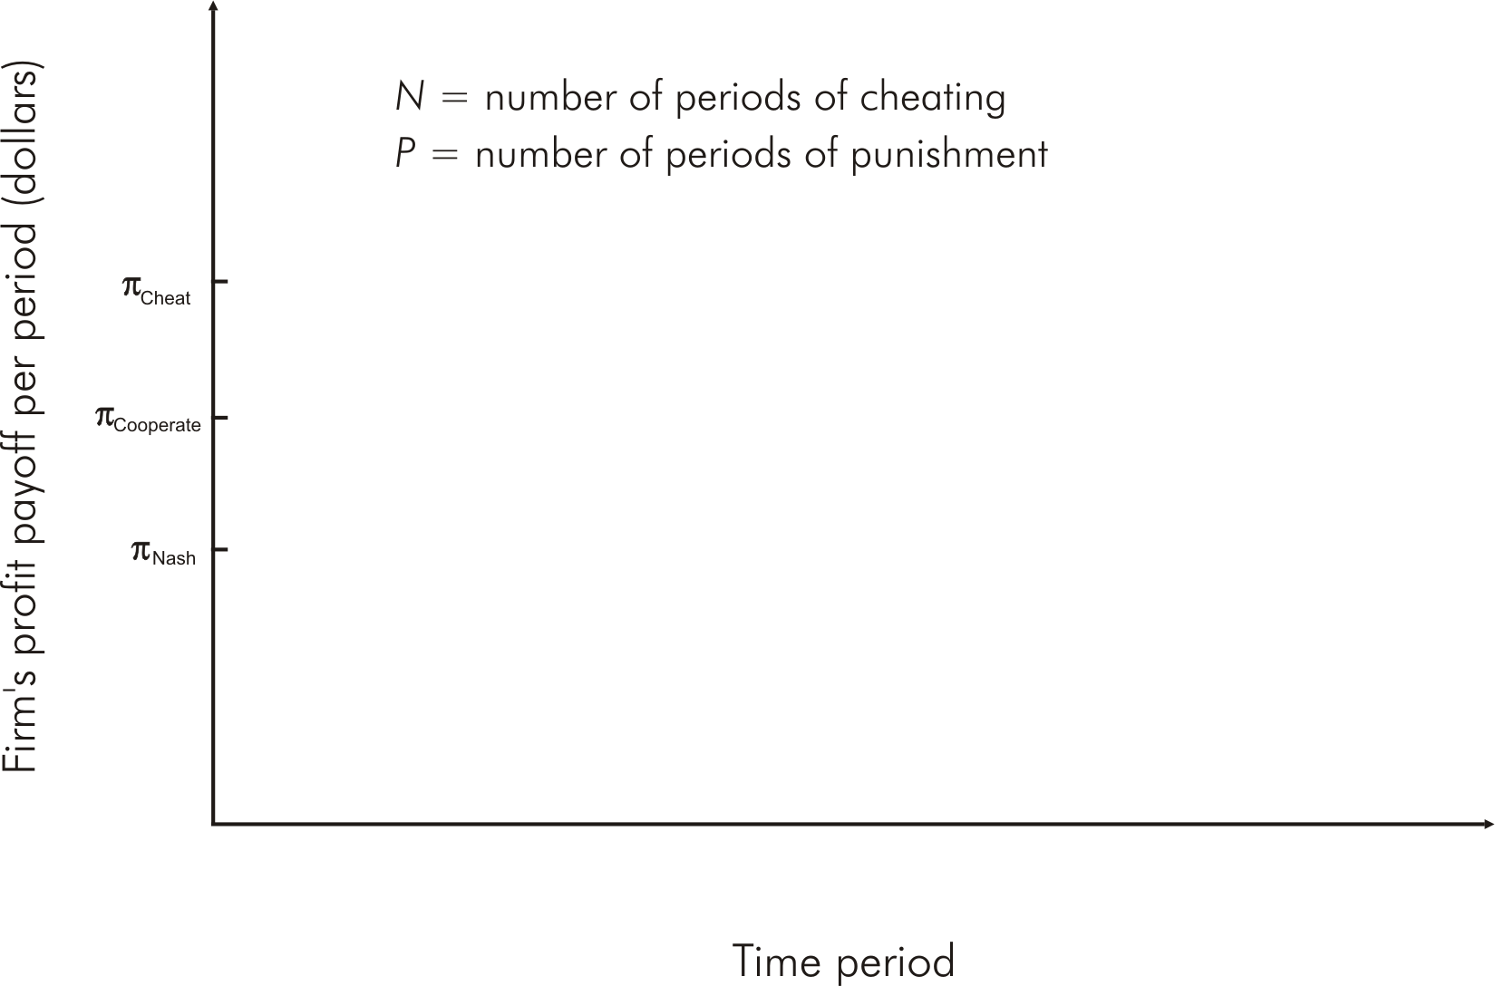
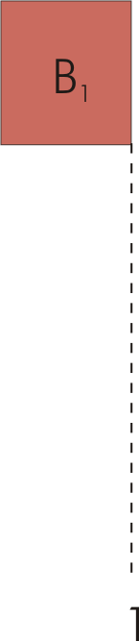
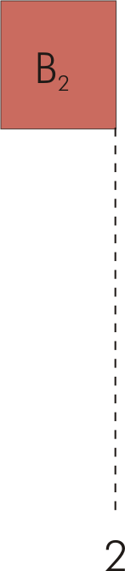
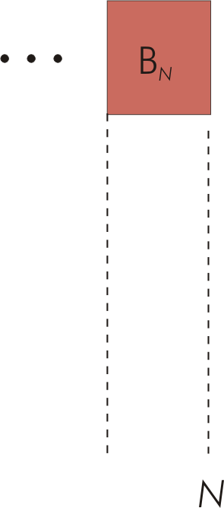
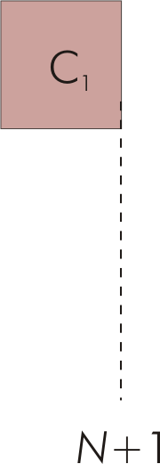
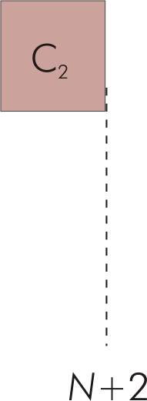
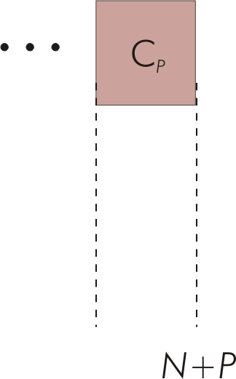
A Firm’s Benefits & Costs of Cheating (Figure 13.5)

Slide 68
Trigger Strategies
A rival’s cheating “triggers” punishment phase
Tit-for-tat strategy
  Punishes after an episode of cheating & returns to cooperation if cheating ends
Grim strategy
  Punishment continues forever, even if cheaters return to cooperation

Slide 69
Facilitating Practices
Legal tactics designed to make cooperation more likely
Four tactics
  Price matching
  Sale-price guarantees
  Public pricing
  Price leadership

Slide 70
Price Matching
Firm publicly announces that it will match any lower prices by rivals
  Usually in advertisements
Discourages noncooperative price-cutting
  Eliminates benefit to other firms from cutting prices

Slide 71
Sale-Price Guarantees
Firm promises customers who buy an item today that they are entitled to receive any sale price the firm might offer in some stipulated future period
  Primary purpose is to make it costly for firms to cut prices

Slide 72
Public Pricing
Public prices facilitate quick detection of noncooperative price cuts
  Timely & authentic
Early detection
  Reduces PV of benefits of cheating
  Increases PV of costs of cheating
  Reduces likelihood of noncooperative price cuts

Slide 73
Price Leadership
Price leader sets its price at a level it believes will maximize total industry profit
  Rest of firms cooperate by setting same price
Does not require explicit agreement
  Generally lawful means of facilitating cooperative pricing

Slide 74
Cartels
Most extreme form of cooperative oligopoly
Explicit collusive agreement to drive up prices by restricting total market output
Illegal in U.S., Canada, Mexico, Germany, & European Union

Slide 75
Cartels
Pricing schemes usually strategically unstable & difficult to maintain
  Strong incentive to cheat by lowering price
When undetected, price cuts occur along very elastic single-firm demand curve
  Lure of much greater revenues for any one firm that cuts price
  Cartel members secretly cut prices causing price to fall sharply along a much steeper demand curve

Slide 76
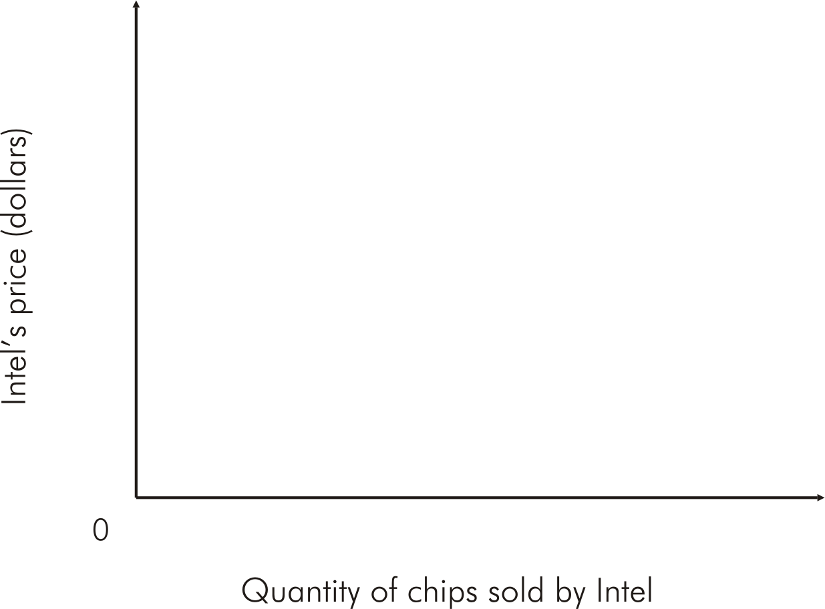

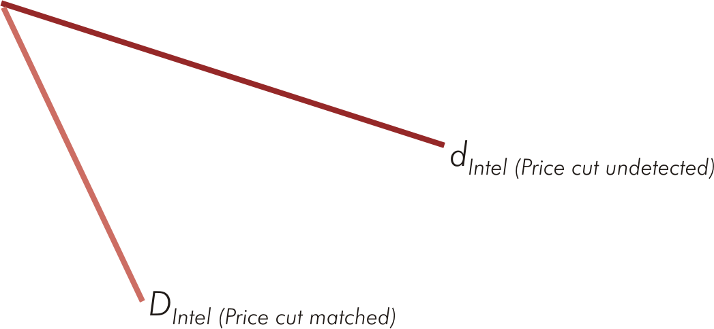



Intel’s Incentive to Cheat (Figure 13.6)

Slide 77
Tacit Collusion
Far less extreme form of cooperation among oligopoly firms
Cooperation occurs without any explicit agreement or any other facilitating practices

Slide 78
Strategic Entry Deterrence
Established firm(s) makes strategic moves designed to discourage or prevent entry of new firm(s) into a market
Two types of strategic moves
  Limit pricing
  Capacity expansion

Slide 79
Limit Pricing
Established firm(s) commits to setting price below profit-maximizing level to prevent entry
  Under certain circumstances, an oligopolist (or monopolist), may make a credible commitment to charge a lower price forever

Slide 80
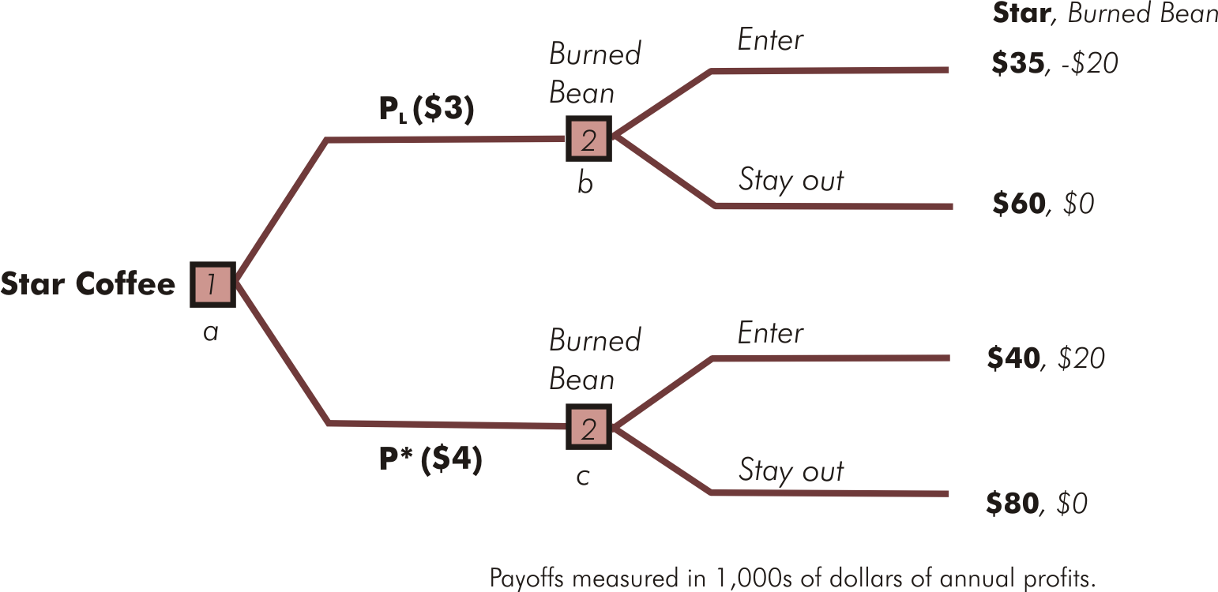

Limit Pricing: Entry Deterred (Figure 13.7)

Slide 81
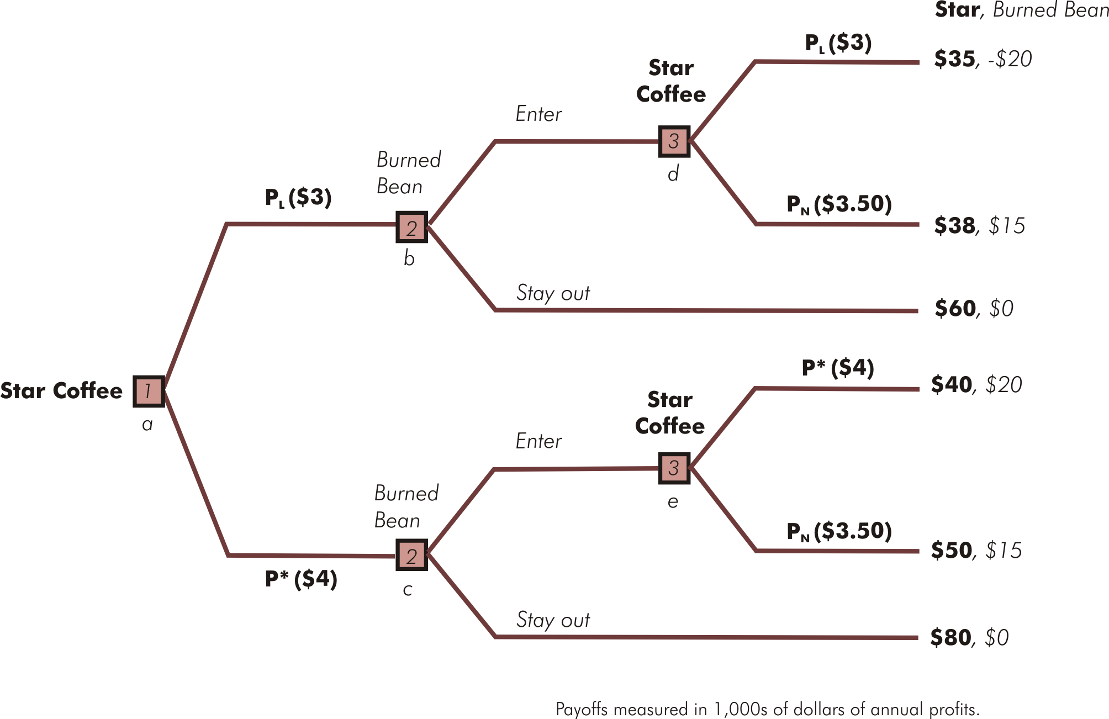






Limit Pricing: Entry Occurs (Figure 13.8)

Slide 82
Capacity Expansion
Established firm(s) can make the threat of a price cut credible by irreversibly increasing plant capacity
When increasing capacity results in lower marginal costs of production, the established firm’s best response to entry of a new firm may be to increase its own level of production
  Requires established firm to cut its price to sell extra output

Slide 83


Excess Capacity Barrier to Entry (Figure 13.9)

Slide 84




Excess Capacity Barrier to Entry (Figure 13.9)

