Slide 1
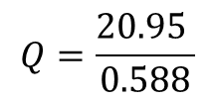
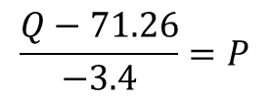
Meat Example – Revenue Maximization
$$Q=71.26−3.4P$$
Need to restate in P=f(Q) form
$$Q−71.26=−3.4P$$
$$\frac{Q−71.26}{−3.4}=P$$
$$P=20.95−0.294Q$$
$$TR=P∙Q=\left(20.95−0.294Q\right)Q=20.95Q−0.294Q^{2}$$
$$MR=\frac{dTR}{dQ}=20.95−0.588Q$$
$$MR=0=20.95−0.588Q$$
$$Q=\frac{20.95 }{0.588}$$
$$20.95−0.588Q=0$$
$$0.588Q=20.95$$
$$Q≈35$$

Slide 2
Meat Example – Revenue Maximization
To find price substitute Q=35 in this equation
$$P=20.95−0.294Q$$
$$P=20.95−0.294(35)$$
$$P=\$10.66$$
To find Total Revenue substitute Q=35 in this equation
$$TR=20.95Q−0.294Q^{2}$$
$$TR=20.95(35)−0.294{(35)}^{2}$$
$$TR≈373$$

