Slide 1
Gross Domestic Product

Slide 2
National Income Accounting is a system used to measure the aggregate income and expenditures for a nation
Gross Domestic Product (GDP) is the most widely reported measure of a nation’s economic performance
GDP measures the market value of all final goods and services produced in a nation during a period of time, usually a year
GDP measures value using dollars, rather than a list of the number of goods and services

Slide 3
Final Goods – finished goods and services produced for the ultimate user
Secondhand Transactions – used items
GDP does not include the sale of a used car
Intermediate Goods – goods and services used as inputs for production of final goods
Intermediate Good: General Motors purchasing tires to build a new car
Final Good: A person replacing worn out tires with new tires
To avoid double counting, GDP only measures final goods and services

Slide 4
Transfer Payments – a government payment to individuals, not in exchange for goods or services currently produced
Nonproductive Financial Transactions – gifts, stocks, bonds, or transfer payments
GDP does not count purely private or public financial transactions
GDP does not count transfer payments
Video

Slide 5
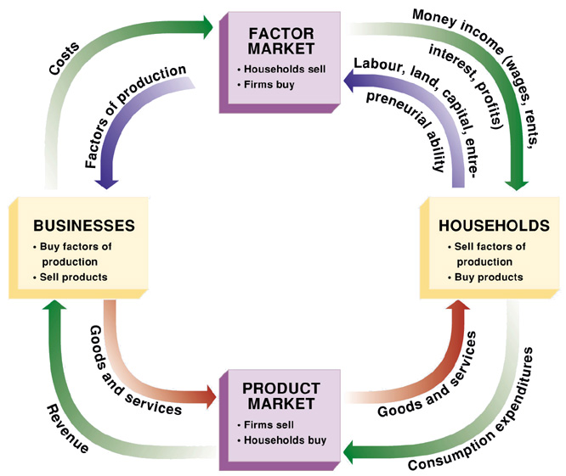
Circular Flow Model – A model that show us how all the pieces of the puzzle fit together
Flow – the rate of change in a quantity during a given time period
Stock – the quantity measured at one point in time
More complex Models
Financial markets
Government
Foreign markets
Video

Slide 6
Four Expenditures Sectors of GDP
Consumption (C)
Durable goods (excluding housing)
Nondurable goods
Services
Investment (I)
Fixed investment
Change in business inventory
Government (G)
Federal
State and Local
Foreign (X - M)
Exports (X)
Imports (M)
Video

Slide 7
Calculating GDP with expenditures – adding all the spending for final goods and services by the four sectors of GDP
GDP = C + I + G + (X - M)
Consumption (C) 12,692.7
Durable goods 1,390.0
Nondurable goods 2,695.4
Services 8,607.3
Investment (I) 2,987.5
Fixed investment 3,002.5
Change in business inventory -15.0
Government (G) 3,262.3
Federal 1,239.2
State and Local 2023.1
Foreign (X - M) -492.4
Exports (X) 2,209.7
Imports (M) 2,702.2
GDP 18,450.1
Source: www.bea.gov, end of year 2016, Q2

Slide 8
Income approach measures GDP by adding all incomes
Compensation of employees is income earned from wages, salaries, and certain supplements paid to labor
Rent income is rent and royalties received by property owners who permit others to use their assets
Profits
Proprietors’ income is all forms of income earned by unincorporated businesses
Corporate profit is all income earned by the stockholders of corporations regardless of whether stockholders receive it
Net interest is interest earned from loans to businesses
Indirect tax is a tax levied as a percentage of the price of a good sold and therefore collected as part of the revenue received by the firm
Depreciation is an allowance for the capital worn out producing GDP

Slide 9
Calculating GDP with incomes – adding all the income sources
Employee compensation 10,017.6
Rental income 700.6
Profits 3,021.2
Proprietors’ income 1,407.8
Corporate profits 1,613.4
Net interest 672.8
Business taxes 543.9
Depreciation 2,901.8
Discrepancy 592.2
GDP 18,450.1
Source: www.bea.gov, end of year 2016, Q2

Slide 10
Shortcomings of GDP
Nonmarket transactions
Householder
Do it yourself
Distribution, kind, & quality of products
Tank vs. Bulldozer
1960s Television vs. 2010 Television
Neglect of leisure time
Underground economy
Gambling
Drugs
Prostitution
Economic bads
War
Earth quake

Slide 11
Disposable Personal Income (DI) is the amount of income that households have to spend or save after payment of personal taxes
National Income (NI) is the total earned by resource owners, including wages, rents, interest, and profits
Personal Income (PI) is the total income received by households that is available for consumption, saving, and payment of personal taxes
Gross domestic product (GDP) 18,450.1
Depreciation -2501.3
National Income (NI) 15,948.8
Corporate profits -2,021.0
Contributions for Social Security -1,239.7
Transfer payments and other income 3,205.1
Personal Income (PI) 15,893.2
Personal Tax -1,945.2
Disposable personal income 13,948.0
Source: www.bea.gov, end of year 2016, Q2

Slide 12
Nominal GDP is the value of all final goods based on the prices existing during the time period of production
Real GDP is the value of all final goods produced during a given time period based on the prices existing in a selected base year
Chain Price Index is a measure that compares changes in the prices of all final goods during a given period to the prices of those goods in a base year
Video

Slide 13
Nominal GDP vs. Real GDP
Nominal GDP: Year = 2010
10 apples x $1.00 = $10.00
10 oranges x $2.00 = $20.00
10 bananas x $1.50 = $15.00
GDP $45.00
Nominal GDP report economics output in current year dollars with may not be a representation of “real” economics growth
Nominal GDP: Year = 2011
10 apples x $1.40 = $14.00
8 oranges x $2.25 = $18.00
10 bananas x $1.70 = $18.00
GDP $50.00
Nominal 2011 GDP increased by $5.00 over 2011 because price increases not because the economy created more output
Real GDP: Year = 2011
10 apples x $1.00 = $10.00
8 oranges x $2.00 = $16.00
10 bananas x $1.50 = $15.00
GDP $41.00
Real 2011 GDP stated in 2010 prices illustrates 2011 economic output declined relative to 2010 output

Slide 14
Nominal and Real GDP Estimates
Year | Nominal GDP* | Chain Price Index | Real GDP**
2005 | 13,094 | 92.0 | 14,234
2006 | 13,856 | 94.8 | 14,614
2007 | 14,478 | 97.3 | 14,874
2008 | 14,719 | 99.3 | 14,830
2009 | 14,419 | 100.0 | 14,419
2010 | 14,964 | 101.2 | 14,784
2011 | 15,518 | 103.3 | 15,021
2012 | 16,155 | 105.2 | 15,355
2013 | 16,692 | 106.9 | 15,612
2014 | 17,393 | 108.8 | 15,982
2015 | 18,037 | 110.0 | 16,397
Nominal GDP
Real GDP
*GDP in billions of current dollars
**GDP in billions of chained 2009 dollars
Real GDP 2010 calculation
nominal GDP x 100
GDP chain price index
18,037 x 100
90.9
Real GDP =
=
= 16,397
Video

