Slide 1
Homework Five
This homework flows well with
Statistics for Business and Economics, Anderson, Sweeney, and Williams, 13th edition, chapter 9.

Slide 2
Problem One:
The manager of the Danvers-Hilton Resort Hotel stated that the mean guest bill for a weekend is $600 or less. A member of the hotel’s accounting staff noticed that the total charges for guest bills have been increasing in recent months. The accountant will use a sample of further weekend guest bills to test the manager’s claim.
Which form of the hypotheses should be used to test the manager’s claim?
Explain.
H0: m $≥$ 600 H0: m $≤$ 600 H0: m $=$ 600
Ha: m $<$ 600 Ha: m $>$ 600 Ha: m $>≠$ 600
b. What conclusion is appropriate when H0 cannot be rejected?
c. What conclusion is appropriate when H0 can be rejected?

Slide 3
Problem Two:
The label on a 3-quart container of orange juice states that the orange juice contains an average of 1 gram of fat or less. Answer the following questions for a hypothesis test that could be used to test the claim on the label.
a. Develop the appropriate null and alternative hypotheses.
b. What is the Type I error in this situation? What are the consequences of making this error?
c. What is the Type II error in this situation? What are the consequences of making this error?

Slide 4
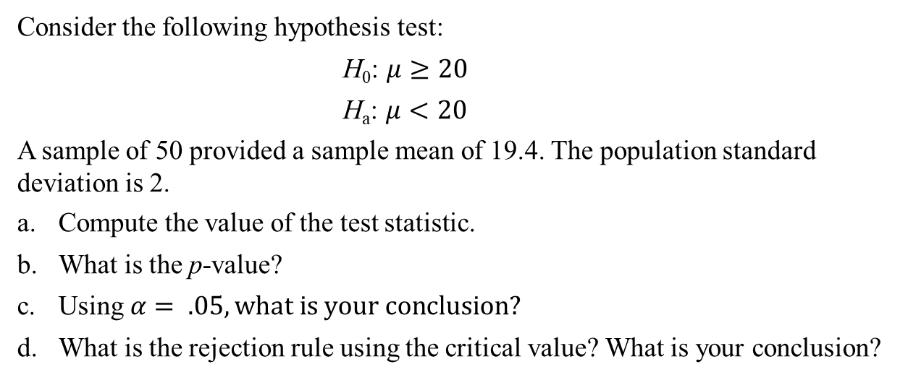
Problem Three:
Consider the following hypothesis test:
H₀: $μ≥20$
H_{a}: $μ<20$
A sample of 50 provided a sample mean of 19.4. The population standard deviation is 2.
a. Compute the value of the test statistic.
b. What is the p-value?
c. Using $α= .05, what is your conclusion?$
d. What is the rejection rule using the critical value? What is your conclusion?

Slide 5
Problem Four:
Consider the following hypothesis test:
H0: µ≥80
Ha: µ<80
A sample of 100 is used and the population standard deviation is 12. Compute the p-value and state your conclusion for each of the following sample results. Use $α$ = .01.
$\overline{x}$ = 78.5
$\overline{x}$ = 77
$\overline{x}$ = 75.5
d. $\overline{x}$ = 81

Slide 6
Problem Five:
Annual expenditure for prescription drugs was $838 per person in the Northeast of the country (Hospital Care Cost Institute website, November 7, 2012). A sample of 60 individuals in the Midwest showed a per person annual expenditure for prescription drugs of $745. Use a population standard deviation of $300 to answer the following questions.
a. Formulate hypotheses for a test to determine whether the sample data support the conclusion that the population annual expenditure for prescription drugs per person is lower in the Midwest than in the Northeast.
b. What is the value of the test statistic?
c. What is the p-value?
d. At α = .01, what is your conclusion?

Slide 7
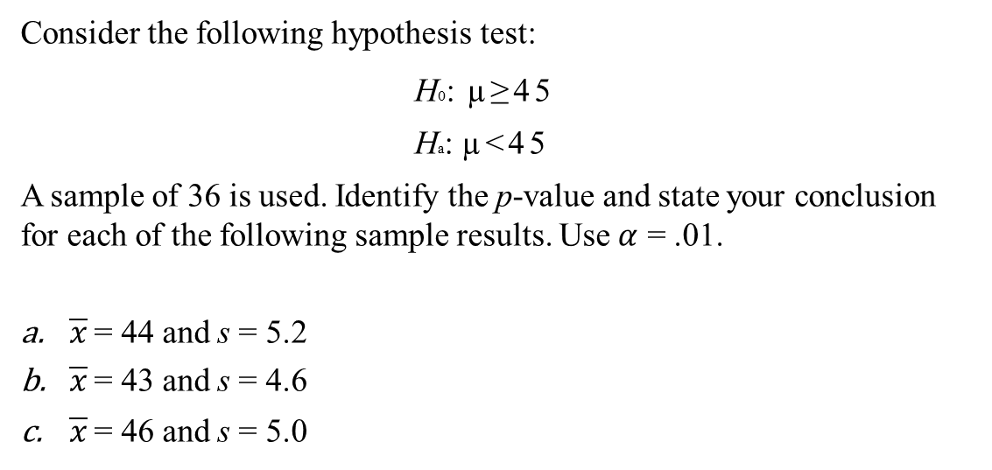
Problem Six:
Consider the following hypothesis test:
H0: µ≥45
Ha: µ<45
A sample of 36 is used. Identify the p-value and state your conclusion for each of the following sample results. Use $α$ = .01.
$\overline{x}$ = 44 and s = 5.2
$\overline{x}$ = 43 and s = 4.6
$\overline{x}$ = 46 and s = 5.0

Slide 8
Problem Seven:
The Coca-Cola Company reported that the mean per capita annual sales of its beverages in the United States was 423 eight-ounce servings (Coca-Cola Company website, February 3, 2009). Suppose you are curious whether the consumption Coca-Cola beverages higher in Atlanta, Georgia, the location of Coca-Cola’s corporate headquarters. A sample of 36 individuals from the Atlanta area showed a sample mean annual consumption of 460.4 eight-ounce servings with a standard deviation of s = 101.9 ounces. Using α = .05, do the sample results support the conclusion that mean annual consumption of Coca-Cola beverage products are higher in Atlanta?

Slide 9
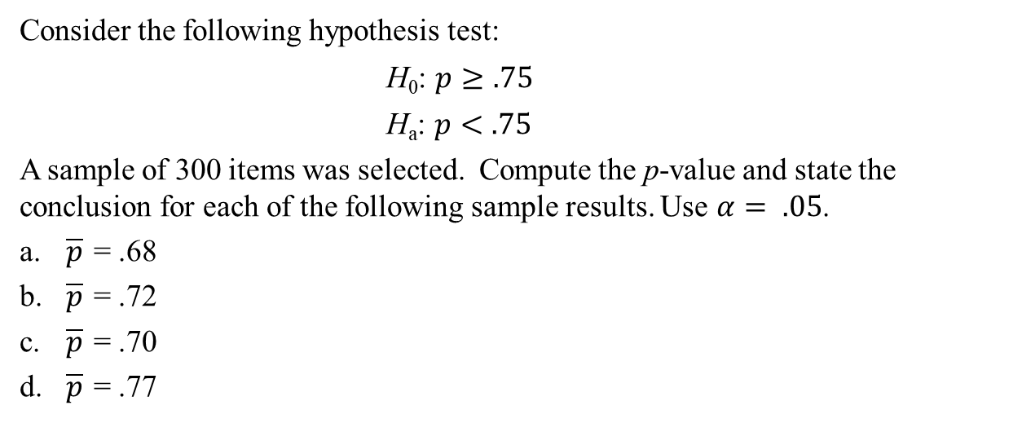
Problem Eight:
Consider the following hypothesis test:
H₀: $p≥.75$
H_{a}: $p<.75$
A sample of 300 items was selected. Compute the p-value and state the conclusion for each of the following sample results. Use $α= .05$.
a. $\overline{p}$ = .68
b. $\overline{p}$ = .72
c. $\overline{p}$ = .70
d. $\overline{p}$ = .77

Slide 10
Problem Nine:
The U.S. Bureau of Labor Statistic reports that 11.3% of U.S. workers belong to unions (BLS website, January 2014). Suppose a sample of 400 U.S. workers is collected in 2014 to determine whether union efforts to organize have increased union membership.
a. Formulate the hypotheses that can be used to determine whether union membership increased in 2014.
b. If the sample results show that 52 of the workers belonged to unions, what is the p-value for your hypothesis test?
c. At α = .05, what is your conclusion?

