Slide 1
Business Statistics
Interval Estimation
This lecture flows well with
Statistics for Business and Economics, Anderson, Sweeney, and Williams, 13th edition, chapter 8.

Slide 2
Interval Estimation
Population Mean: σ Known
Population Mean: σ Unknown
Determining the Sample Size
Population Proportion

Slide 3
Margin of error and the Interval Estimate
A point estimator cannot be expected to provide the exact value of the population parameter.
An interval estimate can be computed by adding and subtracting a margin of error to the point estimate.
Point estimate $±$ Margin of error
The purpose of an interval estimate is to provide information about how close the point estimate, is to the value of the parameter.
The general form of an interval estimate of a population mean is
$\overline{x}$ + Margin of error

Slide 4
Interval Estimate of a Population Mean: σ Known
In order to develop an interval estimate of a population mean, the margin of error must be computed using either:
the population standard deviation σ , or
the sample standard deviation s
σ is rarely known exactly. But often a good estimate can be obtained based on historical data or other information.
We refer to such cases as the σ known case.

Slide 5
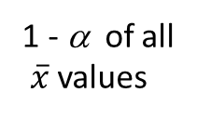
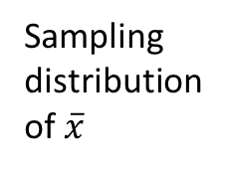
Interval Estimate of a Population Mean: σ Known
There is a 1 - α probability that the value of a sample mean will provide a margin of error of $z_{α/2}σ_{\overline{x}}$ or less.
Sampling
distribution
of $\overline{x}$
1 - α of all
$\overline{x}$ values
α/2
α/2
$$\overline{x}$$
μ
$$\overset{←}{} z_{α/2}σ_{\overline{x}} \overset{→}{}$$
$$\overset{←}{} z_{α/2}σ_{\overline{x}} \overset{→}{}$$

Slide 6
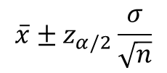
Interval Estimate of a Population Mean: σ Known
Interval Estimate of μ
$$\overline{x}{± z}_{α/2}\frac{σ}{\sqrt{n}}$$
where: $\overline{x}$ is the sample mean
1 - α is the confidence coefficient
z_{α/2} is the z value providing an area of
α/2 in the upper tail of the standard
normal probability distribution
σ is the population standard deviation
n is the sample size

Slide 7
Interval Estimate of a Population Mean: σ Known
Values of z_{α/2} for the Most Commonly Used Confidence Levels
Confidence Table
Level α α/2 Look-up Area z_{α/2}
90% .10 .05 .9500 1.645
95% .05 .025 .9750 1.960
99% .01 .005 .9950 2.576

Slide 8
Meaning of Confidence
Because 95% of all the intervals constructed using $\overline{x }$+ $1.96σ_{\overline{x} }$will contain the population mean, we say we are 95% confident that the interval $\overline{x }$+ $1.96σ_{\overline{x} }$includes the population mean μ.
We say that this interval has been established at the 95% confidence level.
The value .95 is referred to as the confidence coefficient.

Slide 9
Interval Estimate of a Population Mean: σ Known
Example: Statistics State University
Statistics State University has 4,000 students on campus. The university is considering a new scholarship program to retain students from households with average income at the university.
A sample of 50 student applications was taken; the sample mean income is $38,500. The population is not believed to be highly skewed. The population standard deviation is estimated to be $2,500, and the confidence coefficient to be used in the interval estimate is .95.

Slide 10
Interval Estimate of a Population Mean: σ Known
Example: Statistics State University
95% of the sample means that can be observed are within + 1.96 $σ_{\overline{x}}$ of the population mean μ. The margin of error is:
$$z_{α/2}\frac{σ}{\sqrt{n}}=1.96\left(\frac{\$2,500}{\sqrt{50}}\right)= \$692.96$$
Thus at 95% confidence, the margin of error is $692.96.
$38,500 + $692.96
or
$37,807.04 to $39,192.96
Interval estimate of μ is:
We are 95% confident that the interval contains the population mean.

Slide 11
Interval Estimate of a Population Mean: σ Known
Example: Statistics State University
Confidence Margin
level of error Interval estimate
90% $581.60 $37,918.40 - $39,081.60
95% $692.96 $37,807.04 - $39,192.96
99% $910.75 $37,589.25 - $39,410.75
In order to have a higher degree of confidence, the margin of error and thus the width of the confidence interval must be larger.

Slide 12
Interval Estimate of a Population Mean: σ Known
Adequate Sample Size
In most applications, a sample size of n$≥$ 30 is adequate.
If the population distribution is highly skewed or contains outliers, a sample size of 50 or more is recommended.
If the population is not normally distributed but is roughly symmetric, a sample size as small as 15 will suffice.
If the population is believed to be at least approximately normal, a sample size of less than 15 can be used.

Slide 13
Interval Estimate of a Population Mean: σ Unknown
If an estimate of the population standard deviation σ cannot be developed prior to sampling, we use the sample standard deviation s to estimate σ .
This is the σ unknown case.
In this case, the interval estimate for μ is based on the t distribution*.
(We’ll assume for now that the population is normally distributed.)
*William Gosset, a graduate of Oxford in mathematics, is the founder of the t distribution.

Slide 14
t Distribution
The t distribution is a family of similar probability distributions.
A specific t distribution depends on a parameter known as the degrees of freedom.
Degrees of freedom refer to the number of independent pieces of information that go into the computation of s.
A t distribution with more degrees of freedom has less dispersion.
As the degrees of freedom increases, the difference between the t distribution and the standard normal probability distribution becomes smaller and smaller.

Slide 15
t Distribution
Standard
normal
distribution
t distribution
(20 degrees
of freedom)
t distribution
(10 degrees
of freedom)
z, t
0

Slide 16
t Distribution
Degrees
Area in Upper Tail
of Freedom
.20
.10
.05
.025
.01
.005
.
.
.
.
.
.
.
50
.849
1.299
1.676
2.009
2.403
2.678
60
.848
1.296
1.671
2.000
2.390
2.660
80
.846
1.292
1.664
1.990
2.374
2.639
100
.845
1.290
1.660
1.984
2.364
2.626
$$∞$$
.842
1.282
1.645
1.960
2.326
2.576
For more than 100 degrees of freedom, the standard normal z value provides a good approximation to the t value.
The standard normal z values can be found in the infinite degrees ($∞$ ) row of the t distribution table.

Slide 17

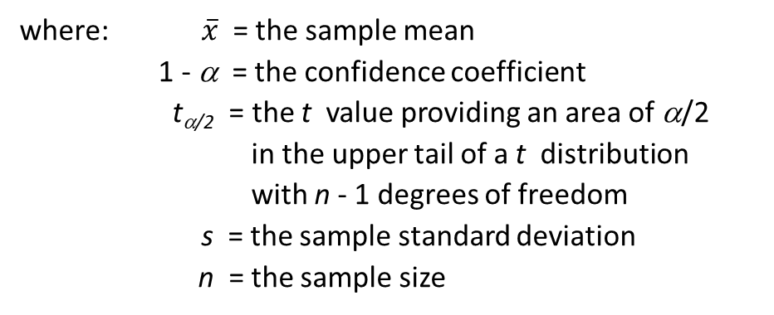
Interval Estimate of a Population Mean: σ Unknown
Interval Estimate
$$\overline{x}{ ± t}_{α/2}\frac{s}{\sqrt{n}}$$
where: $\overline{x}$ = the sample mean
1 - α = the confidence coefficient
t_{α/2} = the t value providing an area of α/2
in the upper tail of a t distribution
with n - 1 degrees of freedom
s = the sample standard deviation
n = the sample size

Slide 18
Interval Estimate of a Population Mean: σ Unknown
Example: Apartment Rents
A reporter for a student newspaper is writing an article on the cost of off-campus housing. A sample of 16 one-bedroom apartments within a half-mile of campus resulted in a sample mean of $750 per month and a sample standard deviation of $55.
Let us provide a 95% confidence interval estimate of the mean rent per month for the population of one-bedroom apartments within a half-mile of campus. We will assume this population to be normally distributed.

Slide 19
Interval Estimate of a Population Mean: σ Unknown
At 95% confidence, α = .05, and α/2 = .025.
t_{.025} is based on n - 1 = 16 - 1 = 15 degrees of freedom.
Degrees
Area in Upper Tail
of Freedom
.20
.10
.05
.025
.01
.005
15
.866
1.341
1.753
2.131
2.602
2.947
16
.865
1.337
1.746
2.120
2.583
2.921
17
.863
1.333
1.740
2.110
2.567
2.898
18
.862
1.330
1.734
2.101
2.520
2.878
19
.861
1.328
1.729
2.093
2.539
2.861
.
.
.
.
.
.
.

Slide 20
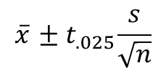
Interval Estimate of a Population Mean: σ Unknown
Interval Estimate
$$\overline{x}{ ± t}_{.025}\frac{s}{\sqrt{n}}$$
750 + 2.131$\frac{55}{\sqrt{16}}$ = 750 + 29.30
We are 95% confident that the mean rent per month for the population of one-bedroom apartments within a half-mile of campus is between $720.70 and $779.30.

Slide 21
Interval Estimate of a Population Mean: σ Unknown
Adequate Sample Size
Usually, a sample size of n $≥$ 30 is adequate when using the expression $\overline{x}±t_{α/2}s/\sqrt{n}$ to develop an interval estimate of a population mean.
If the population distribution is highly skewed or contains outliers, a sample size of 50 or more is recommended.
If the population is not normally distributed but is roughly symmetric, a sample size as small as 15 will suffice.
If the population is believed to be at least approximately normal, a sample size of less than 15 can be used.

Slide 22


Summary of Interval Estimation Procedures
for a Population Mean
Can the
population standard
deviation σ be assumed
known ?
Yes
No
Use the sample
standard deviation
s to estimate σ
Use
Use
$$\overline{x}{± z}_{α/2}\frac{σ}{\sqrt{n}}$$
σ Known
Case
σ Unknown
Case
$$\overline{x}{ ± t}_{α/2}\frac{s}{\sqrt{n}}$$

Slide 23
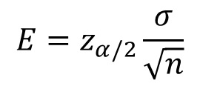
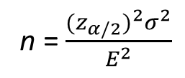
Sample Size for an Interval Estimate of a Population Mean
Let E = the desired margin of error.
E is the amount added to and subtracted from the point estimate to obtain an interval estimate.
If a desired margin of error is selected prior to sampling, the sample size necessary to satisfy the margin of error can be determined.
Margin of error
$$E=z_{α/2}\frac{σ}{\sqrt{n}}$$
Necessary Sample Size
n = $\frac{(z_{α/2})^{2}σ^{2}}{E^{2}}$

Slide 24
Sample Size for an Interval Estimate of a Population Mean
The Necessary Sample Size equation requires a value for the population standard deviation σ .
If σ is unknown, a preliminary or planning value for σ can be used in the equation.
1. Use the estimate of the population standard deviation computed in a previous study.
2. Use a pilot study to select a preliminary sample and use the sample standard deviation from the study.
3. Use judgment or a “best guess” for the value of σ.

Slide 25
Sample Size for an Interval Estimate of a Population Mean
Example: Statistics State University
Recall Statistics State University is evaluating a potential new scholarship program based on the mean annual income of student households.
Suppose the university wants an estimate of the population mean such that there is a .95 probability that the sampling error is $500 or less.
How large a sample size is needed to meet the required precision?
At 95% confidence, z_{.025} = 1.96. Recall that σ = $2,500.
$$n\text{=} \frac{(z_{α/2})^{2}σ^{2}}{E^{2}}=\frac{(1.96)^{2}(\$2,500)^{2}}{(\$500)^{2}}⋍ 97$$
A sample of size 97 is needed to reach a desired precision of + $500 at 95% confidence.

Slide 26
Interval Estimate of a Population Proportion
The general form of an interval estimate of a population proportion is:
$\overline{p}$ + Margin of error
The sampling distribution of $\overline{p}$ plays a key role in computing the margin of error for this interval estimate.

Slide 27

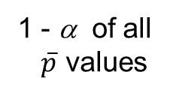
Interval Estimate of a Population Proportion
Normal Approximation of Sampling Distribution of $\overline{p}$
$$σ_{\overline{p}}=\sqrt{\frac{p(1−p)}{n}}$$
α /2
1 - α of all
$\overline{p}$ values
α /2
$$\overline{p}$$
p
$$←z_{α/2}σ_{\overline{p}}→$$
$$←z_{α/2}σ_{\overline{p}}→$$

Slide 28
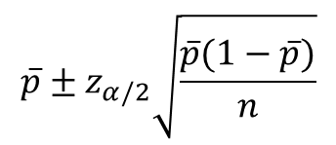
Interval Estimate of a Population Proportion
Interval Estimate
$$\overline{p}±z_{α/2}\sqrt{\frac{\overline{p}(1−\overline{p})}{n}}$$
where: 1 - α is the confidence coefficient,
z_{α/2} is the z value providing an area of α/2
in the upper tail of the standard normal
probability distribution, and
$\overline{p}$ is the sample proportion

Slide 29
Interval Estimate of a Population Proportion
Example: VOX Political Polls
VOX Political Polls (VOX) specializes in voter polls and surveys designed to keep political office seekers informed of their position in a race.
Using online surveys, VOX asks registered voters who they would vote for if the election were held that day.
In a current election campaign, VOX has just found that 225 registered voters, out of 400 contacted, favor a particular candidate. VOX wants to develop a 95% confidence interval estimate for the proportion of the population of registered voters that favor the candidate.

Slide 30
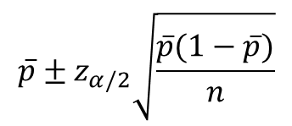
Interval Estimate of a Population Proportion
$$\overline{p}±z_{α/2}\sqrt{\frac{\overline{p}(1−\overline{p})}{n}}$$
where: n = 400, $\overline{p}$ = 225/400 = .5625, z_{α/2} = 1.96
$.5625±$1.96$\sqrt{\frac{.5625(1−.5625)}{400}}$ = .5625 ± .034725
PSI is 95% confident that the proportion of all voters that favor the candidate is between .5278 to .5972.

Slide 31
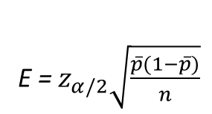
Sample Size for an Interval Estimate of a Population Proportion
Margin of error
E = $z_{α/2}\sqrt{\frac{\overline{p}(1−\overline{p})}{n}}$
Solving for the necessary sample size n, we get
$$n=\frac{{\left(z_{α/2}\right)}^{2}\overline{p}\left(1−\overline{p}\right)}{E^{2}}$$
However, $\overline{p}$ will not be known until after we have selected the sample. We will use the planning value p* for $\overline{p}$.

Slide 32
Sample Size for an Interval Estimate of a Population Proportion
Necessary Sample Size
$$n=\frac{{\left(z_{α/2}\right)}^{2}p^{∗}\left(1−p^{∗}\right)}{E^{2}}$$
The planning value p* can be chosen by:
1. Using the sample proportion from a previous sample of the same or similar units, or
2. Selecting a preliminary sample and using the sample proportion from this sample.
3. Using judgment or a “best guess” for a p* value.
4. Otherwise, using .50 as the p* value.

Slide 33
Sample Size for an Interval Estimate of a Population Proportion
Example: VOX Political Polls
Suppose that VOX would like a .95 probability that the sample proportion is within $±$ .02 of the population proportion.
How large a sample size is needed to meet the required precision? (A previous sample of similar units yielded .5625 for the sample proportion.)
At 95% confidence, z_{.05/2} = 1.96. Recall that p* = .5625.
$$n=\frac{{\left(z_{α/2}\right)}^{2}p^{∗}\left(1−p^{∗}\right)}{E^{2}}=\frac{{\left(1.96\right)}^{2}(.5625)\left(1−.5625\right)}{{(.02)}^{2}}≈ 2,364$$
A sample of size 2,364 is needed to reach a desired precision of + .02 at 95% confidence.

Slide 34
Sample Size for an Interval Estimate of a Population Proportion
Note: We used .5625 as the best estimate of p in the preceding expression. If no information is available about p, then .5 is often assumed because it provides the highest possible sample size. If we had used p = .5, the recommended n would have been 2,401.

Slide 35
A problem to help learning.
A random sample of 50 service stations in the Bowling Green area revealed the mean price of gas is $2.12 per gallon with sample standard deviation of $0.20 per gallon.
Please calculate the 95% confidence limits and interpret the outcome.
The study also found 20 of the 50 service stations sampled are “full service”
Please calculate the 95% confidence limits around the proportion of “full service” stations and interpret the outcome.

